Slide 1
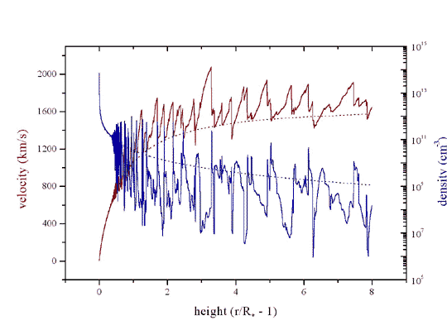
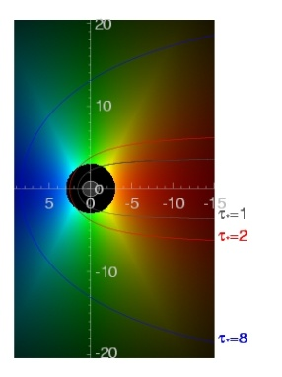
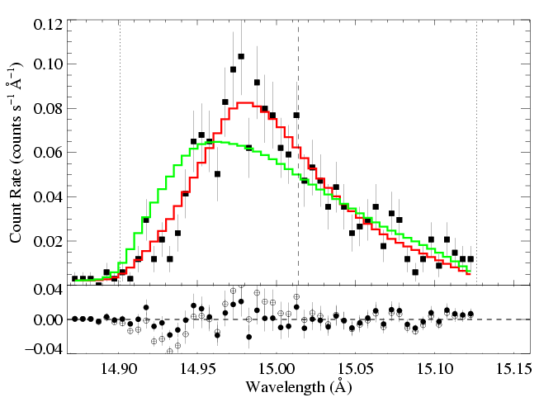
X-ray Emission and Absorption in Massive Star Winds
Constraints on shock heating and wind mass-loss rates
David Cohen
Swarthmore College

Slide 2
What we know about X-rays from single O stars
via high-resolution spectroscopy
David Cohen
Swarthmore College

Slide 3
Outline
Morphology of X-ray spectra
Embedded Wind Shocks: X-ray diagnostics of kinematics and spatial distribution
Line profiles and mass-loss rates
Broadband absorption

Slide 4
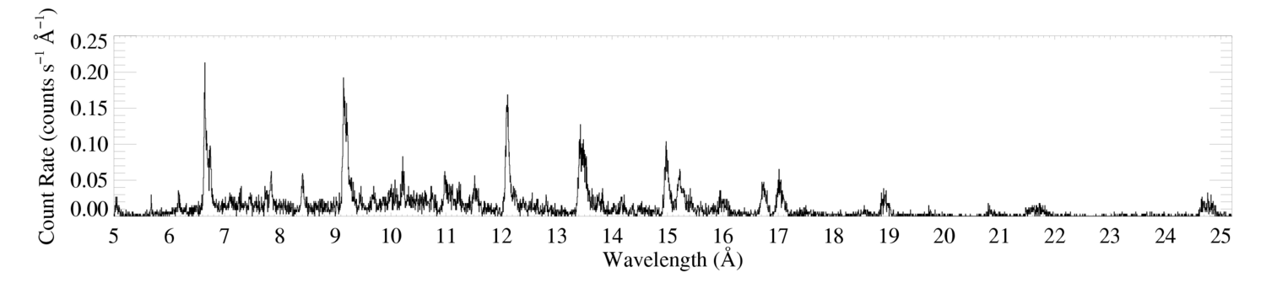
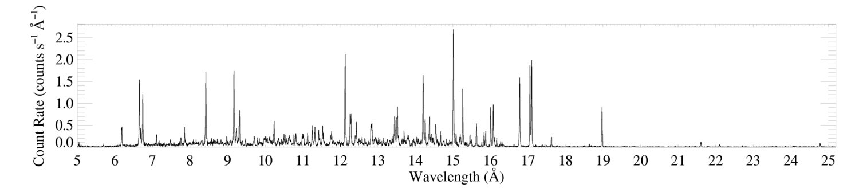
Morphology
ζ Pup (O4 If)
Capella (G5 III) – coronal source
– for comparison
Notes:
Massive star X-ray spectra are superficially similar to coronal X-ray spectra: line-dominated; same lines present by and large; the temperature distribution isn’t very different, but…there are some subtle differences in the line strength distribution. However, the biggest difference is clearly the line widths. O stars have broad X-ray lines.

Slide 5
Si XIV
Mg XII
Ne X
Fe XVII
Si XIII
Mg XI
Ne IX
ζ Pup (O4 If)
Capella (G5 III) – coronal source
– for comparison

Slide 6
Si XIV
Mg XII
Ne X
H-like vs. He-like
Si XIII
Mg XI
Ne IX
ζ Pup (O4 If)
Capella (G5 III) – coronal source
– for comparison

Slide 7
Mg XII
H-like vs. He-like
Mg XI
ζ Pup (O4 If)
Capella (G5 III) – coronal source
– for comparison
Notes:
Capella, the coronal source, has hotter plasma (larger H/He ratios)…but note, overall, the O star, zeta Pup’s spectrum is harder

Slide 8
Mg XII
H-like vs. He-like
Mg XI
ζ Pup (O4 If)
Capella (G5 III) – coronal source
– for comparison
Notes:
Capella, the coronal source, has hotter plasma (larger H/He ratios)…but note, overall, the O star, zeta Pup’s spectrum is harder

Slide 9
Spectral energy distribution trends
The O star has a harder spectrum, but apparently cooler plasma
We’ll see later on that soft X-ray absorption by the winds of O stars explains this

Slide 10
Next
First, we’ll look at what can be learned about the kinematics and location of the X-ray emitting plasma from the emission lines
After that, we’ll look at the issues of wind absorption and its effects on line shapes and on the broadband hardness trend

Slide 11
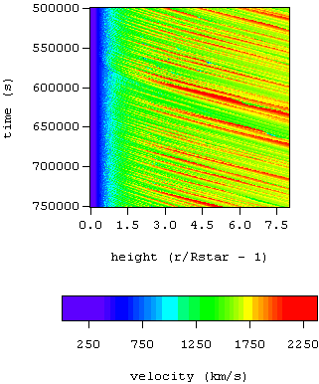
Embedded wind shocks
Numerical simulations of the line-driven instability (LDI) predict:
  Distribution of shock-heated plasma
  Above an onset radius of r ~ 1.5 R*

Slide 12
1-D rad-hydro simulations
Self-excited instability (smooth initial conditions)

Slide 13
V_{shock} ~ 300 km/s :
T ~ 10⁶ K
shock onset at r ~ 1.5 R_{star}
pre-shock wind plasma has low density
Notes:
13

Slide 14
V_{shock} ~ 300 km/s :
T ~ 10⁶ K
shock onset at r ~ 1.5 R_{star}
Shocked wind plasma is decelerated back down to the local CAK wind velocity
Notes:
14

Slide 15
Morphology
ζ Pup (O4 If)
Capella (G5 III) – coronal source
– for comparison
Notes:
Back to the broad lines.

Slide 16
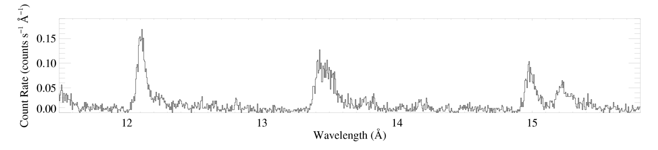
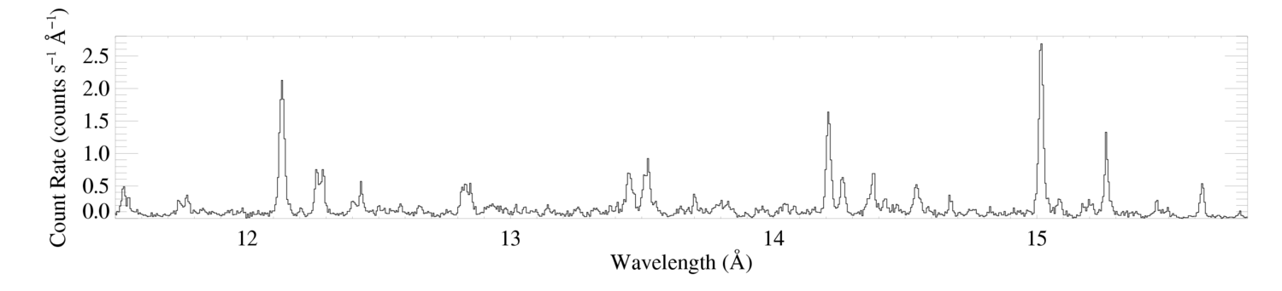
Morphology – line widths
ζ Pup (O4 If)
Ne X
Ne IX
Fe XVII
Capella (G5 III) – coronal source
– for comparison

Slide 17
Morphology – line widths
ζ Pup (O4 If)
Ne X
Ne IX
Fe XVII
~2000 km/s ~ v_{inf}
Capella (G5 III) – coronal source
– for comparison

Slide 18
Shock heated wind plasma is moving at >1000 km/s :
broad X-ray emission lines

Slide 19
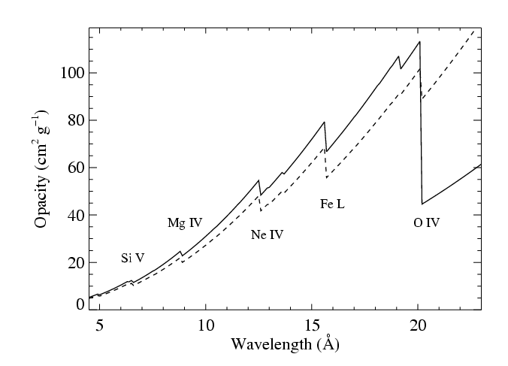
99% of the wind mass is cold*, partially ionized…
x-ray absorbing
opacity
*typically 20,000 – 30,000 K; maybe better described as “warm”

Slide 20
x-ray absorption is due to bound-free opacity of metals
opacity
…and it takes place in the 99% of the wind that is unshocked

Slide 21
Emission + absorption = profile model
The kinematics of the emitting material dictates the line width and overall profile
Absorption affects line shapes

Slide 22
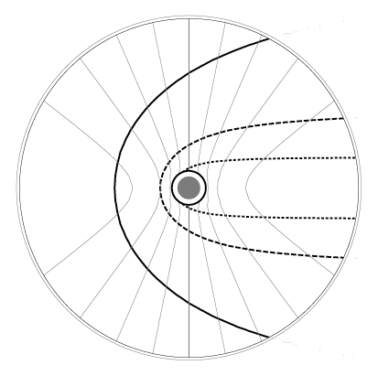
Onset radius of X-ray emission, R_{o}
isovelocity contours
-0.2v_{inf}
+0.2v_{inf}
-0.6v_{inf}
+0.6v_{inf}
-0.8v_{inf}
+0.8v_{inf}
observer
on left

Slide 23
isovelocity contours
-0.2v_{inf}
+0.2v_{inf}
-0.6v_{inf}
+0.6v_{inf}
-0.8v_{inf}
+0.8v_{inf}
observer
on left
τ = 3
τ = 1
optical depth contours
τ = 0.3

Slide 24
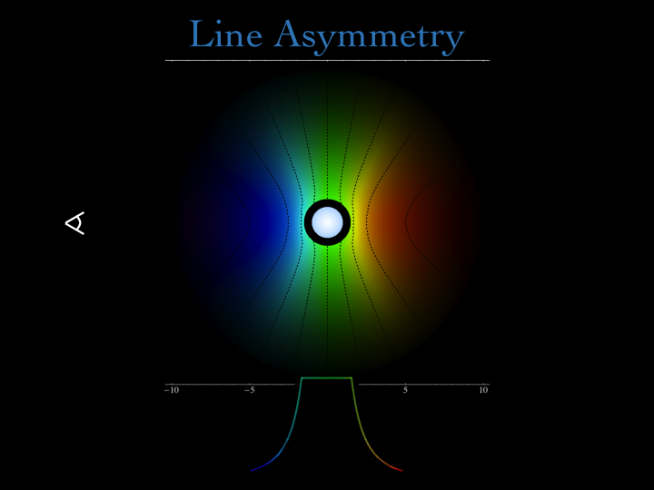

Slide 25
Profile shape assumes beta velocity law and onset radius, R_{o}

Slide 26
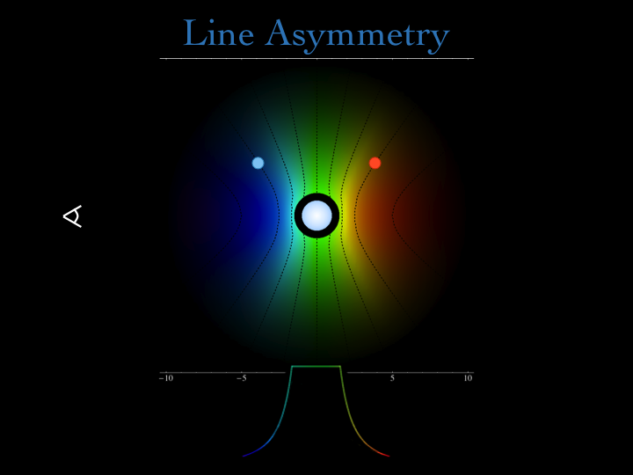

Slide 27
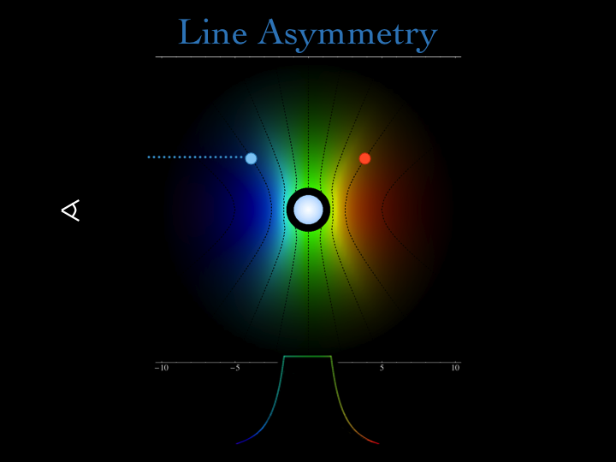

Slide 28


Slide 29


Slide 31
Universal property of the wind
z different for each point

Slide 32
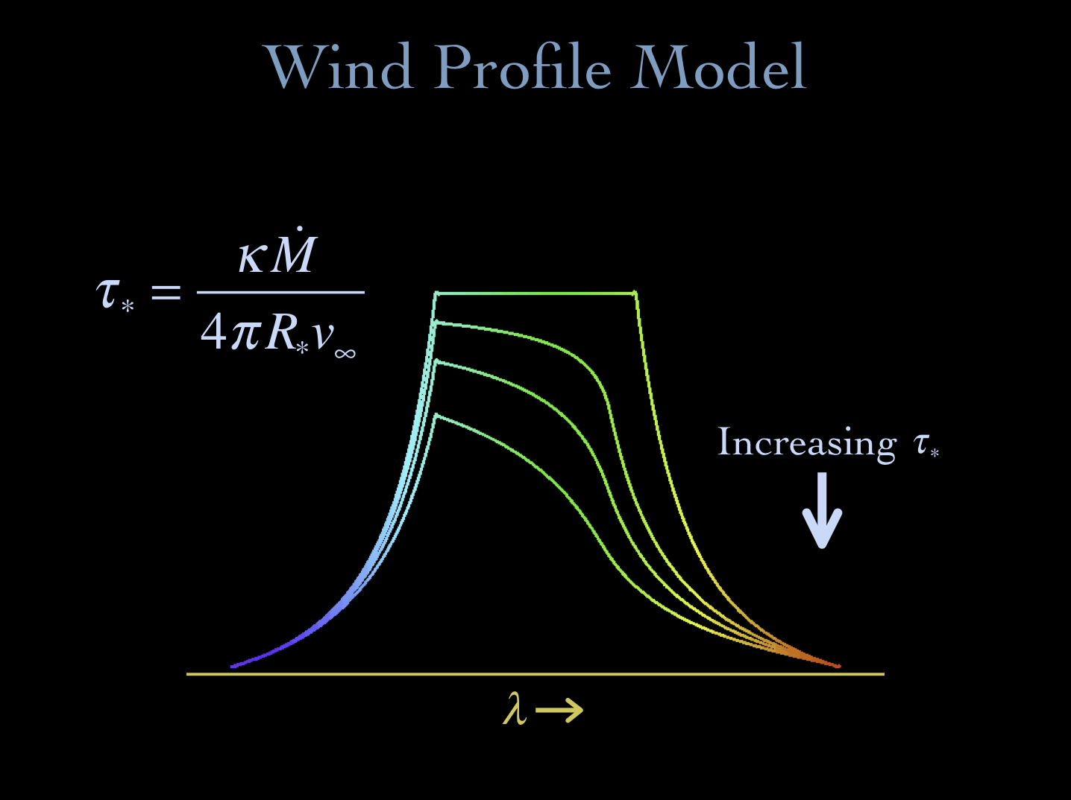
Notes:
32

Slide 33
opacity of the cold wind
wind mass-loss rate
wind terminal velocity
radius of the star
Notes:
33

Slide 34
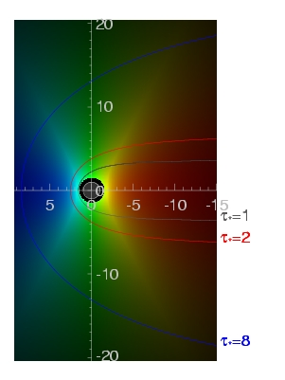
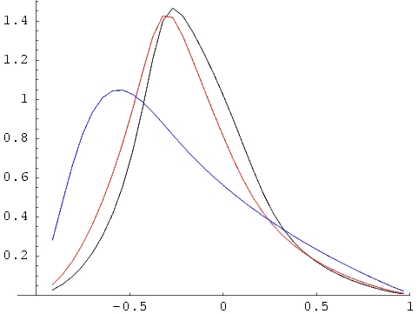
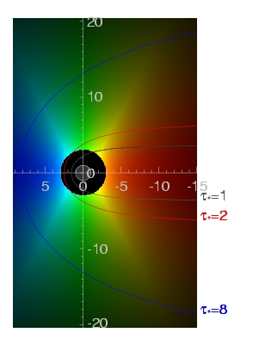
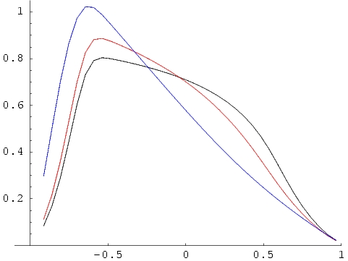
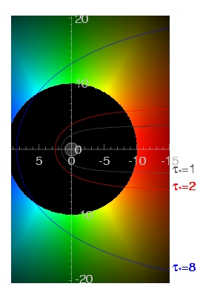
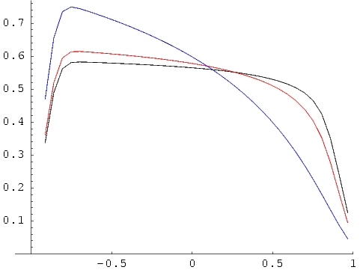
τ = 1 contours
τ∗=1,2,8
R_{o}=1.5
key parameters: R_{o} & τ*
j ~ ρ² for r/R* > R_{o}
= 0 otherwise
R_{o}=3
R_{o}=10
Notes:
34

Slide 35
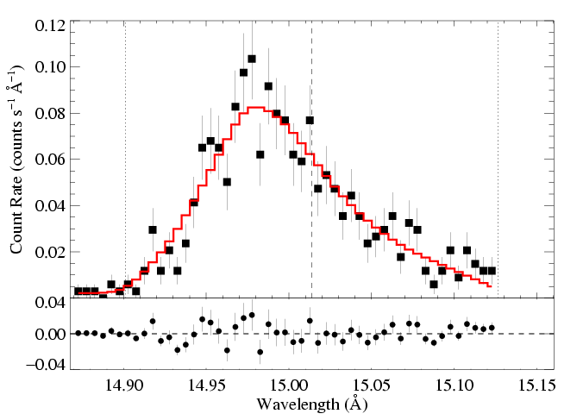
We fit these x-ray line profile models to each line in the Chandra data
Fe XVII
Fe XVII
Notes:
35

Slide 36
And find a best-fit τ* and R_{o}…
Fe XVII
τ* = 2.0
R_{o} = 1.5
Fe XVII
Notes:
36

Slide 37
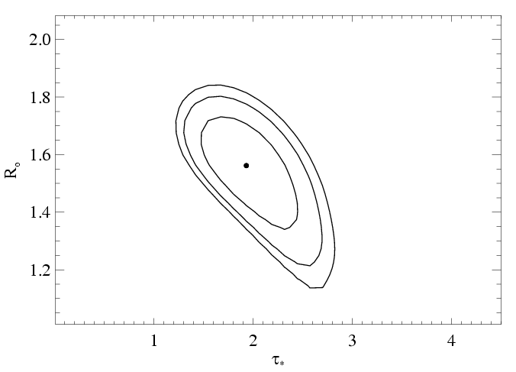
…and place confidence limits on these fitted parameter values
68, 90, 95% confidence limits
Notes:
37

Slide 38
Let’s focus on the R_{o} parameter first
Note that for β = 1, v = 1/3 v_{inf} at 1.5 R* and 1/2 v_{inf} at 2 R*

Slide 39
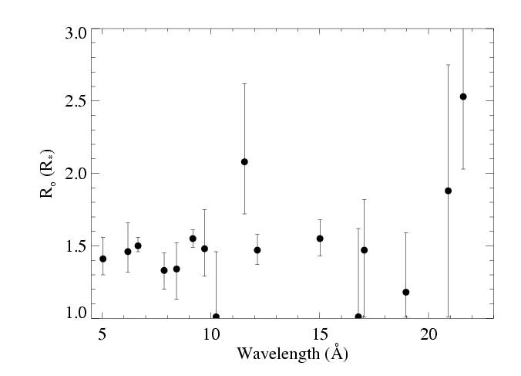
Distribution of R_{o} values in the Chandra spectrum of ζ Pup

Slide 40
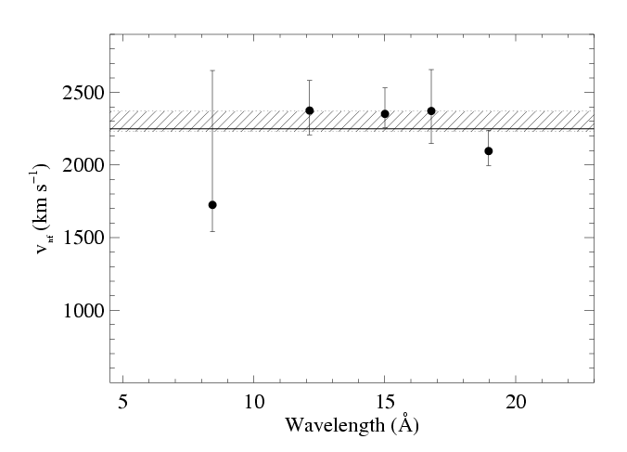
V_{inf} can be constrained by the line fitting too

Slide 41
Wind Absorption
Next, we see how absorption in the bulk, cool, partially ionized wind component affects the observed X-rays
CNO processed
Solar
opacity

Slide 42
Morphology
ζ Pup (O4 If)
Capella (G5 III) – coronal source
– for comparison
Notes:
Massive star X-ray spectra are superficially similar to coronal X-ray spectra: line-dominated; same lines present by and large; the temperature distribution isn’t very different, but…there are some subtle differences in the line strength distribution. However, the biggest difference is clearly the line widths. O stars have broad X-ray lines.

Slide 43
Morphology – line widths
ζ Pup (O4 If)
Ne X
Ne IX
Fe XVII
~2000 km/s ~ v_{inf}
Capella (G5 III) – coronal source
– for comparison

Slide 44
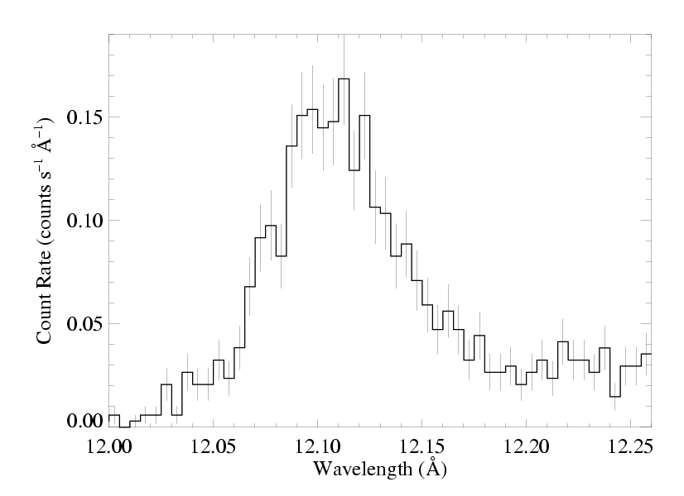
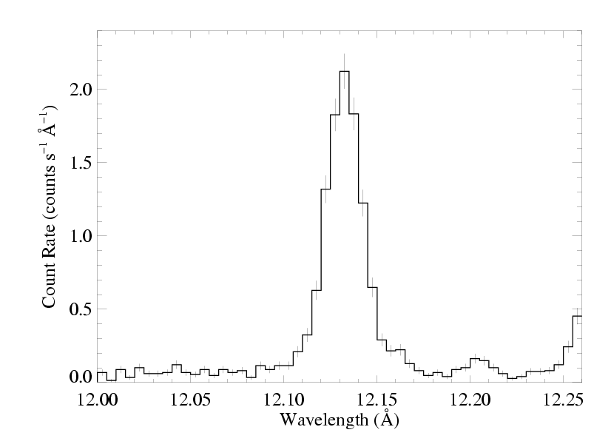
ζ Pup (O4 If)
Capella (G5 III) – unresolved

Slide 45
opacity of the cold wind
wind mass-loss rate
τ* is the key parameter describing the absorption
wind terminal velocity
radius of the star
Notes:
45

Slide 46
τ* = 2 in this wind
-0.2v_{inf}
+0.2v_{inf}
-0.6v_{inf}
+0.6v_{inf}
-0.8v_{inf}
+0.8v_{inf}
observer
on left
τ = 3
τ = 1
optical depth contours
τ = 0.3

Slide 47
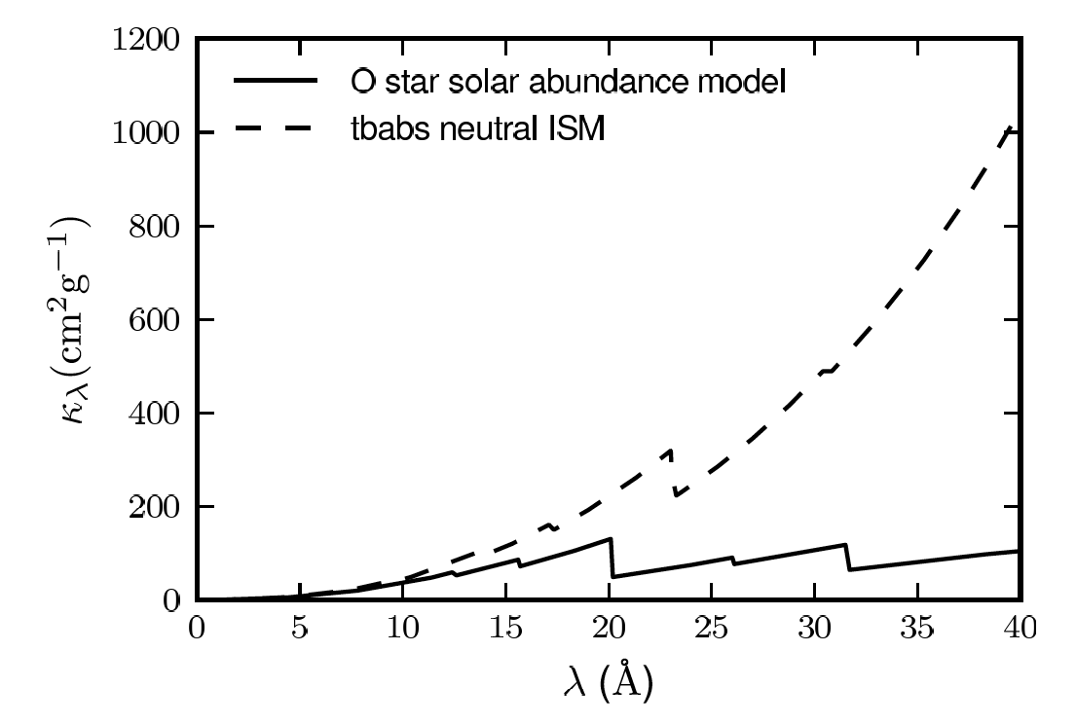
Wind opacity
X-ray bandpass

Slide 48
Wind opacity
X-ray bandpass
Chandra HETGS

Slide 49
X-ray opacity
Zoom in
CNO processed
Solar

Slide 50
We fit these x-ray line profile models to each line in the Chandra data
Fe XVII
Fe XVII
Notes:
50

Slide 51
And find a best-fit τ* and R_{o}…
Fe XVII
τ* = 2.0
R_{o} = 1.5
Fe XVII
Notes:
51

Slide 52
…and place confidence limits on these fitted parameter values
68, 90, 95% confidence limits
Notes:
52

Slide 53
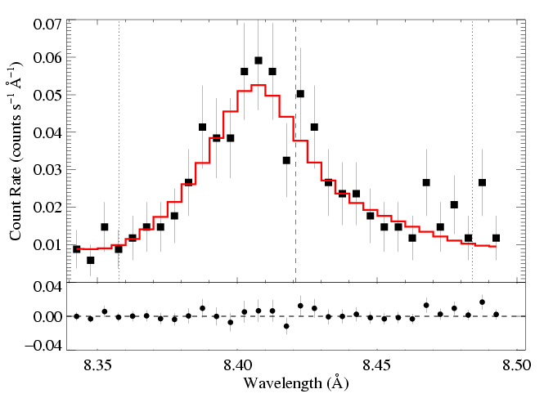
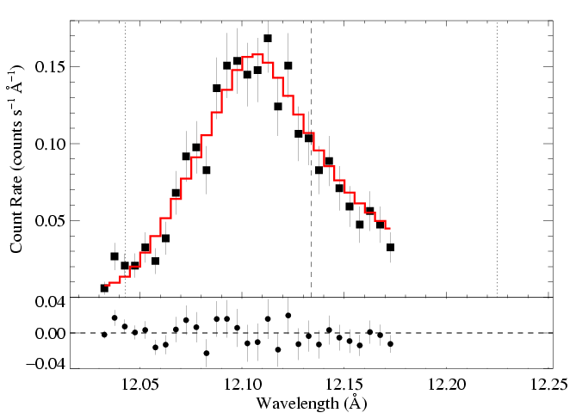
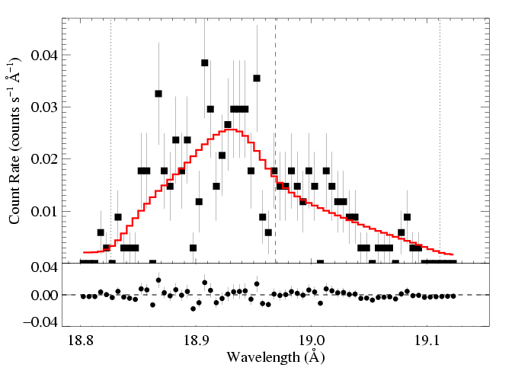
ζ Pup: three emission lines
Mg Lyα: 8.42 Å
Ne Lyα: 12.13 Å
O Lyα: 18.97 Å
τ* = 1
τ* = 2
τ* = 3
Recall:
Notes:
53

Slide 54
atomic opacity of the wind
CNO processed
Solar

Slide 55
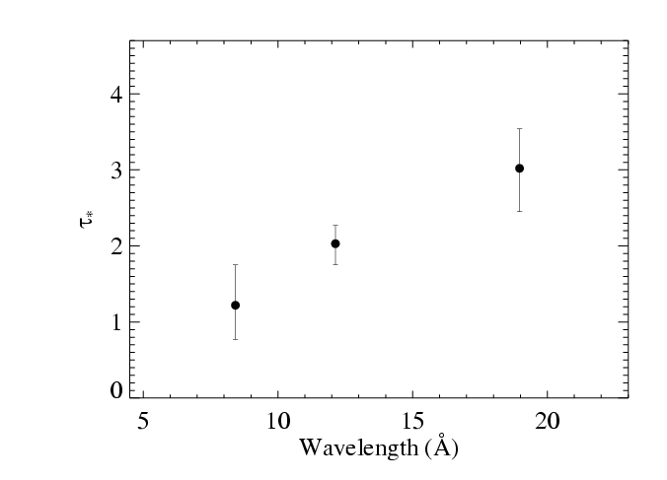
Results from the 3 line fits shown previously
Notes:
55

Slide 56
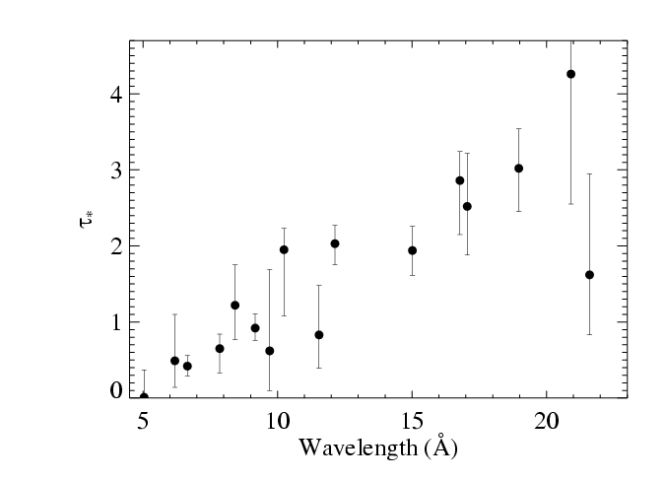
Fits to 16 lines in the Chandra spectrum of ζ Pup
Notes:
56

Slide 57
Fits to 16 lines in the Chandra spectrum of ζ Pup
Notes:
57

Slide 58
Fits to 16 lines in the Chandra spectrum of ζ Pup
τ*(λ) trend consistent with κ(λ)
Notes:
58

Slide 59
Fits to 16 lines in the Chandra spectrum of ζ Pup
CNO processed
τ*(λ) trend consistent with κ(λ)
Solar
Notes:
59

Slide 60
M becomes the free parameter of the fit to the τ*(λ) trend
τ*(λ) trend consistent with κ(λ)
Notes:
60

Slide 61
M becomes the free parameter of the fit to the τ*(λ) trend
τ*(λ) trend consistent with κ(λ)
Notes:
61

Slide 62
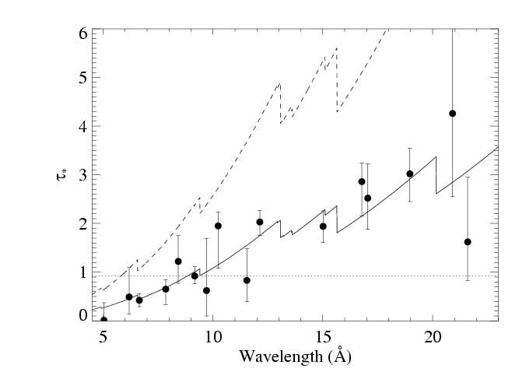
Traditional mass-loss rate:
8.3 X 10⁻⁶ M_{sun}/yr
Our best fit:
3.5 X 10⁻⁶ M_{sun}/yr
Notes:
62

Slide 63
Traditional mass-loss rate:
8.3 X 10⁻⁶ M_{sun}/yr
Fe XVII
Our best fit:
3.5 X 10⁻⁶ M_{sun}/yr
Notes:
63

Slide 64
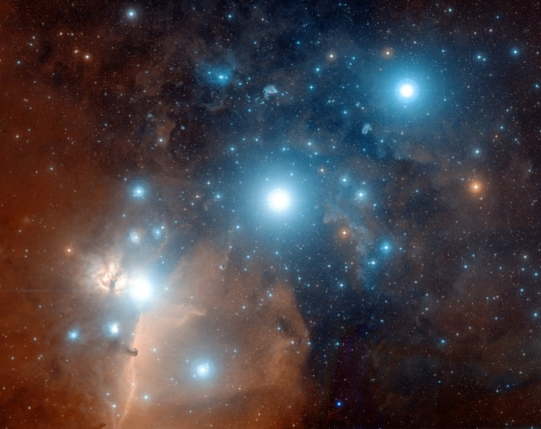
ζ Ori: O9.5
ε Ori: B0

Slide 65
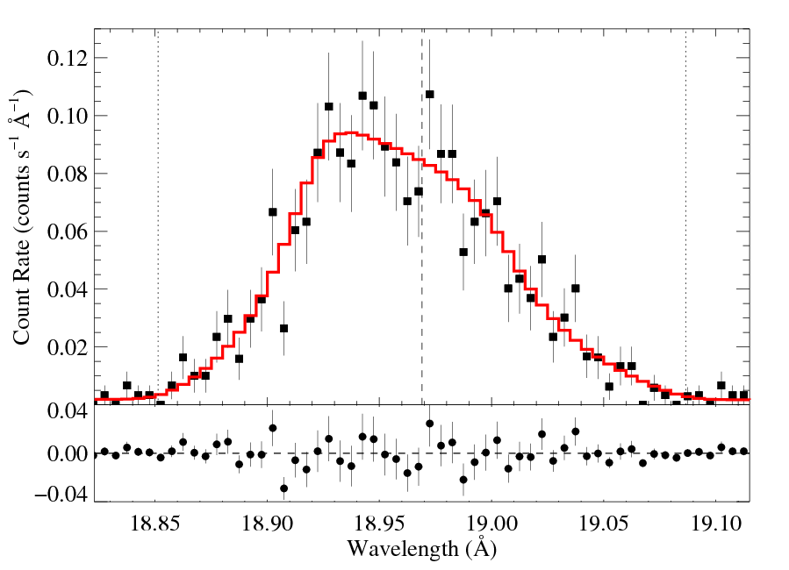
ζ Ori (09.7 I): O Lyα 18.97 Å
R_{o} = 1.6 R*
τ* = 0.3
Notes:
65

Slide 66
τ* quite low: is resonance scattering affecting this line?
R_{o} = 1.6 R*
τ* = 0.3
Notes:
66

Slide 67
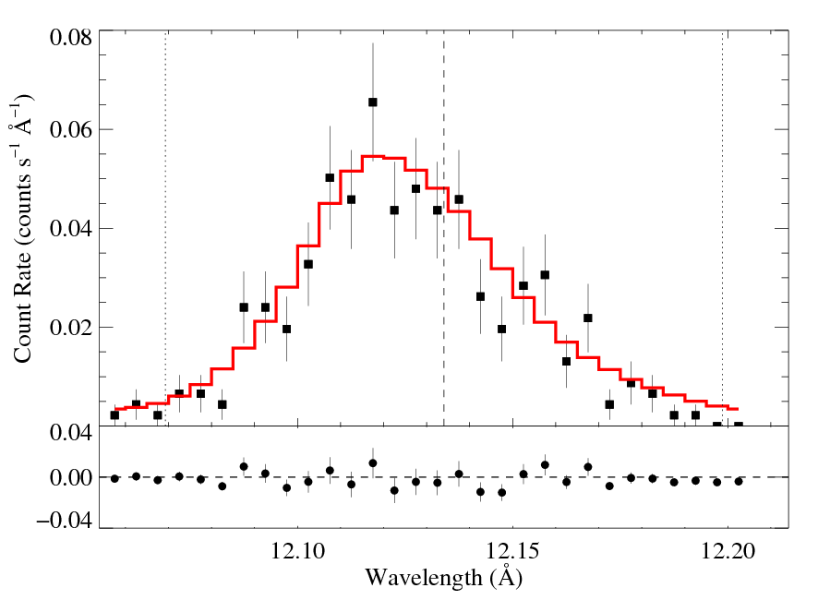
ε Ori (B0 Ia): Ne Lyα 12.13 Å
R_{o} = 1.5 R*
τ* = 0.6
Notes:
67

Slide 68
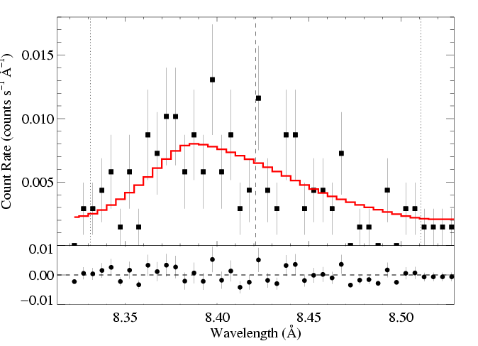
M-dot ~ 2 x 10⁻⁵ M_{sun}/yr from unclumped Hα
HD 93129Aab (O2 If*): Mg XII Lyα 8.42 Å
V_{inf} ~ 3200 km/s
M-dot ~ 5 x 10⁻⁶ M_{sun}/yr
R_{o} = 1.8 R*
τ* = 1.4
Notes:
68

Slide 69
HD93129A – O2 If*
Most massive, luminous O star (10^{6.4} L_{sun})
Strongest wind of any O star
(2 X 10⁻⁵ M_{sun}/yr; v_{inf} = 3200 km/s)

Slide 70
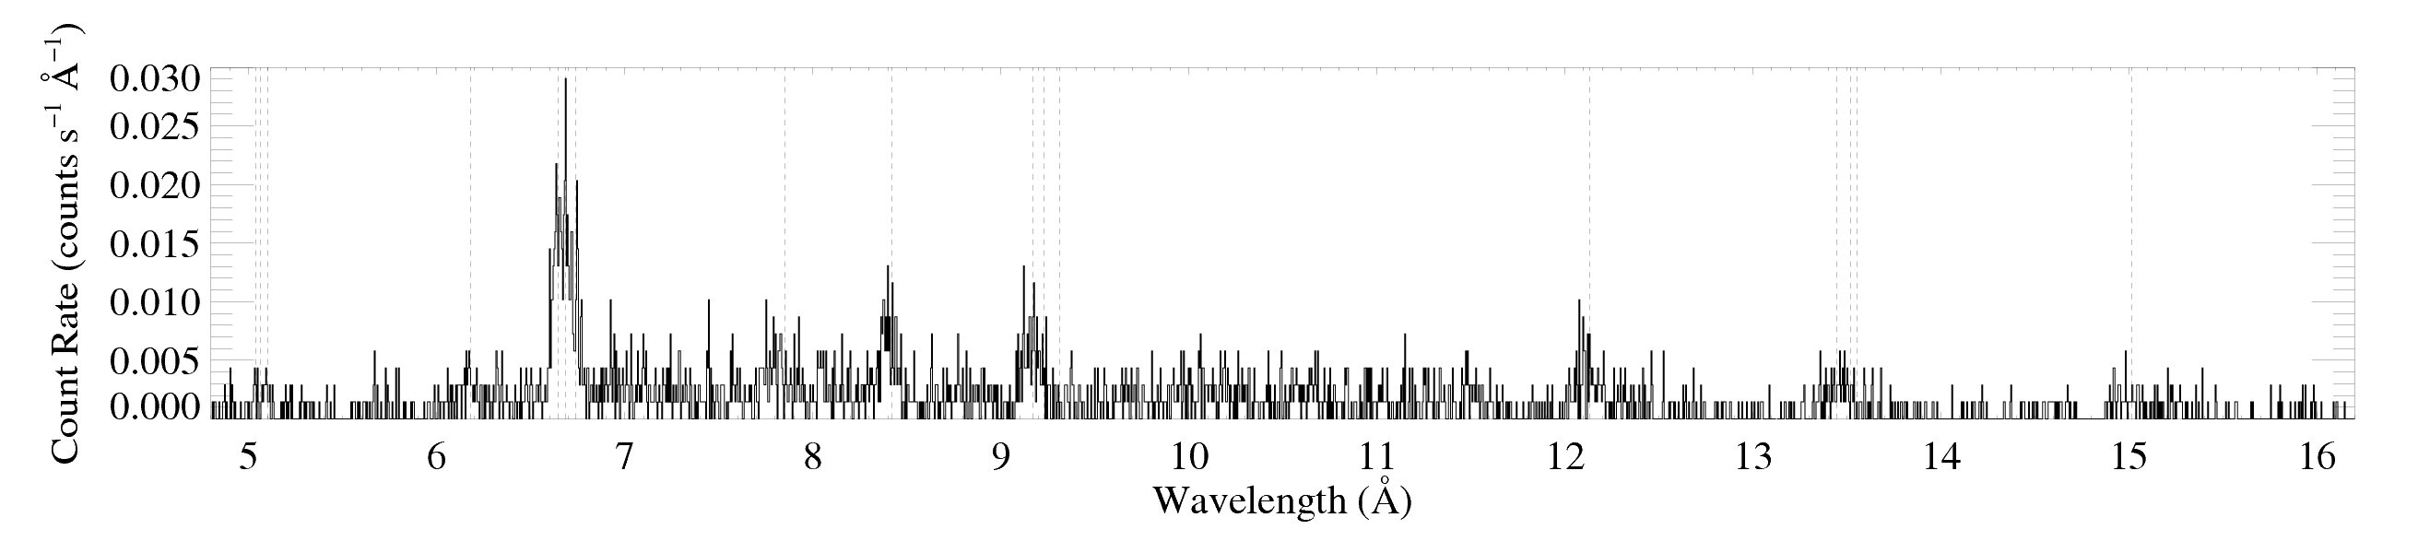
Its X-ray spectrum is hard
low H/He
high H/He

Slide 71
Its X-ray spectrum is hard
Si
Mg
low H/He
high H/He
But very little plasma with kT > 8 million K

Slide 72
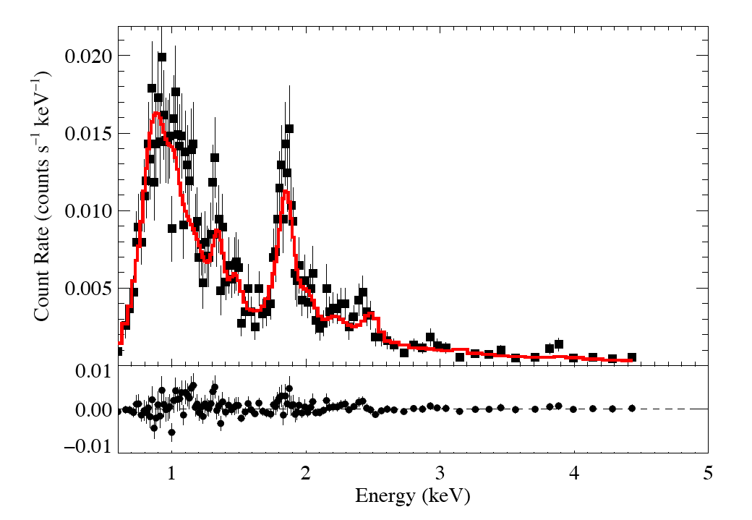
Low-resolution Chandra CCD spectrum of HD93129A
Fit: thermal emission with wind + ISM absorption plus a second thermal component with just ISM
kT = 0.6 keV *wind_abs*ism
add 5% kT = 2.0 keV*ism

Slide 73
τ*/κ = 0.03 (corresp. ~ 5 x 10⁻⁶ M_{sun}/yr)
Typical of O stars like ζ Pup
kT = 0.6 keV *wind_abs*ism
add 5% kT = 2.0 keV*ism
Small contribution from colliding wind shocks

Slide 74
What about broadband effects?
The X-ray opacity changes across the Chandra bandbass – this should affect the overall X-ray SED: soft-X-ray absorption in O star winds should harden the emergent X-rays

Slide 75
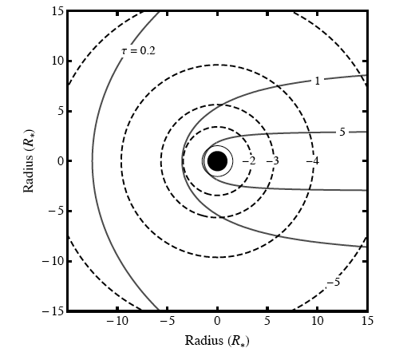
Emission measure and optical depth

Slide 76
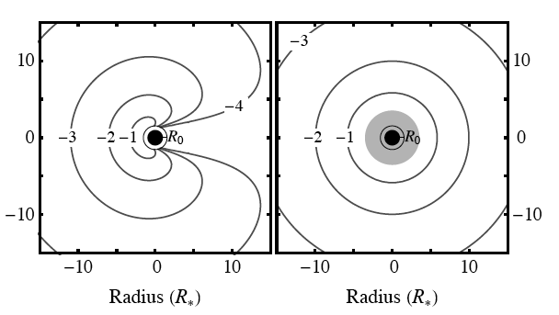
Emergent X-ray flux
exact
exospheric

Slide 77

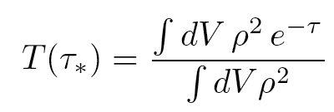
Transmission

Slide 78
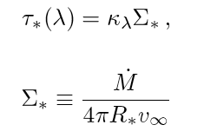
Σ* is the free parameter
Once you assume a run of opacity vs. wavelength, κ(λ)

Slide 79
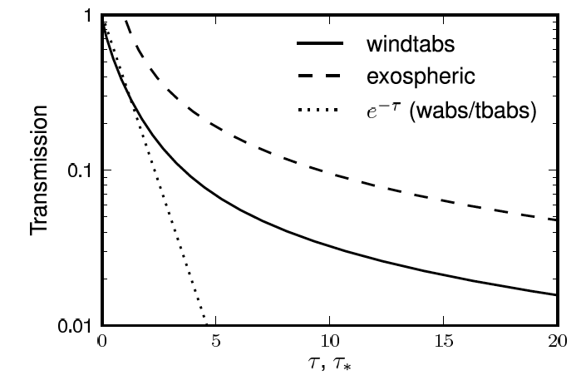
exponential absorption (from a slab) is inaccurate

Slide 80
Wind opacity
X-ray bandpass

Slide 81
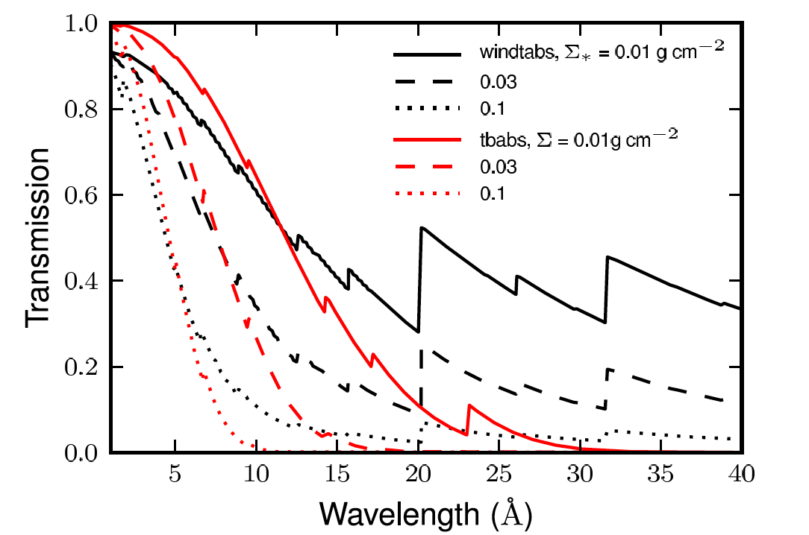
Combining opacity and transmission models

Slide 82
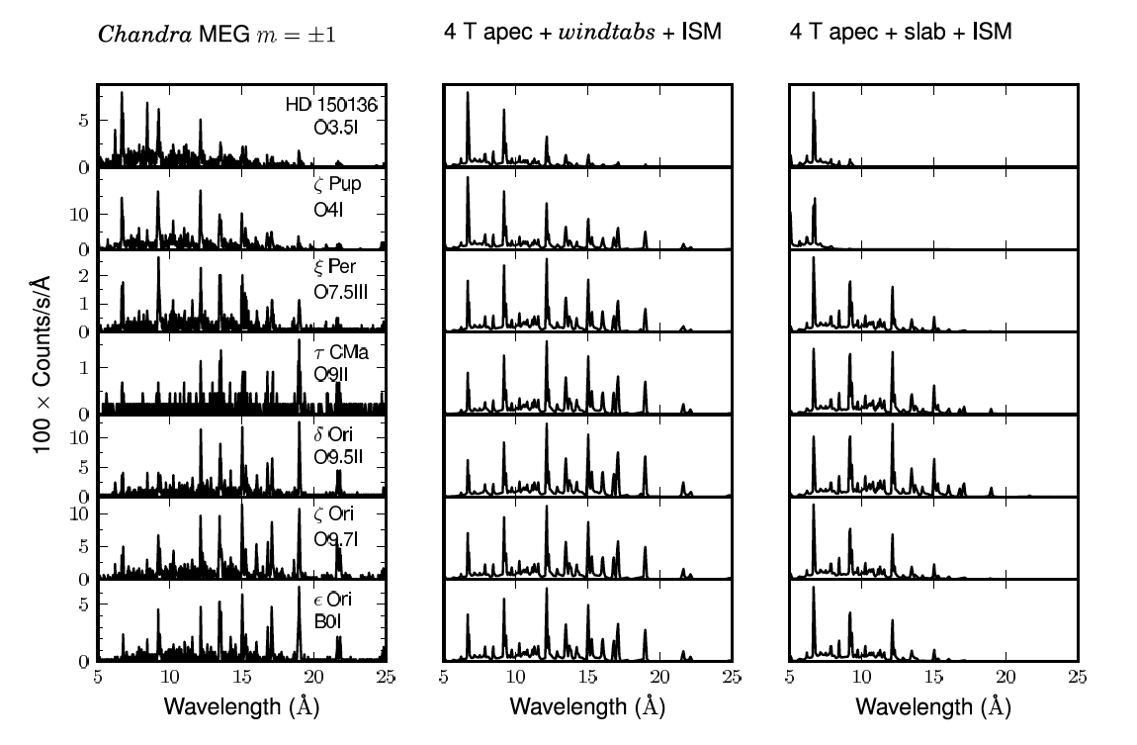
Broadband trend is mostly due to absorption

Slide 83
Although line ratios need to be analyzed too
low H/He
high H/He

Slide 84
Conclusions
Wind absorption has an important effect on the X-rays we observe from single O stars
Resolved line profiles show widths consistent with shock onset radii of ~1.5 R*
And shapes indicative of wind absorption – though with low mass-loss rates
Initial results on broadband X-ray spectra indicate that wind absorption is significant there, too

Slide 85
Additional Slides
Clumping and por0sity

Slide 86
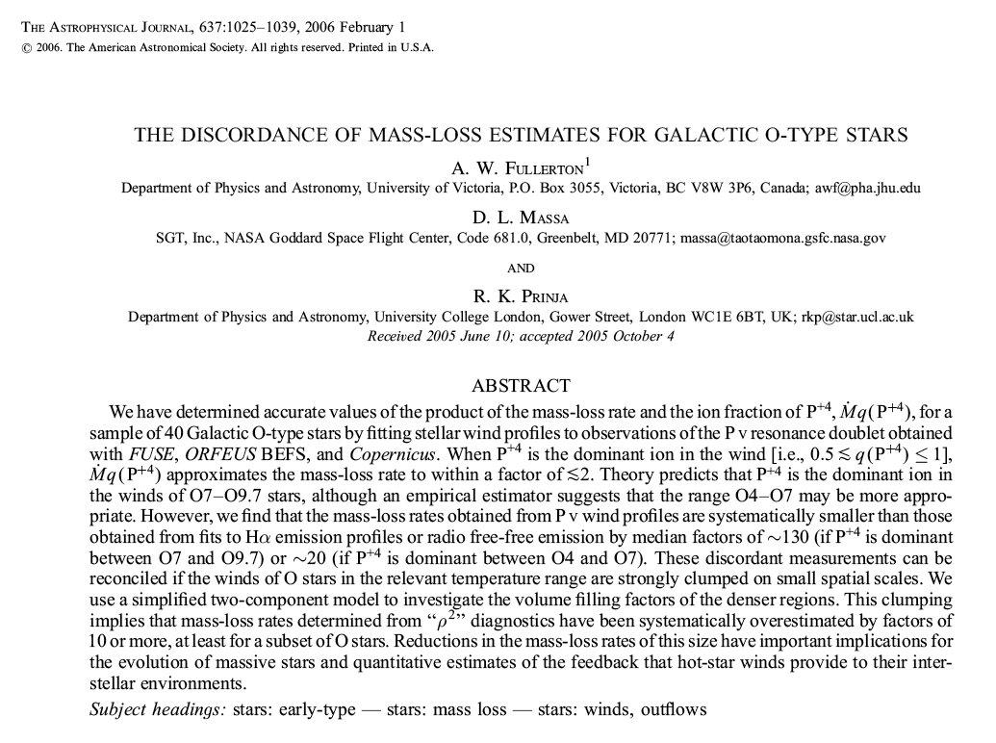
Multi-wavelength evidence for lower mass-loss rates 2005 onward
Notes:
86

Slide 87

ζ Pup mass-loss rate < 4.2 x 10⁻⁶ M_{sun}/yr
Notes:
87

Slide 88
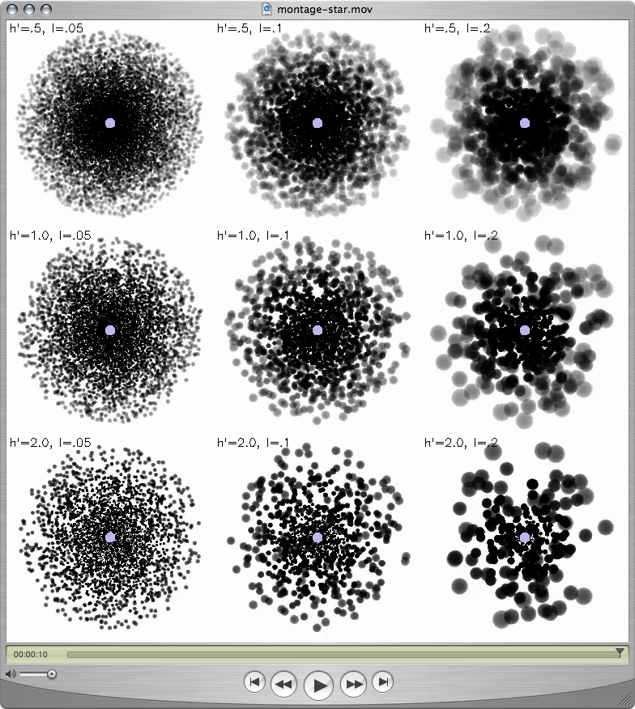
“Clumping” – or micro-clumping: affects density-squared diagnostics; independent of clump size, just depends on clump density contrast (or filling factor, f )
visualization: R. Townsend

Slide 89
But porosity is associated with optically thick clumps, it acts to reduce the effective opacity of the wind; it does depend on the size scale of the clumps
The key parameter is the porosity length,
h = (L³/ℓ²) = ℓ/f
ℓ
L
f = ℓ³/L³

Slide 90
Clump size increasing →
The porosity length, h:
clump size
h = ℓ/f
Porosity length increasing →
clump filling factor (<1)

Slide 91
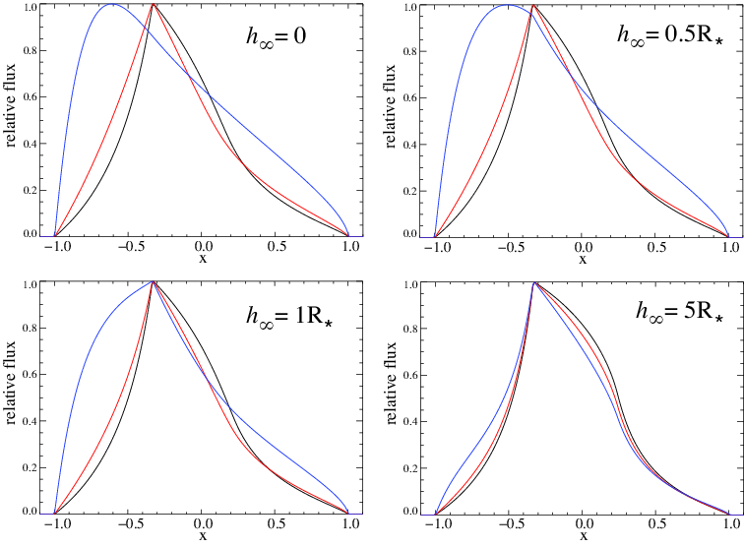
Porosity only affects line profiles if the porosity length (h) exceeds the stellar radius

Slide 92
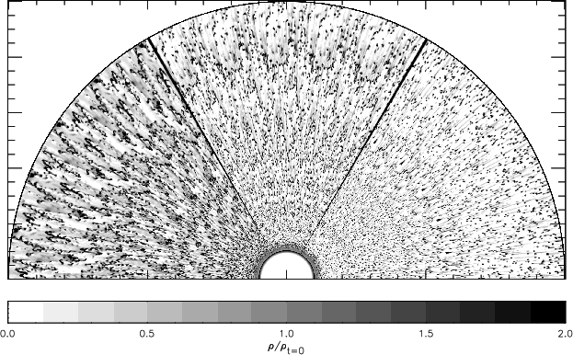
The clumping in 2-D simulations (density shown below) is on quite small scales
Dessart & Owocki 2003, A&A, 406, L1
Notes:
92

Slide 93
No expectation of porosity from simulations
Natural explanation of line profiles without invoking porosity
Finally, to have porosity, you need clumping in the first place, and once you have clumping…you have your factor ~3 reduction in the mass-loss rate
Notes:
93

Slide 94
No expectation of porosity from simulations
Natural explanation of line profiles without invoking porosity
Finally, to have porosity, you need clumping in the first place, and once you have clumping…you have your factor ~3 reduction in the mass-loss rate
Notes:
94

Slide 95
No expectation of porosity from simulations
Natural explanation of line profiles without invoking porosity
Finally, to have porosity, you need clumping in the first place, and once you have clumping…you have your factor ~3 reduction in the mass-loss rate
(for ζ Pup, anyway)
Notes:
95

Slide 96
f ~ 0.1 is indicated by Hα, UV, radio free-free analysis
f = 0.2
f = 0.05
f = 0.1

Slide 97
And lack of evidence for porosity…
leads us to suggest visualization in upper left is closest to reality
f = 0.2
f = 0.05
f = 0.1

Slide 98
Though simulations suggest even smaller-scale clumping
f = 0.2
f = 0.05
f = 0.1

