Slide 1
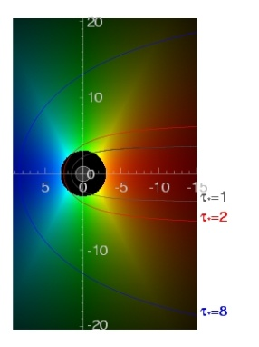
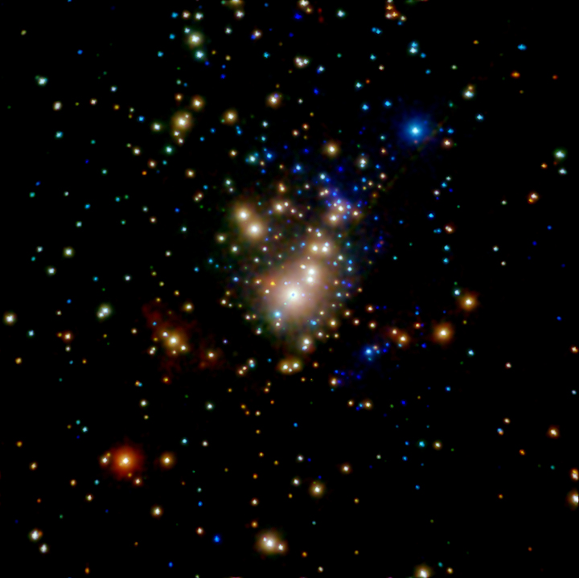
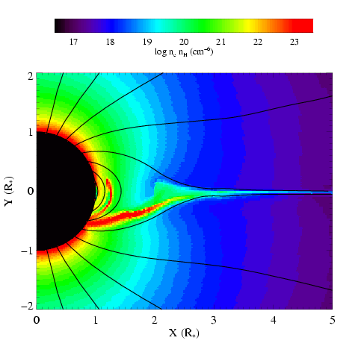
X-rays from Young Massive Stars
David Cohen Swarthmore College

Slide 2
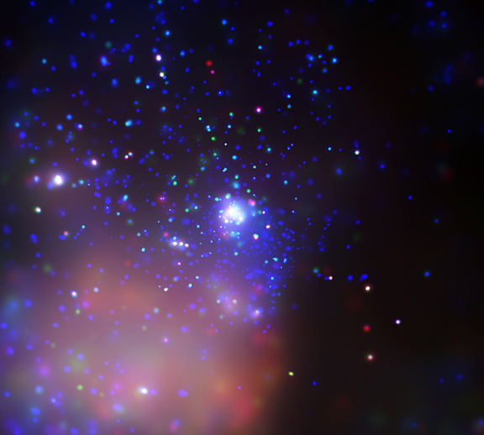
O Stars are the brightest X-ray sources in young clusters
In addition to the X-ray and UV radiation from O stars
Prodigious matter, momentum, and kinetic energy input into the cluster environment via their winds
Tr 14 in Carina: Chandra
The winds are the site and energy source of the X-rays
Notes:
Effects of O stars and their high-energy radiation: disk chemistry in nearby low mass PMS stars; drives ablation and compression of cloud surfaces; Sne progenitors; trace instabilities in radiation-driven winds of the O stars; diffuse X-ray emission fills many clusters

Slide 3
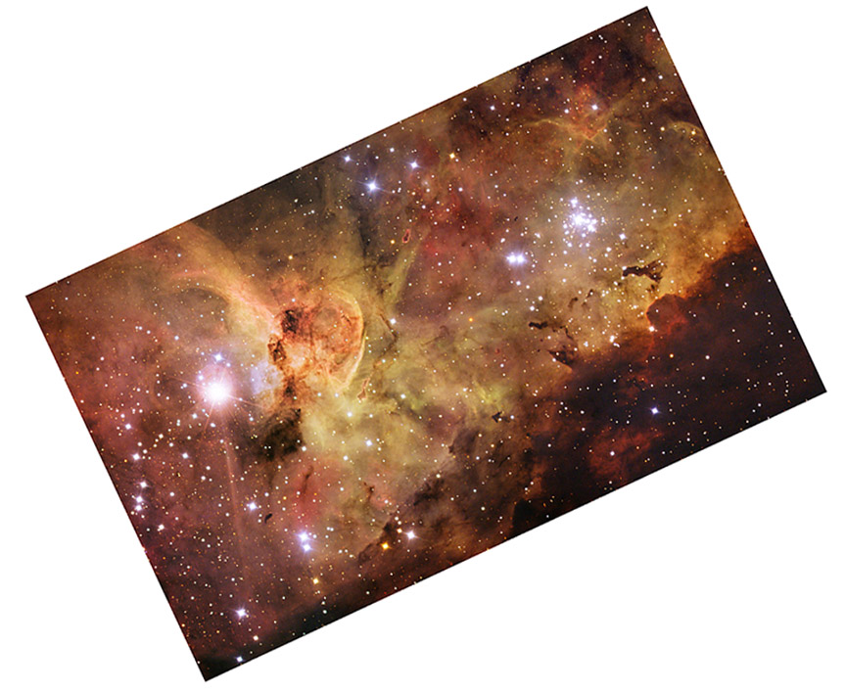
The Carina Complex
HD 93129A (O2If*)
Tr 14 in Carina: Chandra
Carina: ESO

Slide 4
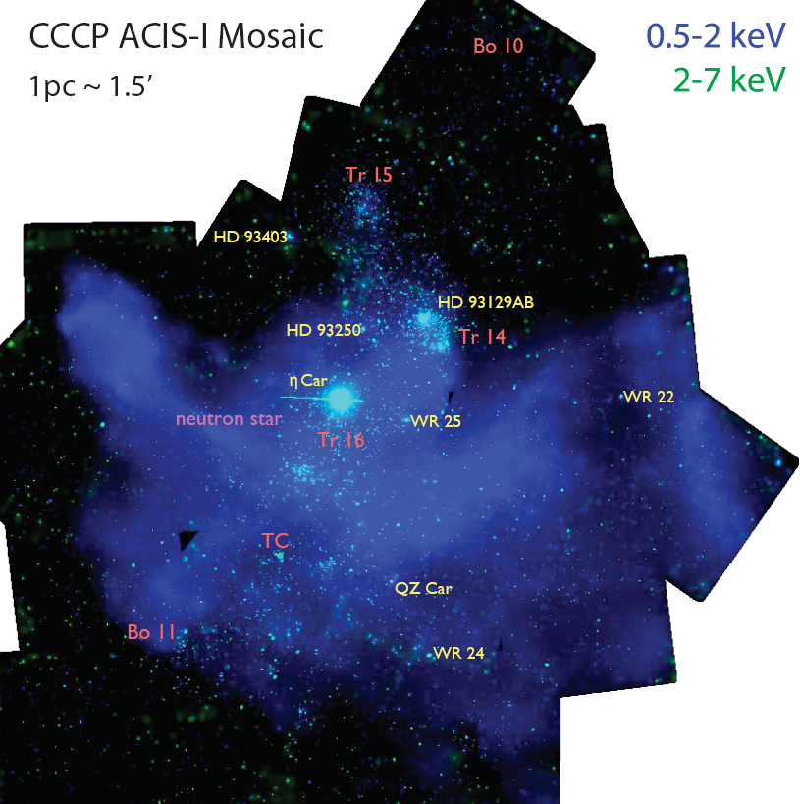
Chandra Carina Complex Project (Townsley)

Slide 5
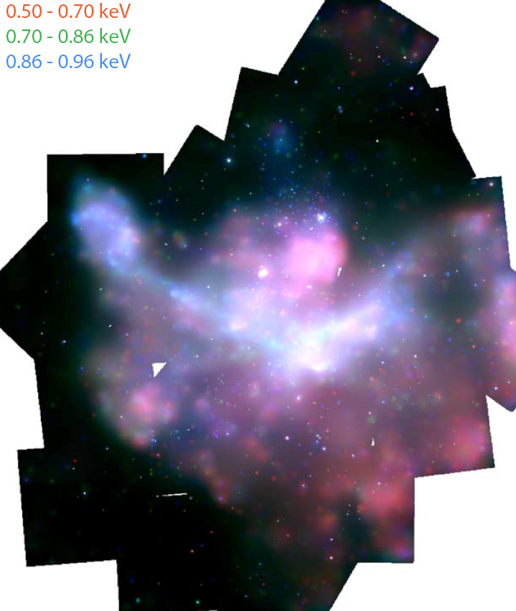

Slide 6
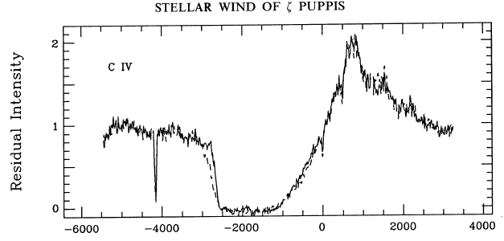
Radiation-driven O star winds
ζ Pup (O4 supergiant): M ~ few 10⁻⁶ M_{sun}/yr
UV spectrum: C IV 1548, 1551 Å
v∞=2350 km/s
Velocity (km/s)
Prinja et al. 1992, ApJ, 390, 266
Notes:
6

Slide 7
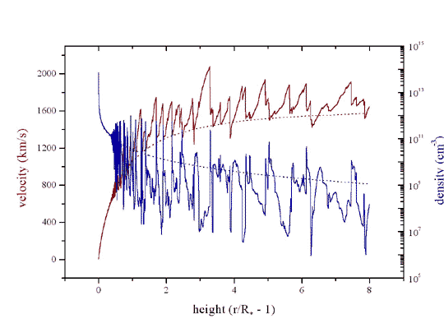
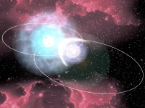
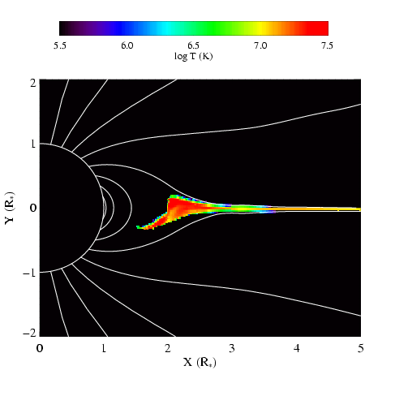
Three mechanisms for massive star x-ray emission
1. Instability driven shocks
2. Wind-wind interaction in close binaries
3. Magnetically channeled wind shocks
Notes:
7

Slide 8
Three mechanisms for massive star x-ray emission
1. Instability driven shocks
2. Wind-wind interaction in close binaries
3. Magnetically channeled wind shocks
Notes:
8

Slide 9
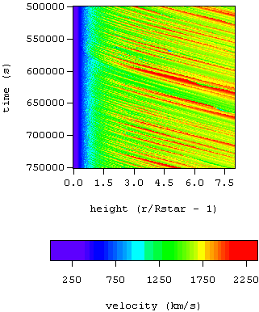
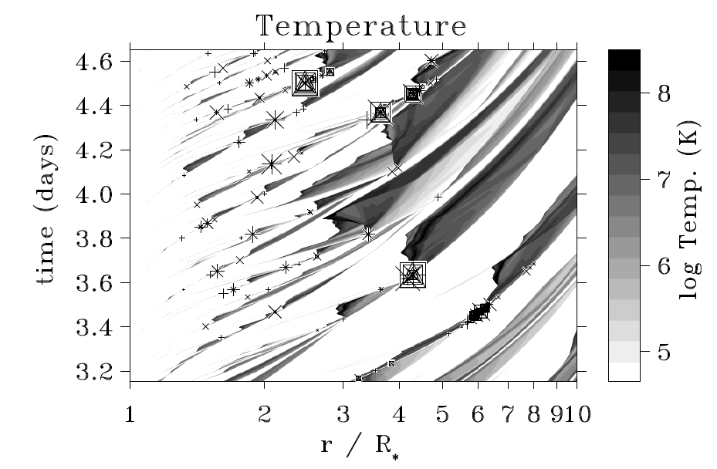
Radiation-driven winds are inherently unstable: shocks, X-rays
Self-excited instability
Excited by turbulence imposed at the wind base
Owocki, Cooper, Cohen 1999
Feldmeier,Puls, Pauldrach 1997
numerical simulations of the line-driving instability
Notes:
9

Slide 10
Numerous shock structures, distributed above ~1.5 R*
Notes:
10

Slide 11
Shocked plasma is moving ~few 1000 km/s
Emission lines should be Doppler broadened
Notes:
11

Slide 12
Only ~1% of the wind is shock heated at any given time
Bound-free absorption in the other ~99% of the wind
Notes:
12

Slide 13
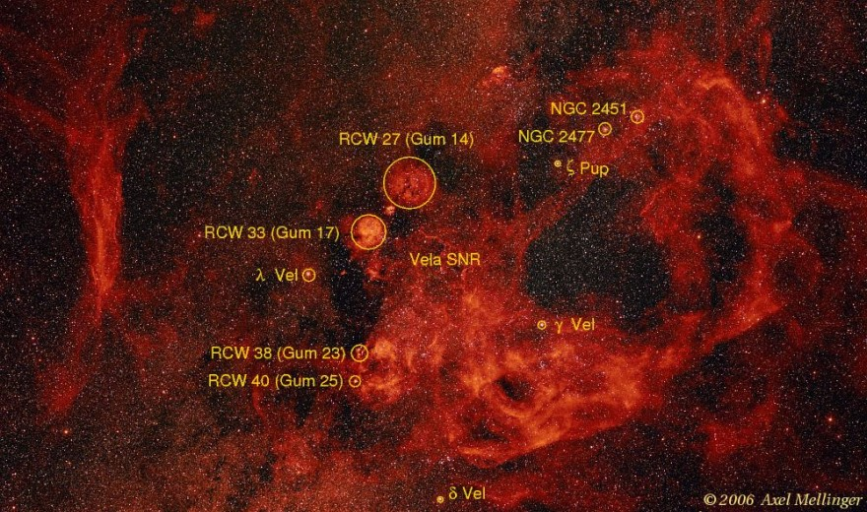
ζ Pup – as prototypical (and nearby at ~400 pc) – O star X-ray source
Notes:
13

Slide 14
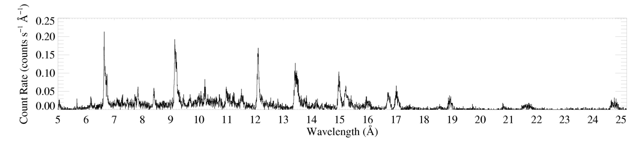
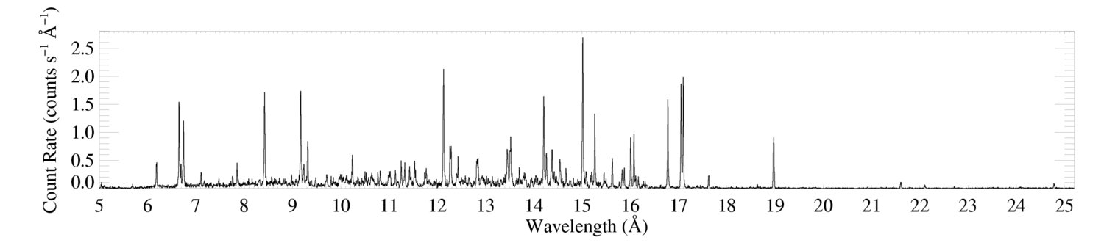
Chandra HETGS
ζ Pup (O4 If)
Capella (G5 III) – coronal source – for comparison
Notes:
Back to the broad lines.

Slide 15
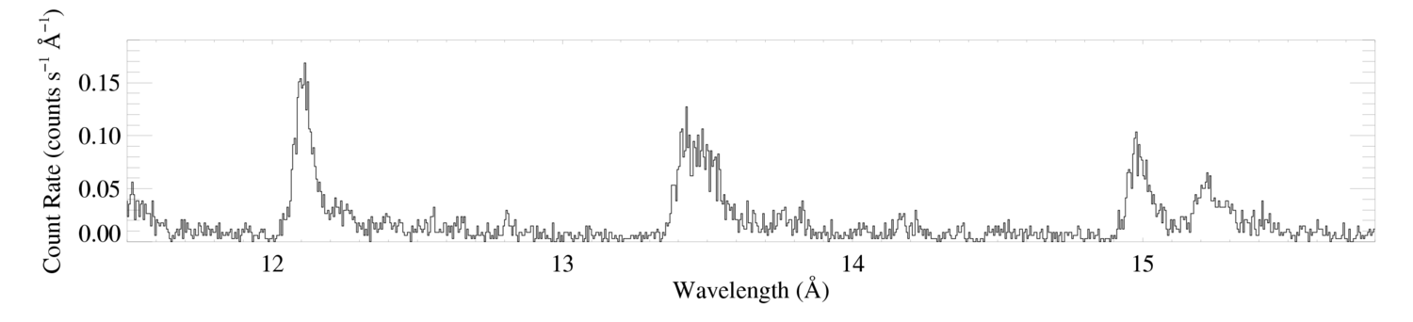
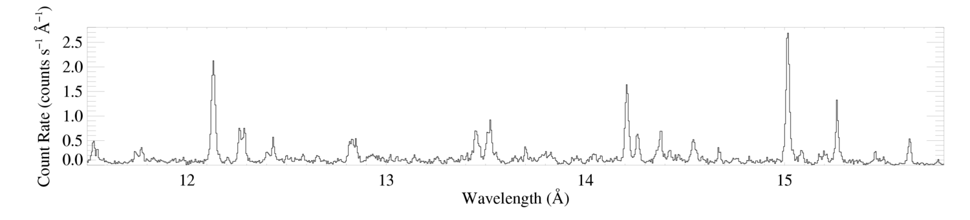
Morphology – line widths
ζ Pup (O4 If)
Ne X
Ne IX
Fe XVII
Capella (G5 III) – coronal source – for comparison

Slide 16
Morphology – line widths
ζ Pup (O4 If)
Ne X
Ne IX
Fe XVII
~2000 km/s ~ v_{inf}
Capella (G5 III) – coronal source – for comparison

Slide 17
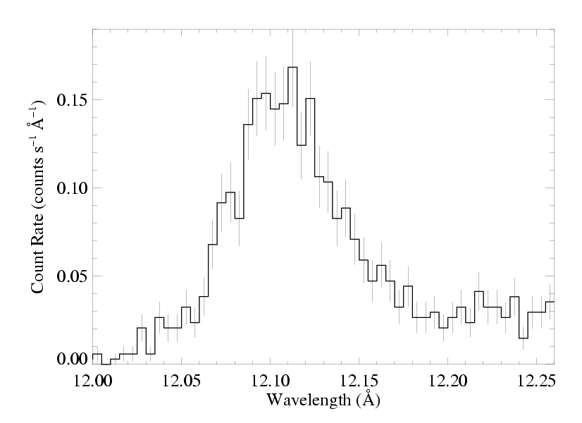
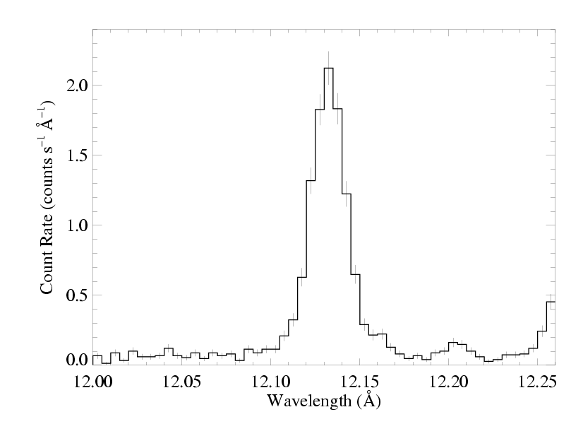
V_{inf}
ζ Pup (O4 If)
Capella (G5 III) – unresolved

Slide 18
V_{inf}
ζ Pup (O4 If)
Kinematics conclusions: consistent with X-rays arising in the stellar wind

Slide 19
V_{inf}
ζ Pup (O4 If)
What about the distinctive profile shape?
blue shift
asymmetry

Slide 20
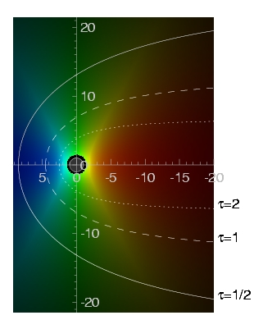
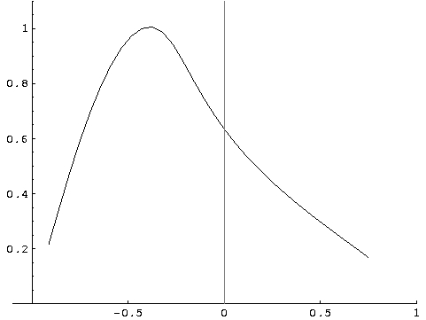
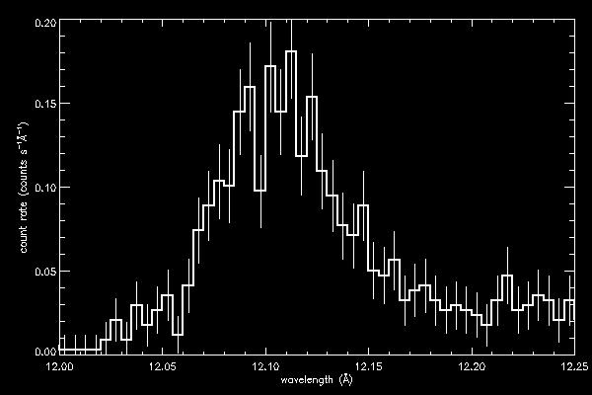
Contours of constant optical depth (observer is on the left)
brightness
blue
red
wavelength
continuum absorption in the bulk wind preferentially absorbs red shifted photons from the far side of the wind

Slide 21
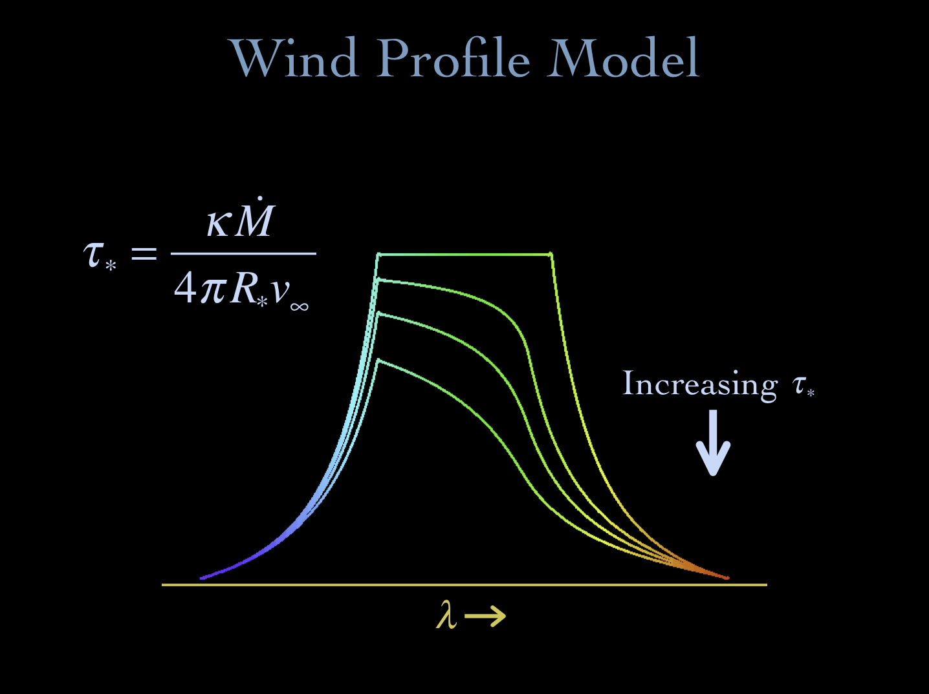
Notes:
21

Slide 22
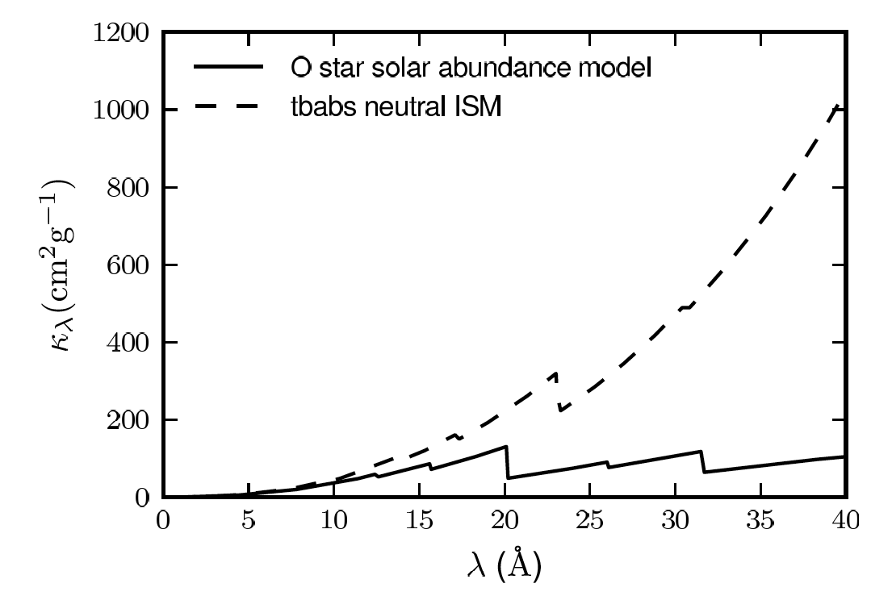
Wind opacity
due to bound-free transitions
Opacity from partially ionized metals
Chandra HETGS

Slide 23
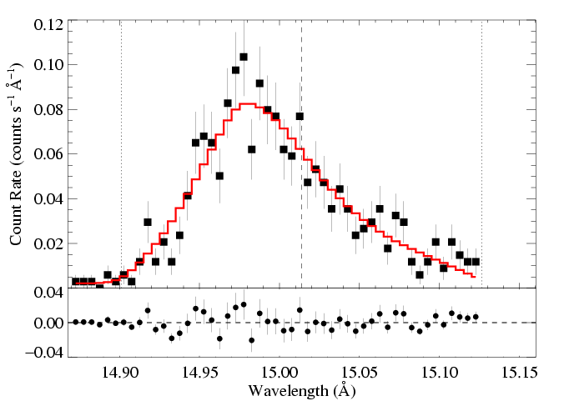
We fit these x-ray line profile models to each line in the Chandra data
Fe XVII
Fe XVII
Notes:
23

Slide 24
And find a best-fit τ*
Fe XVII
τ* = 2.0
Fe XVII
Notes:
24

Slide 25
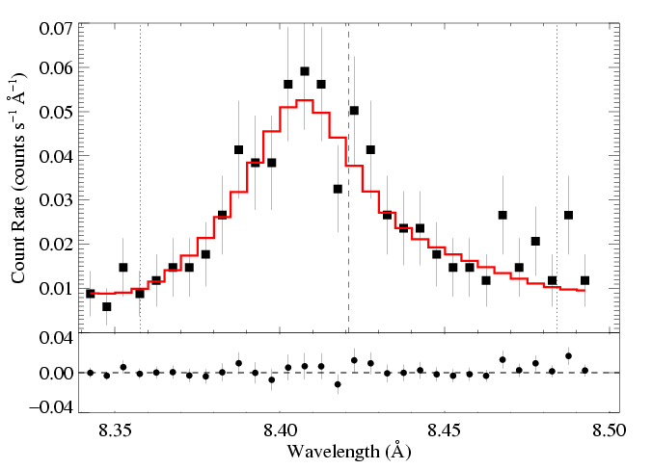
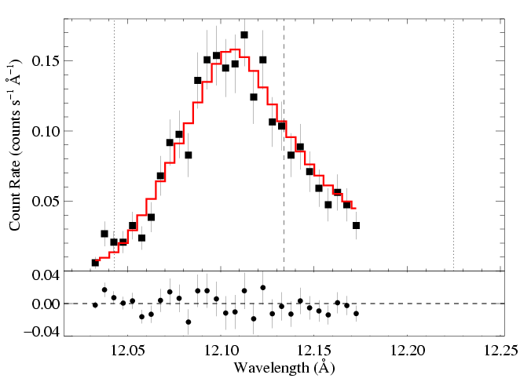
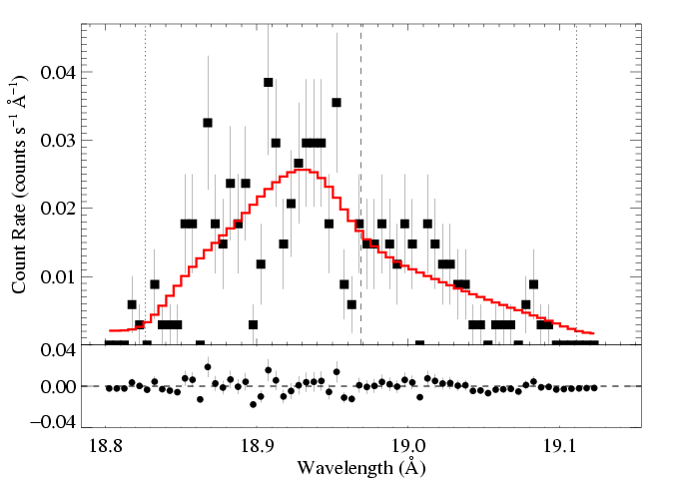
ζ Pup: three emission lines
Mg Lyα: 8.42 Å
Ne Lyα: 12.13 Å
O Lyα: 18.97 Å
τ* = 1
τ* = 2
τ* = 3
Recall:
Notes:
25

Slide 26
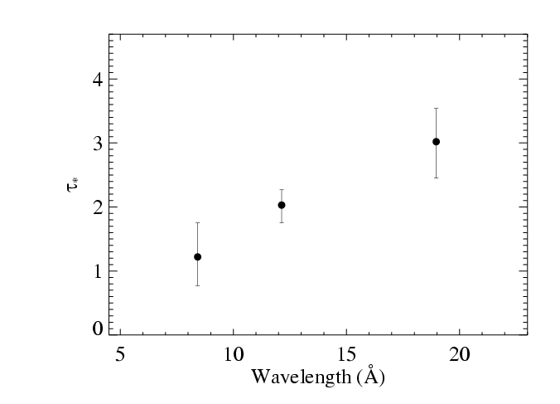
Results from the 3 line fits shown previously
Notes:
26

Slide 27
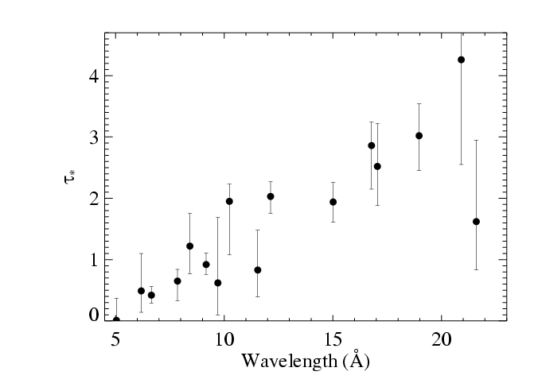
Fits to 16 lines in the Chandra spectrum of ζ Pup
Notes:
27

Slide 28
Fits to 16 lines in the Chandra spectrum of ζ Pup
Notes:
28

Slide 29
Fits to 16 lines in the Chandra spectrum of ζ Pup
τ*(λ) trend consistent with κ(λ)
Notes:
29

Slide 30
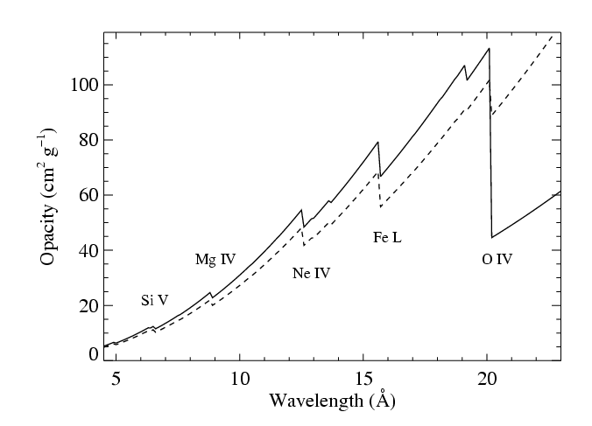
Fits to 16 lines in the Chandra spectrum of ζ Pup
CNO processed
τ*(λ) trend consistent with κ(λ)
Solar
Notes:
30

Slide 31
M becomes the free parameter of the fit to the τ*(λ) trend
τ*(λ) trend consistent with κ(λ)
Notes:
31

Slide 32
M becomes the free parameter of the fit to the τ*(λ) trend
τ*(λ) trend consistent with κ(λ)
Notes:
32

Slide 33
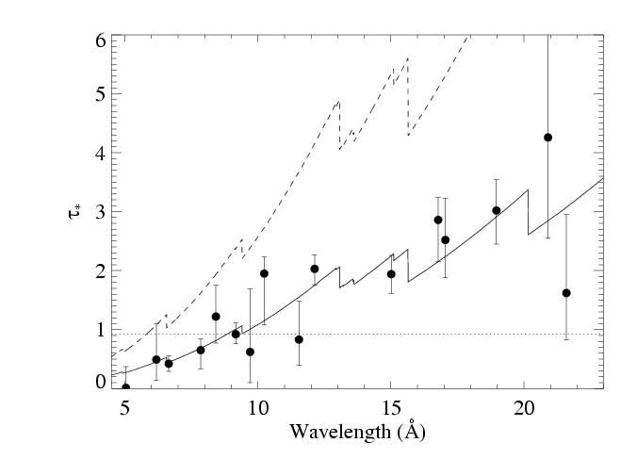
Traditional mass-loss rate: 8.3 X 10⁻⁶ M_{sun}/yr
From H_{α}, ignoring clumping
Our best fit: 3.5 X 10⁻⁶ M_{sun}/yr
Notes:
33

Slide 34
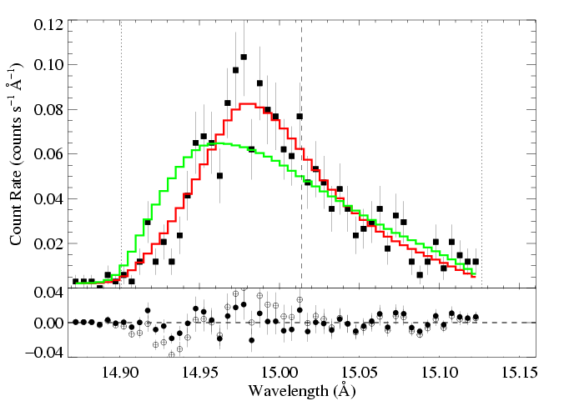
Traditional mass-loss rate: 8.3 X 10⁻⁶ M_{sun}/yr
Fe XVII
Our best fit: 3.5 X 10⁻⁶ M_{sun}/yr
Notes:
34

Slide 35
Mass-loss rate conclusions
The trend of τ* value with λ is consistent with :
Mass-loss rate of 3.5 X 10⁻⁶ M_{sun}/_{yr}
Factor of ~3 reduction w.r.t. unclumped H-alpha mass-loss rate diagnostics

Slide 36
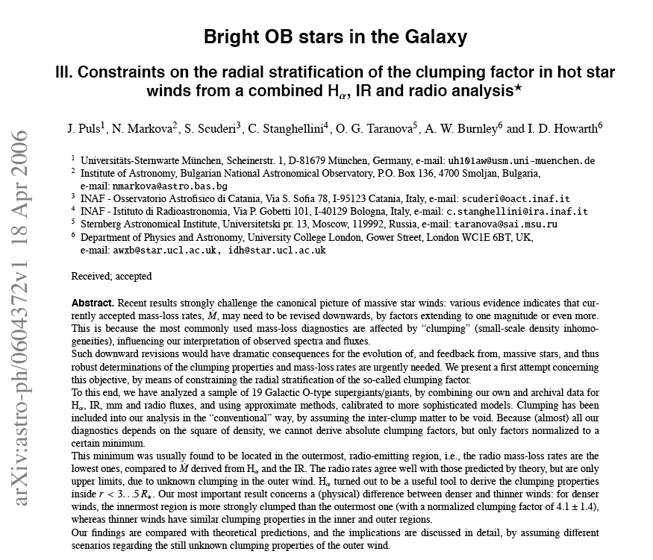
ζ Pup mass-loss rate < 4.2 x 10⁻⁶ M_{sun}/yr
Notes:
36

Slide 37
Three mechanisms for massive star x-ray emission
1. Instability driven shocks
2. Wind-wind interaction in close binaries
3. Magnetically channeled wind shocks
Notes:
37

Slide 38
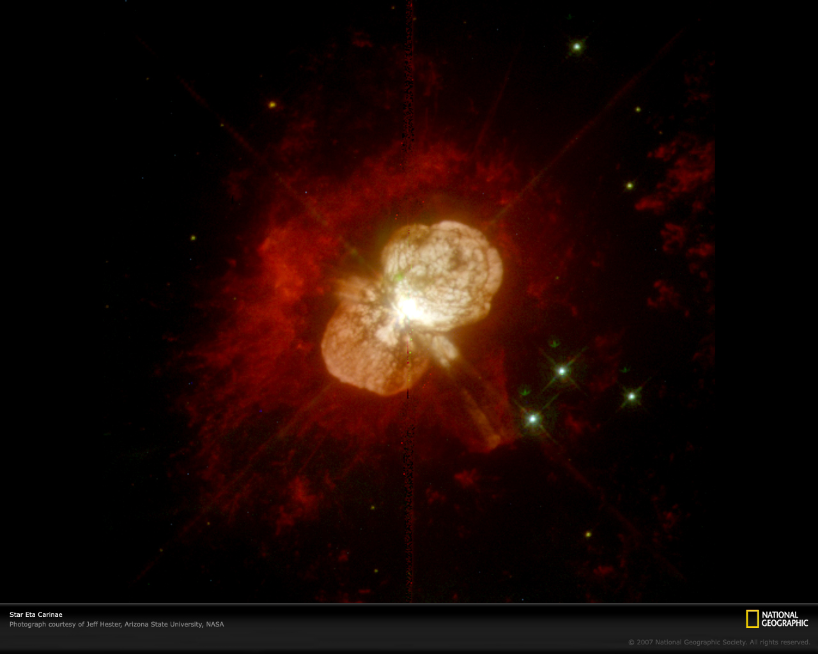
The embedded wind shock (EWS) mechanism should occur in all O stars
But other mechanisms can dominate, especially in young clusters/SFRs
Like colliding wind shocks (CWS) in η Car

Slide 39
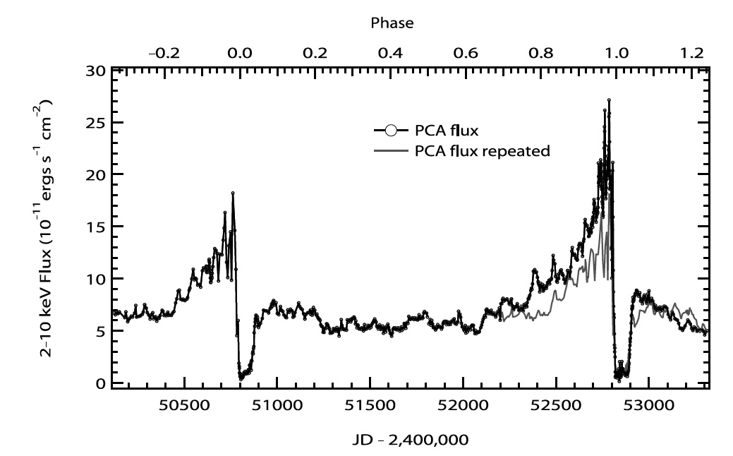
η Car RXTE X-ray light curve
Corcoran et al. 2005

Slide 40
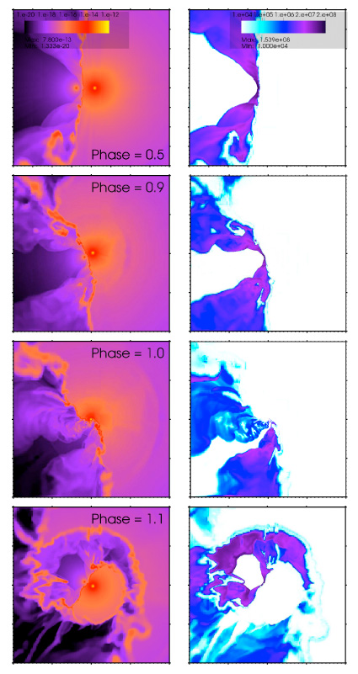
Hydrodynamics simulations of the colliding wind shock mechanism explain much of the observed X-ray properties
hard emission (~5 keV)
L_{x} ~ 10³⁵ erg/s
orbital modulation of X-rays
Parkin et al. 2011

Slide 41
HD 93129A (O2If*) is the 2nd brightest X-ray source in Tr 14
Tr 14: Chandra
Carina: ESO

Slide 42
HD93129A – O2 If*
Extremely massive (120 M_{sun}), luminous O star (10^{6.1} L_{sun})
Strongest wind of any Galactic O star (2 X 10⁻⁵ M_{sun}/yr; v_{inf} = 3200 km/s)
From H-alpha, assuming a smooth wind

Slide 43
There is an O3.5 companion with a separation of ~100 AU
Non-thermal radio measurements indicate wind-wind interactions
But the vast majority of the X-rays come from embedded wind shocks in the O2If* primary

Slide 44
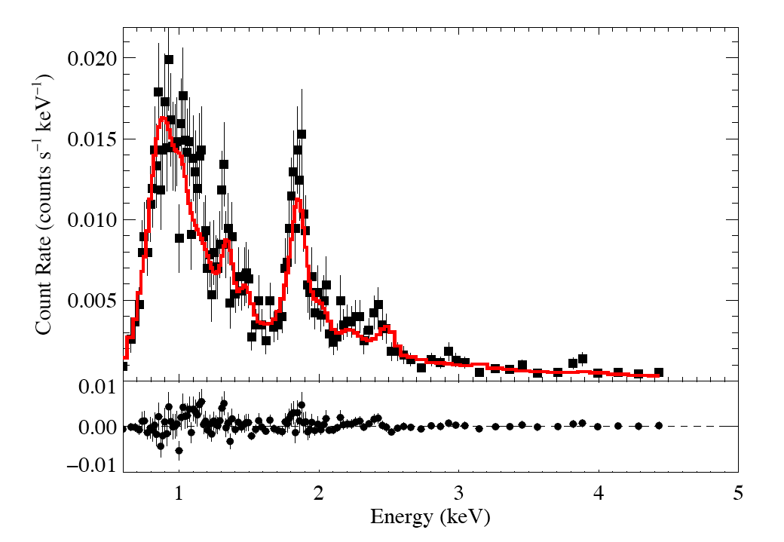
Chandra ACIS (low-res, CCD) spectrum of HD 93129A
Typical of O stars like ζ Pup
kT = 0.6 keV *wind_abs*ism
add 5% kT = 2.0 keV*ism
small contribution from colliding wind shocks

Slide 45
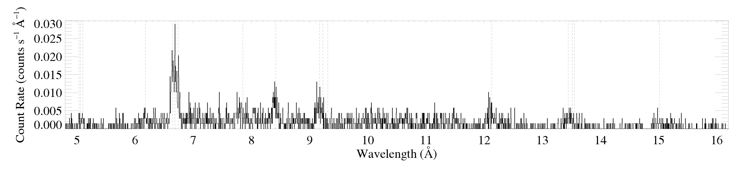
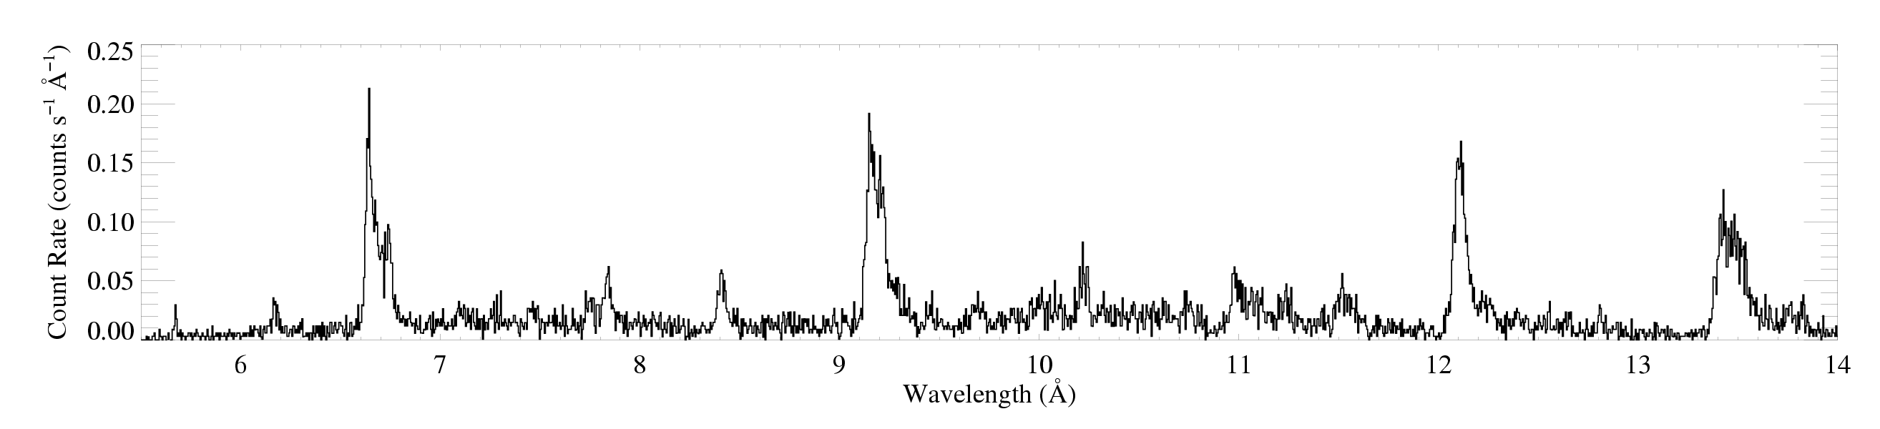
Its X-ray spectrum is hard
HD 93129A
ζ Pup
Si XIV
Si XIII
Mg XII
Mg XI

Slide 46
Its X-ray spectrum is hard
HD 93129A
Si XIV
Si XIII
Mg XII
Mg XI
H-like vs. He-like

Slide 47
Its X-ray spectrum is hard
Si
Mg
HD 93129A
low H/He
But the plasma temperature is low:
little plasma with kT > 8 million K

Slide 48
Its X-ray spectrum is hard
Si
Mg
low H/He
Bound-free absorption in the wind is the cause of the observed X-ray hardness

Slide 49
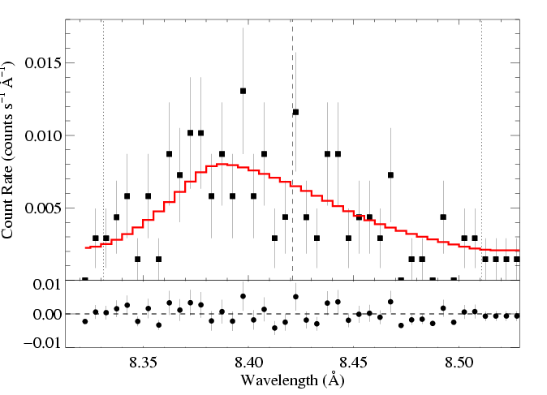
X-ray line profiles show same characteristic shape
R_{o} = 1.8 R*
τ* = 1.4
M-dot ~ 8 x 10⁻⁶ M_{sun}/yr
Notes:
49

Slide 50
M-dot ~ 2 x 10⁻⁵ M_{sun}/yr from unclumped Hα
HD 93129A (O2 If*): Mg XII Lyα 8.42 Å
V_{inf} ~ 3200 km/s
R_{o} = 1.8 R*
τ* = 1.4
M-dot ~ 8 x 10⁻⁶ M_{sun}/yr
Notes:
50

Slide 51
Low-resolution Chandra CCD spectrum of HD93129A
Fit: thermal emission with wind + ISM absorption plus a second thermal component with just ISM
kT = 0.6 keV *wind_abs*ism
add 5% kT = 2.0 keV*ism

Slide 52
τ*/κ = 0.03 (corresp. ~ 8 x 10⁻⁶ M_{sun}/yr)
Typical of O stars like ζ Pup
kT = 0.6 keV *wind_abs*ism
add 5% kT = 2.0 keV*ism
small contribution from colliding wind shocks

Slide 53
Three mechanisms for massive star x-ray emission
1. Instability driven shocks
2. Wind-wind interaction in close binaries
3. Magnetically channeled wind shocks
Notes:
53

Slide 54
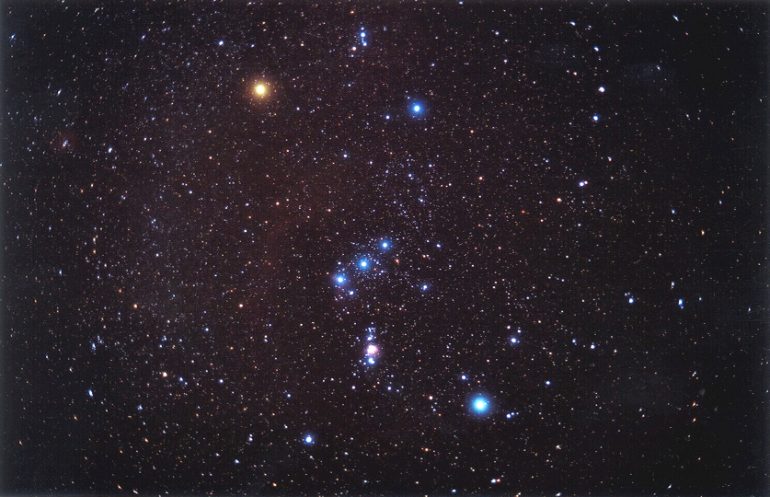
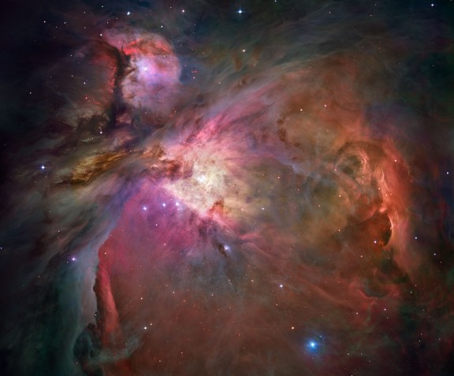
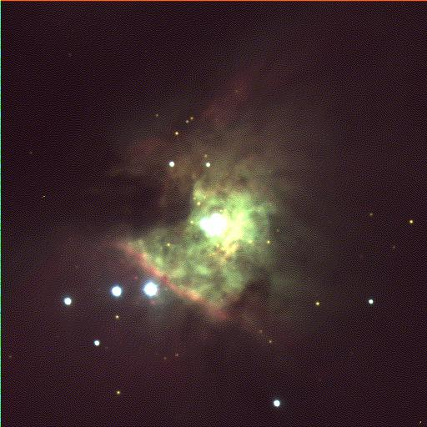
Orion Nebula Cluster: age ~ 1Myr; d ~ 450pc
~7’

Slide 55
Chandra ~10⁶ seconds, COUP (Penn. St.)
Color coding of x-ray energy: <1keV, 1keV < E < 2.5keV, >2.5keV

Slide 56
θ¹ Ori C (O7 V)

Slide 57
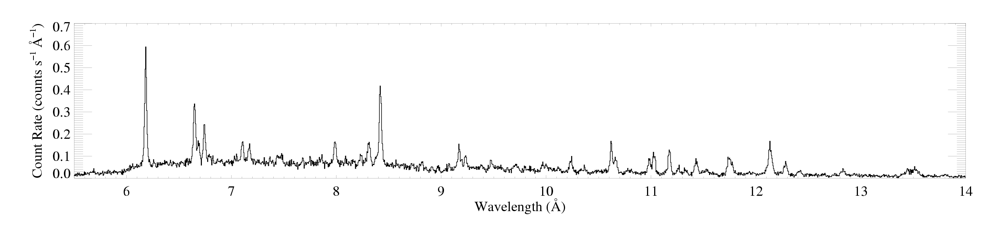
Chandra HETGS
θ¹ Ori C
θ¹ Ori C: hotter plasma, narrower emission lines
ζ Pup
ζ Pup (O4 I): cooler plasma, broad emission lines

Slide 58
H-like/He-like ratio is temperature sensitive
θ¹ Ori C
Mg XII
Mg XI
Si XIV
Si XIII
ζ Pup

Slide 59
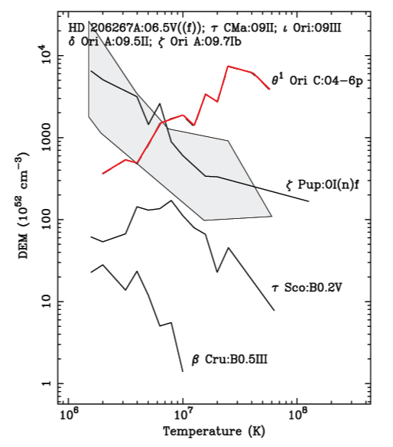
Differential emission measure (temperature distribution)
θ¹ Ori C:
peak near 30 million K
Non-magnetic O stars, peak at a few million K
Wojdowski & Schulz (2005)

Slide 60
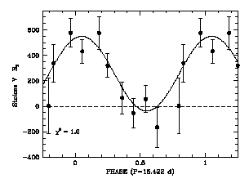
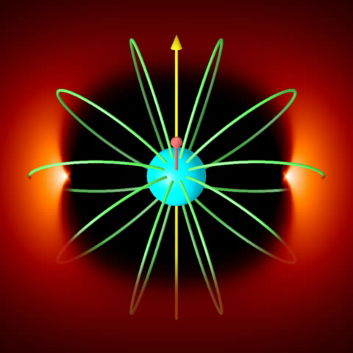
Dipole magnetic field (> 1 kG) measured on θ¹ Ori C
Zeeman magnetic field measurements
Wade et al. (2006)
Magnetic field obliquity, β ~ 45º
R. Townsend

Slide 61
MHD simulations of magnetically channeled wind
temperature
emission measure
simulations by A. ud-Doula; Gagné et al. (2005)
Channeled collision is close to head-on – at 1000+ km s⁻¹ : T = 10⁷+ K

Slide 62
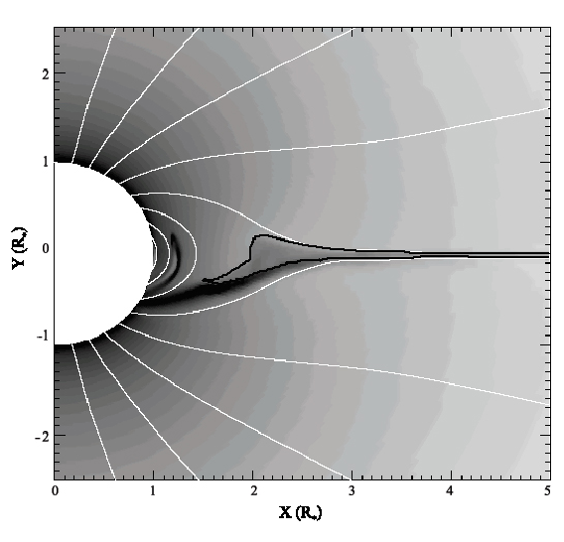
Emission measure
contour encloses T > 10⁶ K

Slide 63
MHD simulations show multi-10⁶ K plasma, moving slowly, ~1R* above photosphere
contour encloses T > 10⁶ K

Slide 64

Differential emission measure (temperature distribution)
MHD simulation of θ¹ Ori C reproduces the observed differential emission measure

Slide 65

Chandra broadband count rate vs. rotational phase
0.4
1.5
0.3
1.0
0.2
Simulation EM (10⁵⁶ cm⁻³)
θ¹ Ori C ACIS-I count rate (s⁻¹)
0.1
0.5
0.0
0.0
0.0 0.2 0.4 0.6 0.8 1.0
Rotational phase (P=15.422 days)
Model from MHD simulation

Slide 66
Helium-like ions (e.g. O⁺⁶, Ne⁺⁸, Mg⁺¹⁰, Si⁺¹², S⁺¹⁴) – schematic energy level diagram
1s2p ¹P
10-20 eV
1s2p ³P
1s2s ³S
resonance (r)
1-2 keV
forbidden (f)
intercombination (i)
g.s. 1s² ¹S

Slide 67
The f/i ratio is thus a diagnostic of the strength of the local UV radiation field.
1s2p ¹P
UV
1s2p ³P
1s2s ³S
resonance (r)
forbidden (f)
intercombination (i)
g.s. 1s² ¹S

Slide 68
If you know the UV intensity emitted from the star’s surface, it thus becomes a diagnostic of the distance that the x-ray emitting plasma is from the star’s surface.
1s2p ¹P
UV
1s2p ³P
1s2s ³S
resonance (r)
forbidden (f)
intercombination (i)
g.s. 1s² ¹S

Slide 69



R_{fir}=1.2 R*
R_{fir}=2.1 R*
R_{fir}=4.0 R*

Slide 70
Conclusions
Shock processes in O star winds convert kinetic energy to heat and X-rays
Three different mechanisms can operate
Harder and stronger emission from CWS and MCWS
But significant and sometimes moderately hard X-ray emission from EWS too
Wind absorption effects are significant and can be used as a clumping-independent mass-loss rate diagnostic: mass lass rates are lower (factors of 3 to 5) than previously thought

