Slide 1
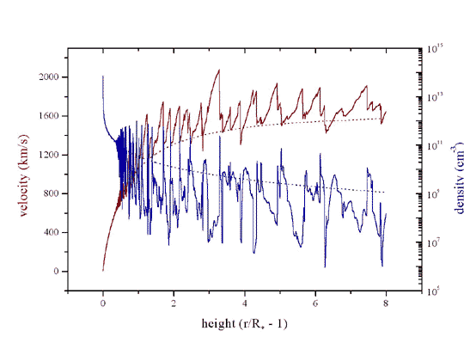
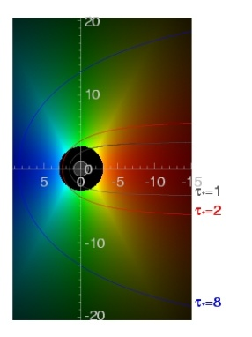
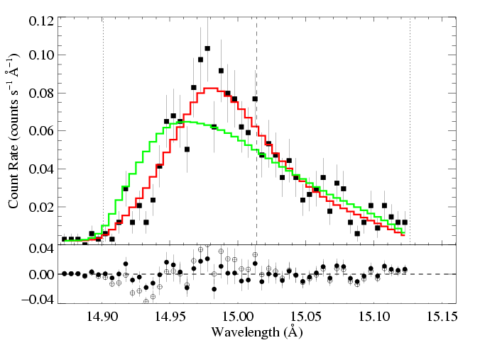
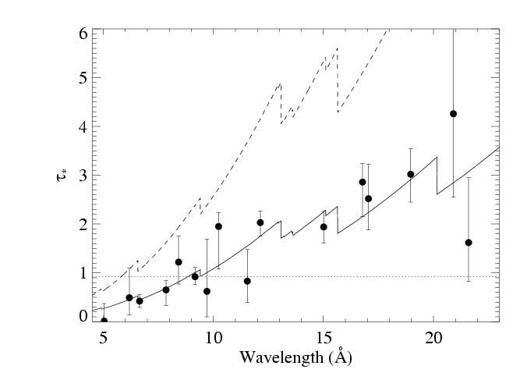
Line Shapes in Hot Stars:
Hydrodynamics & Wind Mass-Loss Rates
David Cohen
Swarthmore College
with Maurice Leutenegger, Stan Owocki, Rich Townsend,
Emma Wollman (‘09), James MacArthur (‘11)

Slide 2
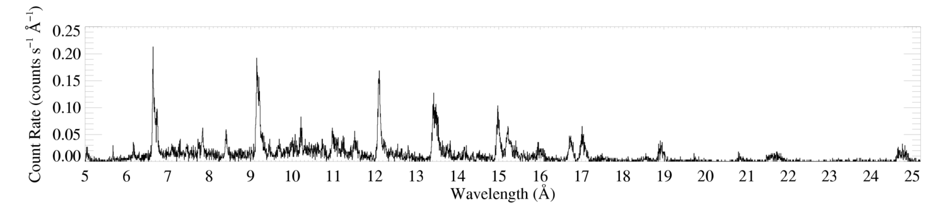
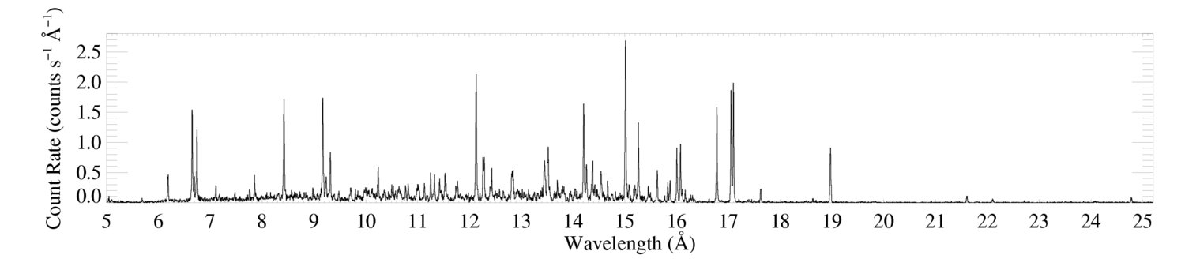
ζ Pup (O4 If)
Capella (G5 III) – coronal source
– for comparison
Notes:
2

Slide 3
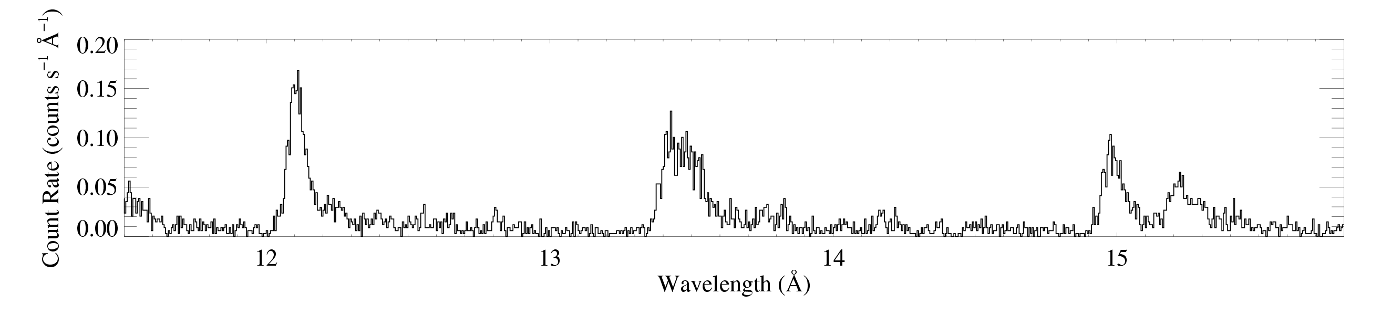
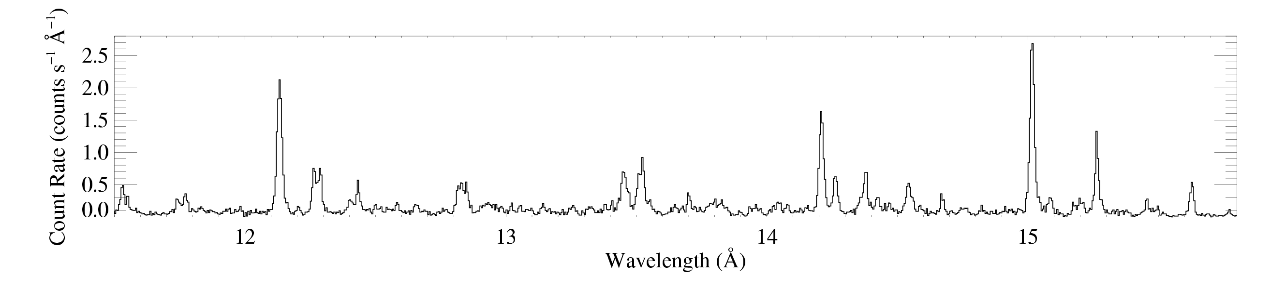
Ne X
ζ Pup
Ne IX
Fe XVII
Capella
Notes:
3

Slide 4
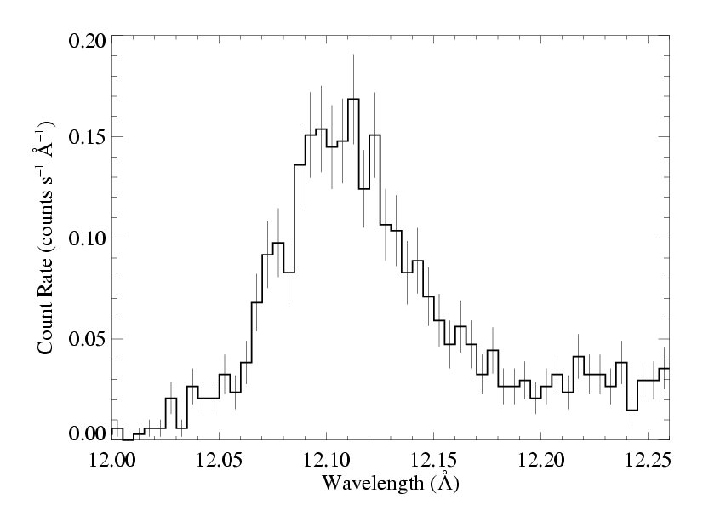
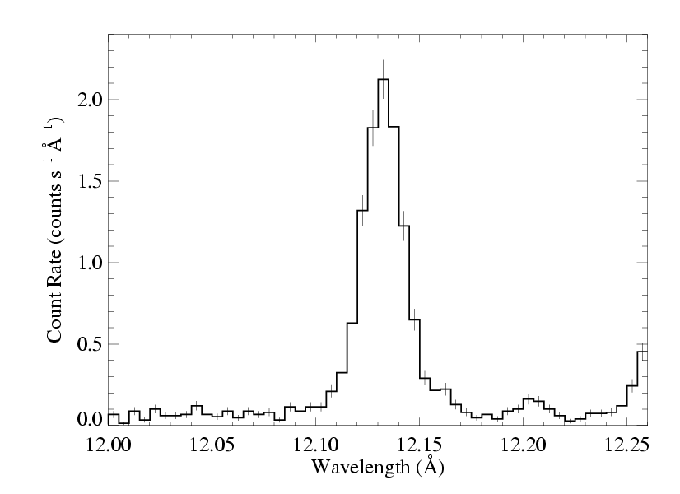
ζ Pup
massive
broad, skewed,
blue shifted
Capella
low mass
unresolved
Notes:
4

Slide 5
rad-hydro wind simulations: line-driving instability
Notes:
5

Slide 6
V_{shock} ~ 300 km/s :
T ~ 10⁶ K
shock onset at r ~ 1.5 R_{star}
hot plasma has low density
Notes:
6

Slide 7
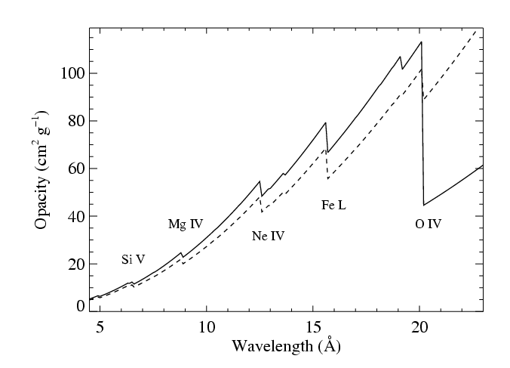
99% of the wind mass is cold*, partially ionized…
x-ray absorbing
*typically 20,000 – 30,000 K; maybe better described as “warm”

Slide 8
photoelectric absorption:
continuum opacity in the cold wind component
CNO processed
solar abundance

Slide 9
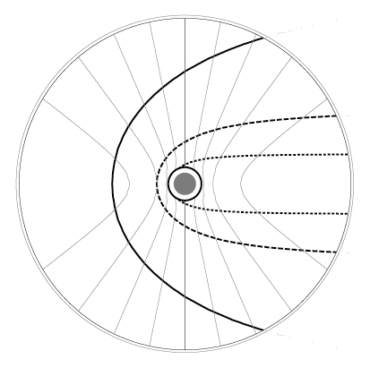
isovelocity contours
-0.2v_{inf}
+0.2v_{inf}
-0.6v_{inf}
+0.6v_{inf}
-0.8v_{inf}
+0.8v_{inf}
observer
on left

Slide 10
isovelocity contours
-0.2v_{inf}
+0.2v_{inf}
-0.6v_{inf}
+0.6v_{inf}
-0.8v_{inf}
+0.8v_{inf}
observer
on left
τ = 3
τ = 1
optical depth contours
τ = 0.3

Slide 11
opacity of the cold wind component
wind mass-loss rate
wind terminal velocity
radius of the star
Notes:
11

Slide 12
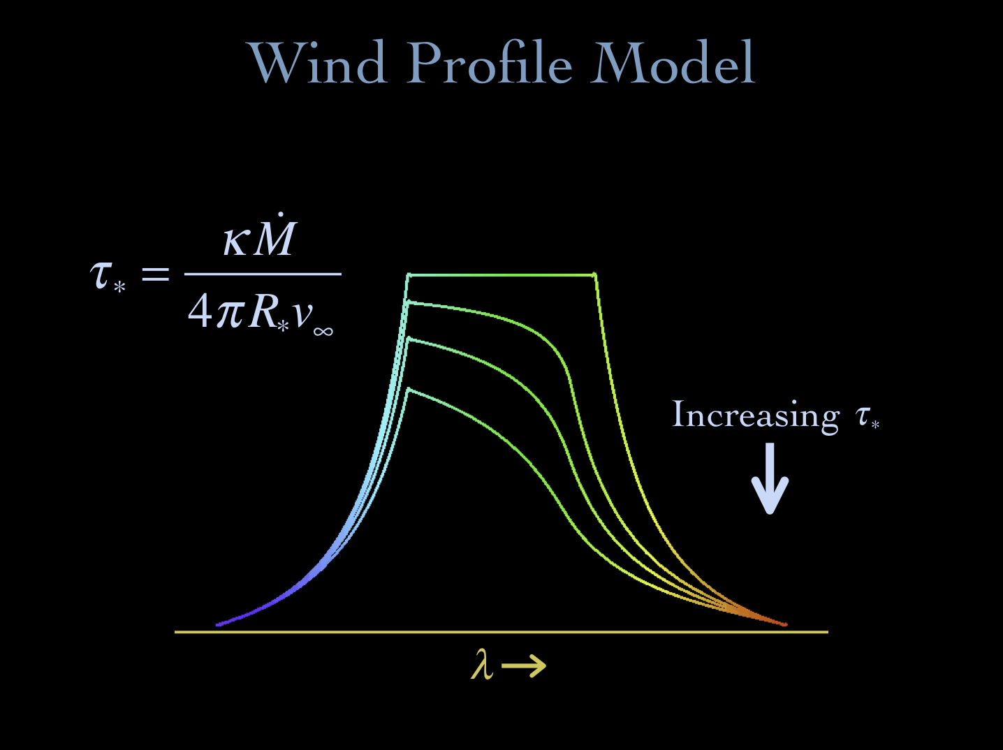
Notes:
12

Slide 13
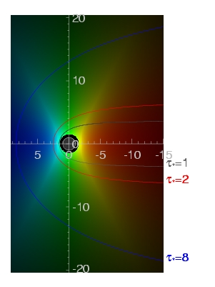
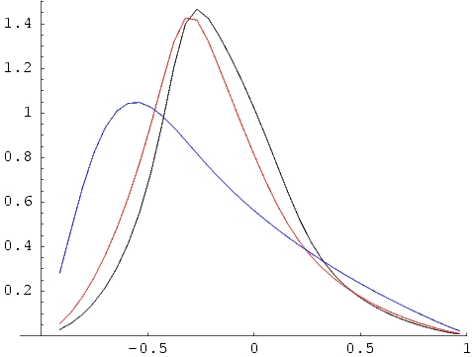
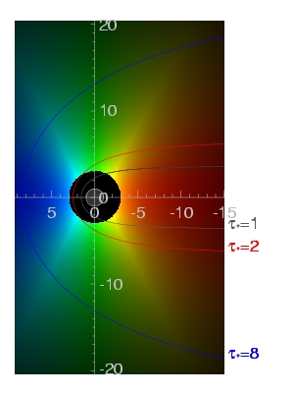
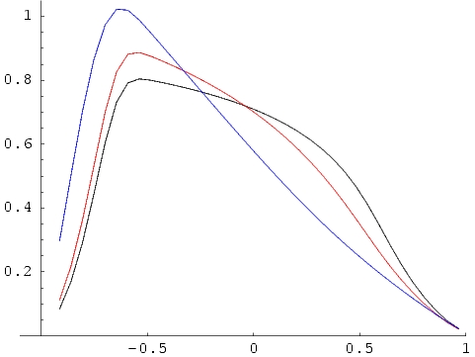
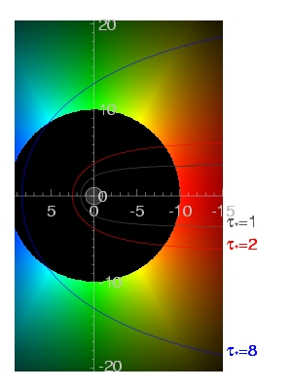
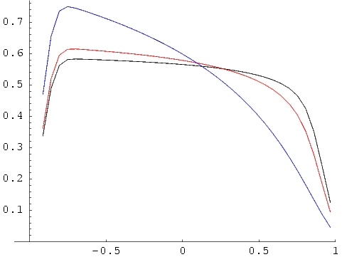
τ=1 contours
τ∗=1,2,8
R_{o}=1.5
key parameters: R_{o} & τ*
j ~ ρ² for r/R* > R_{o},
= 0 otherwise
R_{o}=3
R_{o}=10
Notes:
13

Slide 14
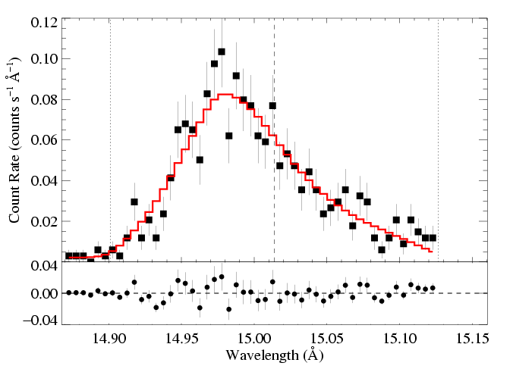
We fit these x-ray line profile models to each line in the Chandra data
Fe XVII
Fe XVII
Notes:
14

Slide 15
And find a best-fit τ* and R_{o}…
Fe XVII
τ* = 2.0
R_{o} = 1.5
Fe XVII
Notes:
15

Slide 16
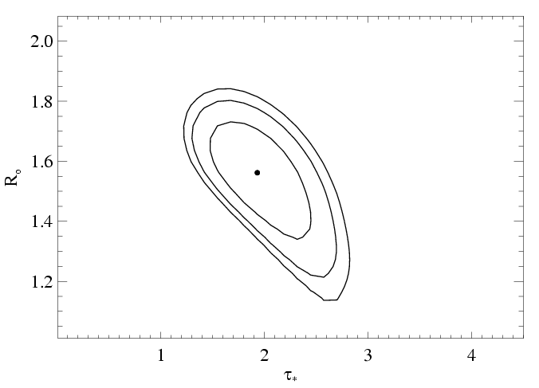
…and place confidence limits on these fitted parameter values
68, 90, 95% confidence limits
Notes:
16

Slide 17
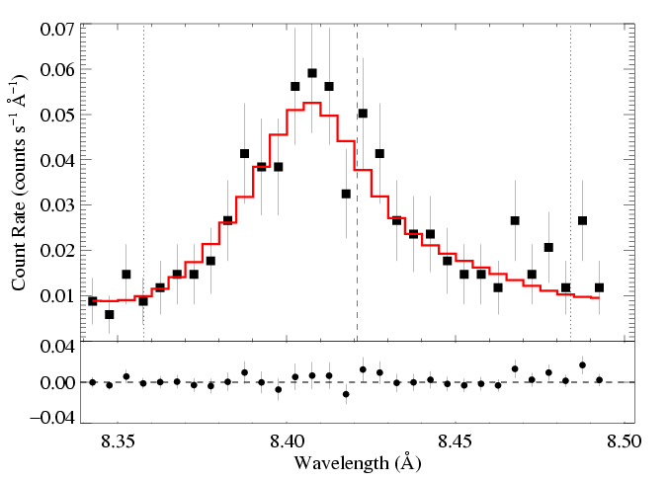
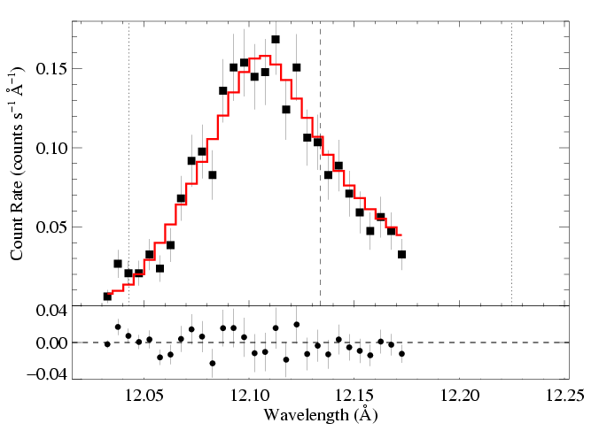
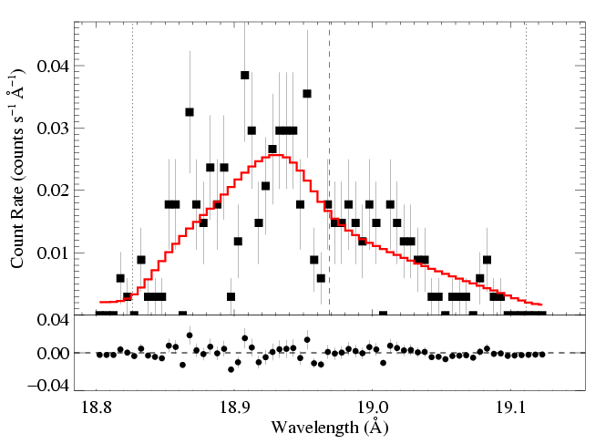
ζ Pup: three emission lines
Mg Lyα: 8.42 Å
Ne Lyα: 12.13 Å
O Lyα: 18.97 Å
τ* = 1
τ* = 2
τ* = 3
Recall:
Notes:
17

Slide 18
atomic opacity of the wind
CNO processed
Solar

Slide 19
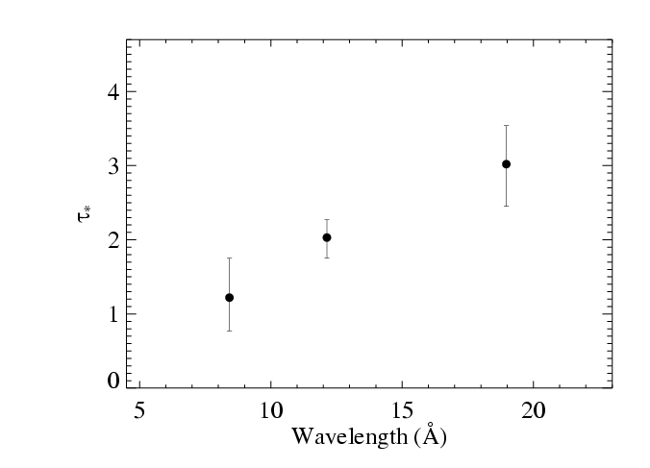
Results from the 3 line fits shown previously
Notes:
19

Slide 20
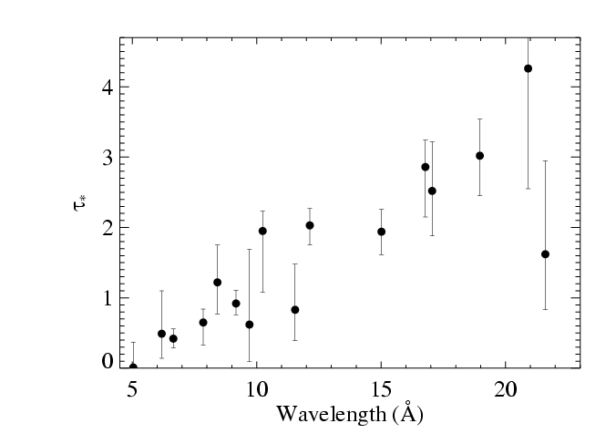
Fits to 16 lines in the Chandra spectrum of ζ Pup
Notes:
20

Slide 21
Fits to 16 lines in the Chandra spectrum of ζ Pup
Notes:
21

Slide 22
Fits to 16 lines in the Chandra spectrum of ζ Pup
τ*(λ) trend consistent with κ(λ)
Notes:
22

Slide 23
M becomes the free parameter of the fit to the τ*(λ) trend
τ*(λ) trend consistent with κ(λ)
Notes:
23

Slide 24
Traditional mass-loss rate:
8.3 X 10⁻⁶ M_{sun}/yr
Our best fit:
3.5 X 10⁻⁶ M_{sun}/yr
Notes:
24

Slide 25
Traditional mass-loss rate:
8.3 X 10⁻⁶ M_{sun}/yr
Fe XVII
Our best fit:
3.5 X 10⁻⁶ M_{sun}/yr
Notes:
25

Slide 26
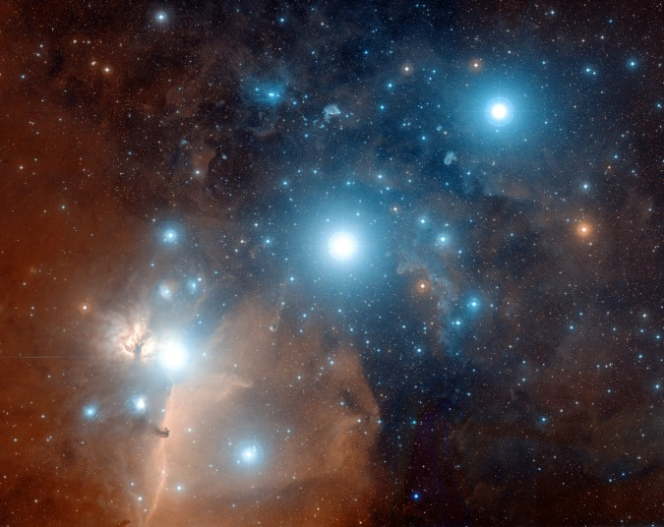
ζ Ori: O9.5
ε Ori: B0

Slide 27
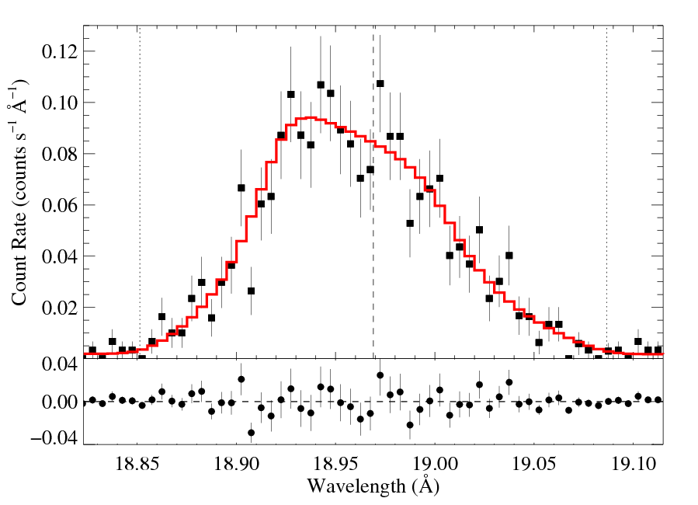
ζ Ori (09.7 I): O Lyα 18.97 Å
R_{o} = 1.6 R*
τ* = 0.3
Notes:
27

Slide 28
τ* quite low: is resonance scattering affecting this line? - Next talk, by M. Leutenegger
R_{o} = 1.6 R*
τ* = 0.3
Notes:
28

Slide 29
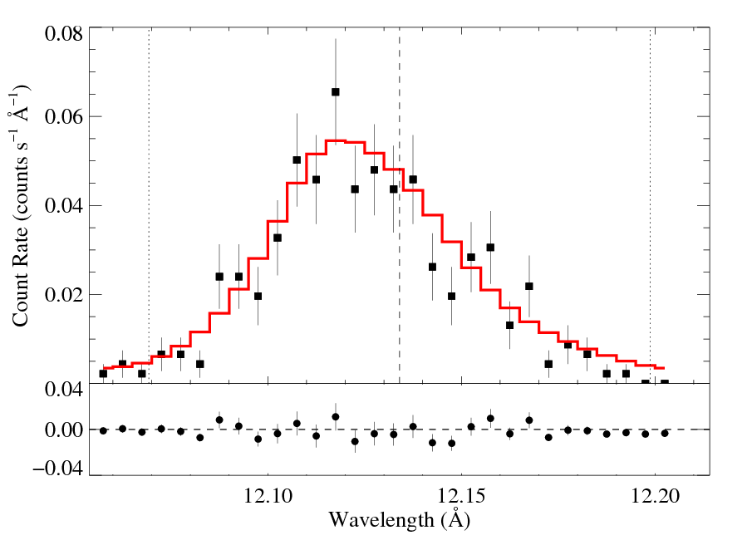
ε Ori (B0 Ia): Ne Lyα 12.13 Å
R_{o} = 1.5 R*
τ* = 0.6
Notes:
29

Slide 30
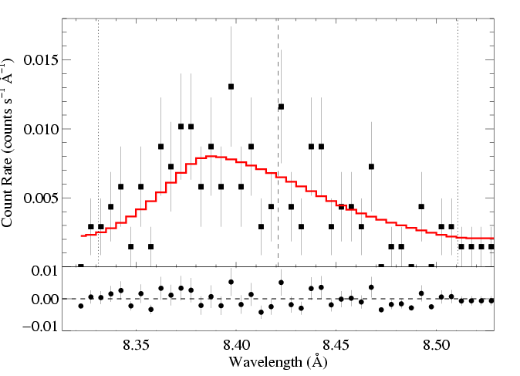
M-dot ~ 2 X 10⁻⁵ M_{sun}/yr
HD 93129Aab (O2.5): Mg XII Lyα 8.42 Å
V_{inf} ~ 3200 km/s
M-dot ~ 5 X 10⁻⁶ M_{sun}/yr
R_{o} = 1.8 R*
τ* = 1.4
Notes:
30

Slide 31
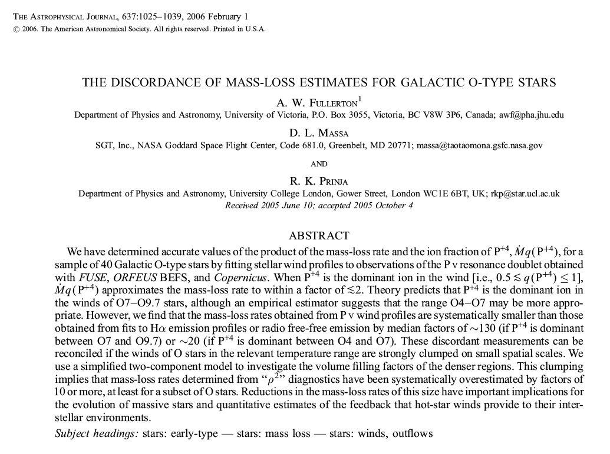
Multi-wavelength evidence for lower mass-loss rates is emerging
Notes:
31

Slide 32
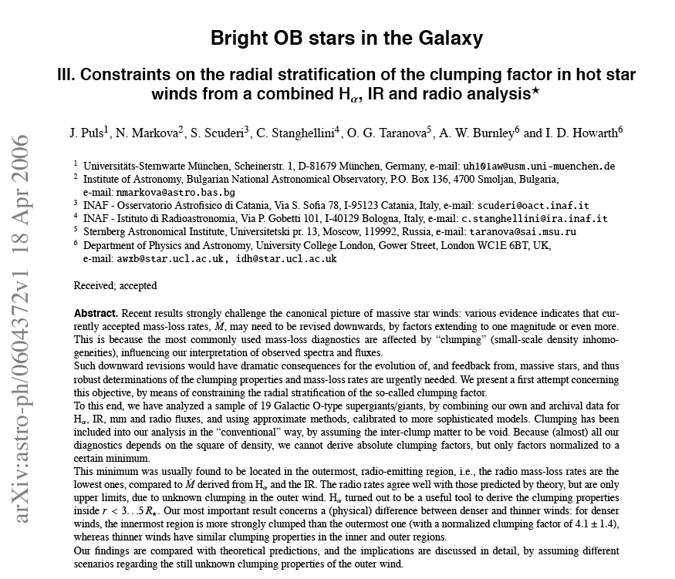
ζ Pup mass-loss rate < 4.2 X 10⁻⁶ M_{sun}/yr
Notes:
32

Slide 33
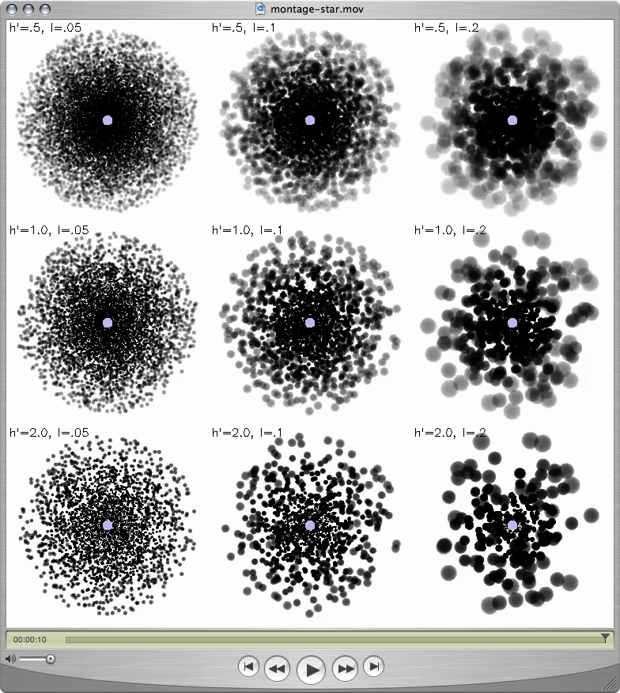
“Clumping” – or micro-clumping: affects density-squared diagnostics; independent of clump size, just depends on clump density contrast (or filling factor, f )
visualization: R. Townsend

Slide 34
But porosity is associated with optically thick clumps, it acts to reduce the effective opacity of the wind; it does depend on the size scale of the clumps
The key parameter is the porosity length,
h = (L³/ℓ²) = ℓ/f
ℓ
L
f = ℓ³/L³

Slide 35
Clump size increasing →
The porosity length, h:
clump size
h = ℓ/f
Porosity length increasing →
clump filling factor (<1)

Slide 36
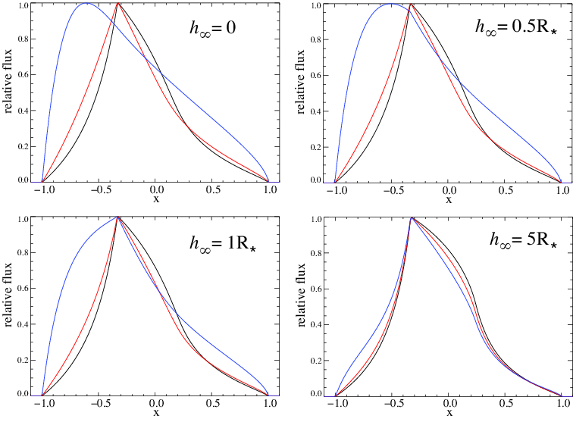
Porosity only affects line profiles if the porosity length (h) exceeds the stellar radius

Slide 37
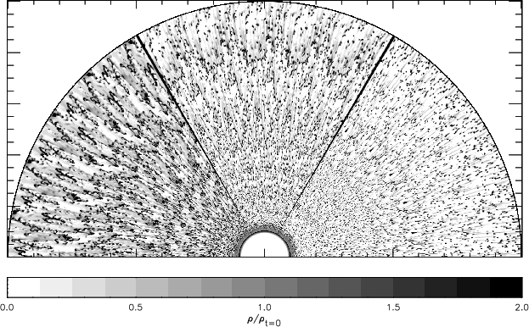
The clumping in 2-D simulations (density shown below) is on quite small scales
Dessart & Owocki 2003, A&A, 406, L1
Notes:
37

Slide 38
No expectation of porosity from simulations
Natural explanation of line profiles without invoking porosity
Finally, to have porosity, you need clumping in the first place, and once you have clumping…you have your factor ~3 reduction in the mass-loss rate
Notes:
38

Slide 39
No expectation of porosity from simulations
Natural explanation of line profiles without invoking porosity
Finally, to have porosity, you need clumping in the first place, and once you have clumping…you have your factor ~3 reduction in the mass-loss rate
Notes:
39

Slide 40
No expectation of porosity from simulations
Natural explanation of line profiles without invoking porosity
Finally, to have porosity, you need clumping in the first place, and once you have clumping…you have your factor ~3 reduction in the mass-loss rate
(for ζ Pup, anyway)
Notes:
40

Slide 41
f ~ 0.1 is indicated by H-alpha, UV, radio free-free analysis
f = 0.2
f = 0.05
f = 0.1

Slide 42
And lack of evidence for porosity…
leads us to suggest visualization in upper left is closest to reality
f = 0.2
f = 0.05
f = 0.1

Slide 43
conclusions
Line widths consistent with embedded wind shocks
Skewed line shapes consistent with photoelectric absorption; magnitude and wavelength trend enable a mass-loss rate measurement
Consistent explanation for zeta Pup – M down by factor of 3, no need to invoke porosity
Notes:
43

Slide 44
conclusions
Line widths consistent with embedded wind shocks
Skewed line shapes consistent with photoelectric absorption; magnitude and wavelength trend enable a mass-loss rate measurement
Consistent explanation for zeta Pup – M down by factor of 3, no need to invoke porosity
Notes:
44

Slide 45
conclusions
Line widths consistent with embedded wind shocks
Skewed line shapes consistent with photoelectric absorption; magnitude and wavelength trend enable a mass-loss rate measurement
Consistent explanation for zeta Pup – M down by factor of 3, no need to invoke porosity
Notes:
45

Slide 46
conclusions
Line widths consistent with embedded wind shocks
Skewed line shapes consistent with photoelectric absorption; magnitude and wavelength trend enable a mass-loss rate measurement
Consistent explanation for zeta Pup – M down by factor of 3, no need to invoke porosity
Notes:
46

