Slide 1
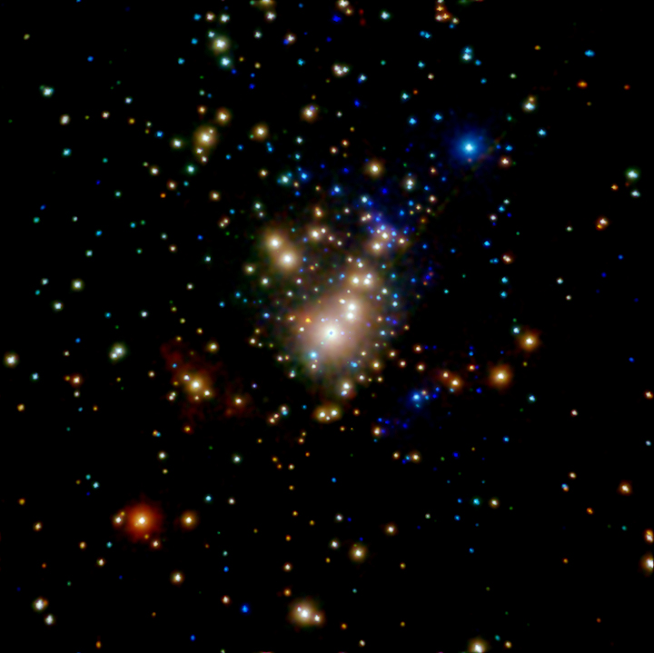
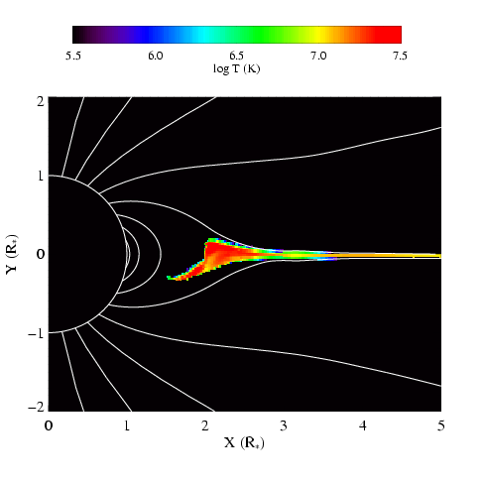
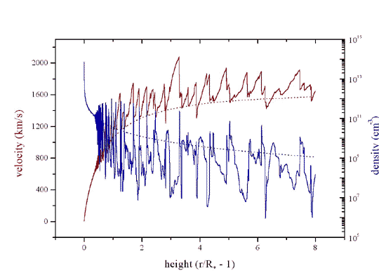
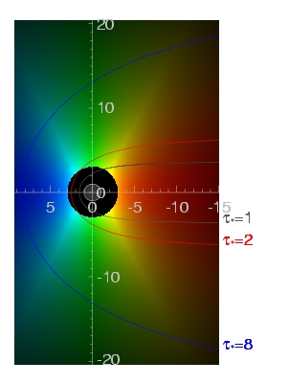
High-Resolution X-ray Spectroscopy of the Winds of Massive Stars
David Cohen Swarthmore College

Slide 2
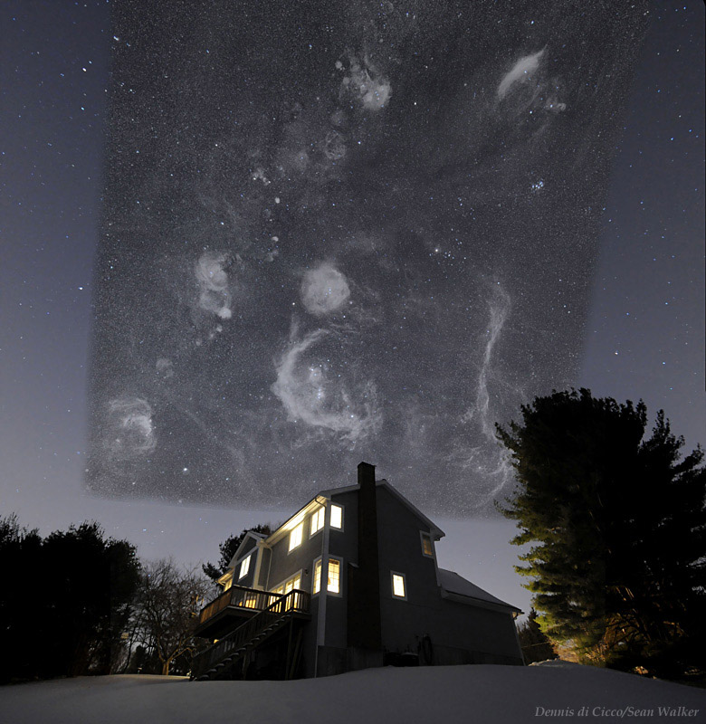
Notes:
2

Slide 3
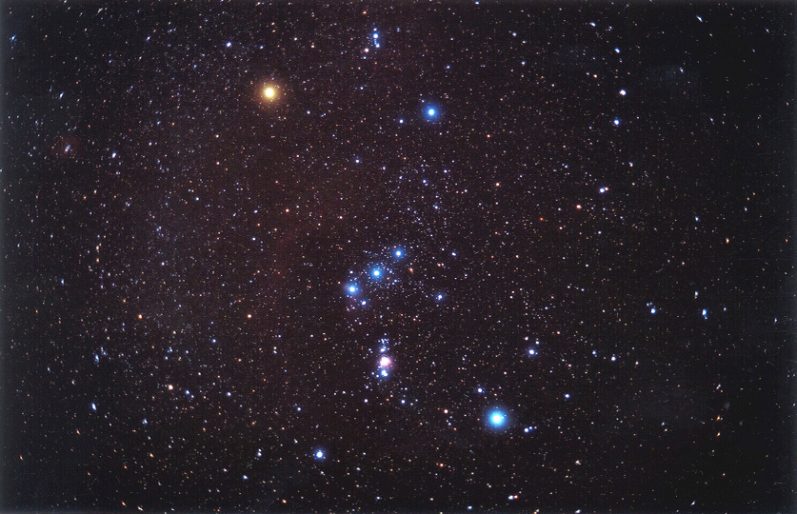
Orion

Slide 4
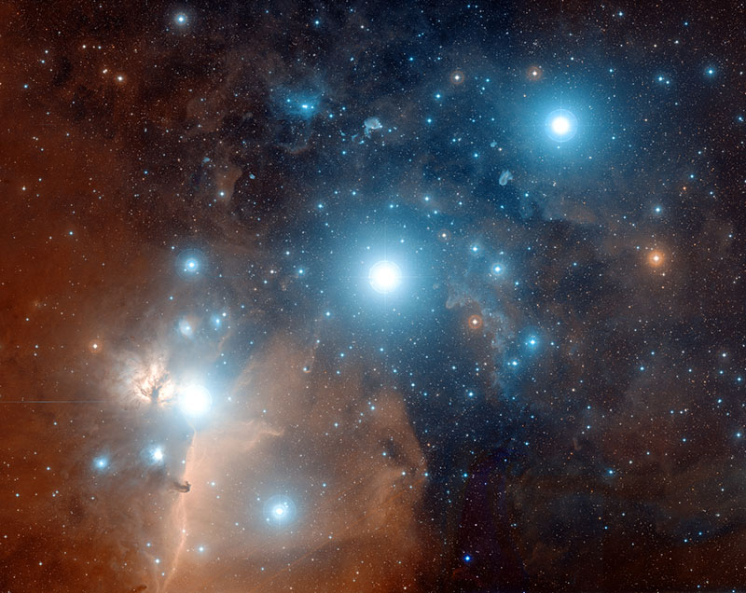
Orion’s belt stars
De Martin/Digitized Sky Survey
Notes:
4

Slide 5
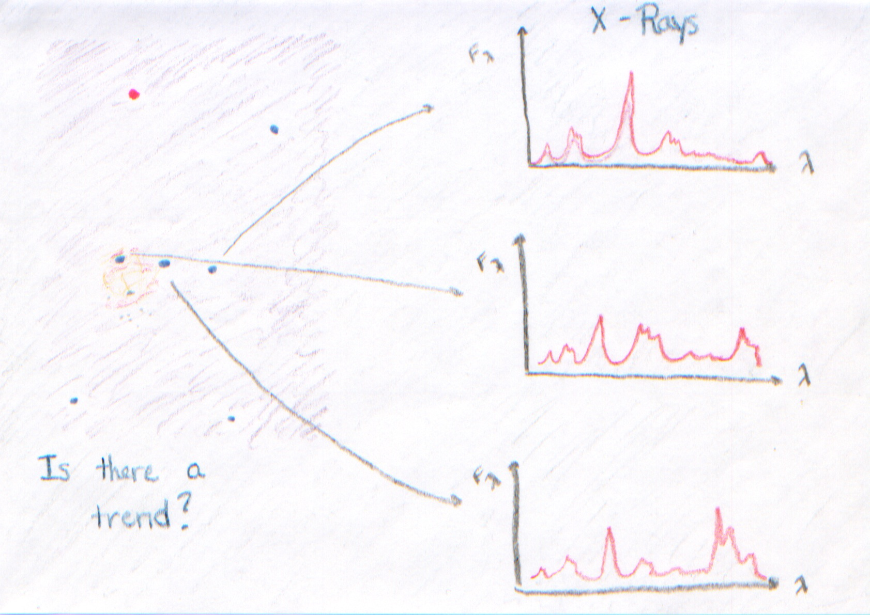
Erin Martell
Notes:
5

Slide 6
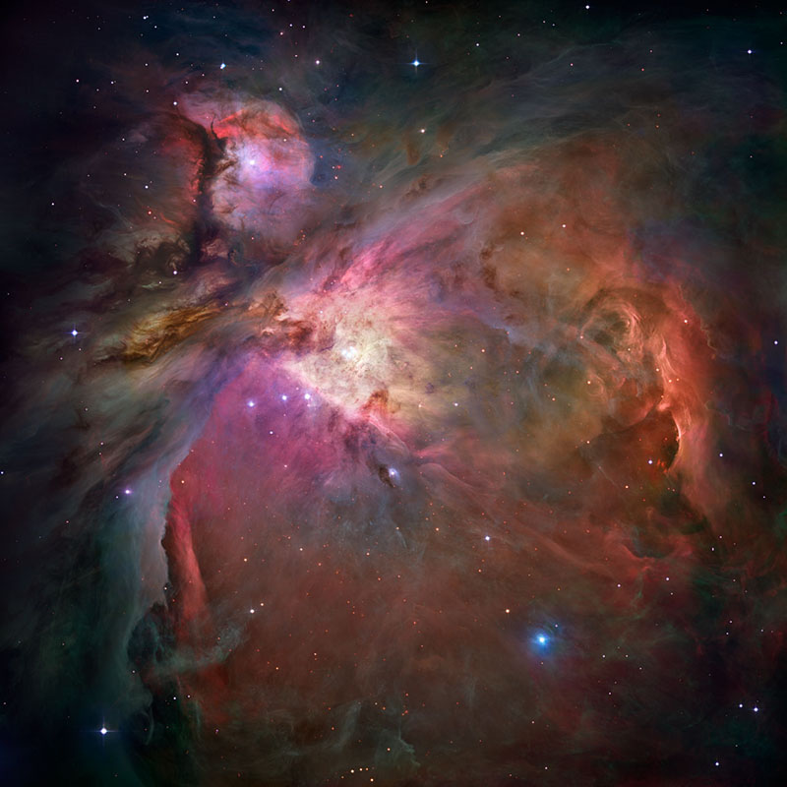
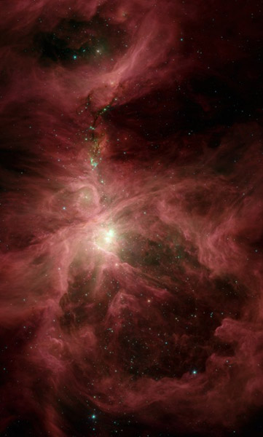
Great Nebula of Orion
Robberto/HST
Megeath/Spitzer
Notes:
6

Slide 7
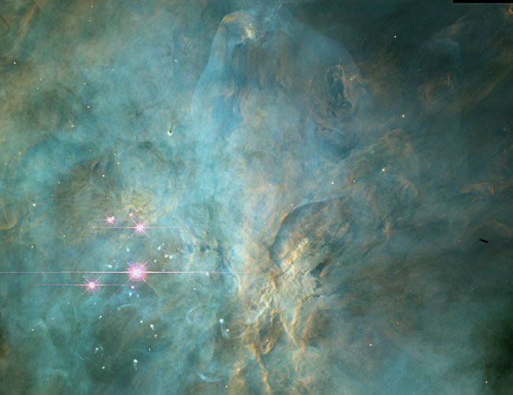
Trapezium: massive, luminous stars at the center of the nebula
Bally/HST
Notes:
7

Slide 8
Chandra X-ray Telescope image of the Orion Nebula Cluster
young, massive star: θ¹ Ori C
Color coded according to photon energy (red: <1keV; green 1 to 2 keV; blue > 2 keV)

Slide 9
Notes:
9

Slide 10
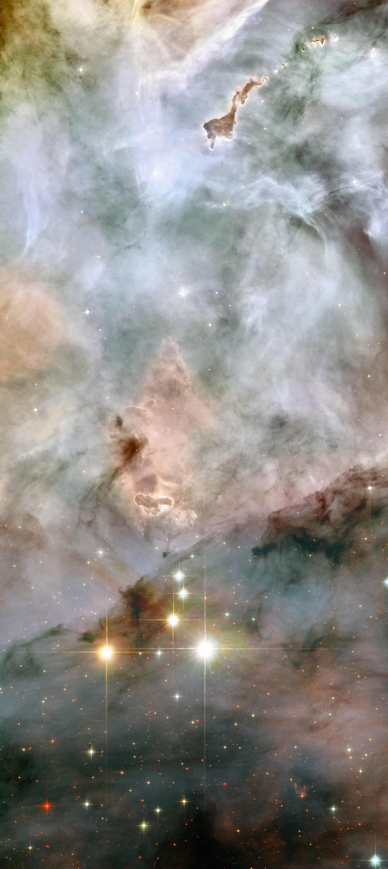
massive stars:
20 to 100 M_{sun}
10⁶ L_{sun}
T ~ 50,000 K
Carina/Keyhole Nebula (HST)
Notes:
10

Slide 11
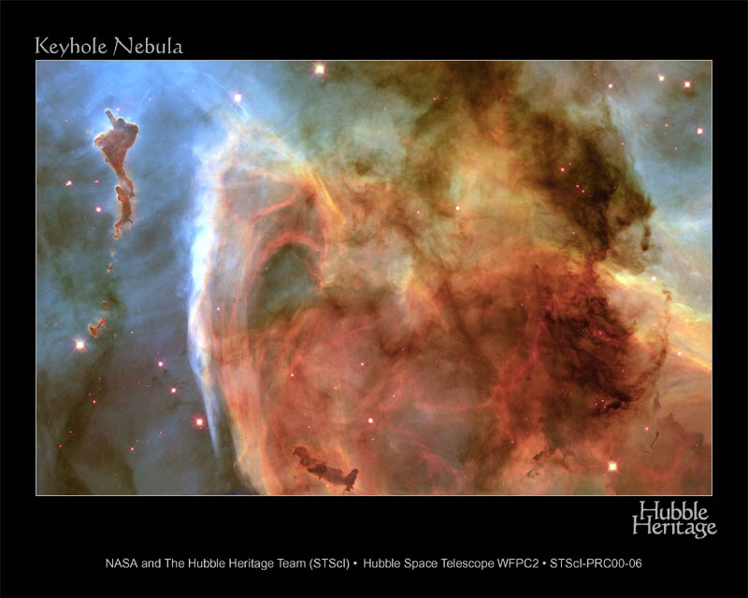
Notes:
11

Slide 12
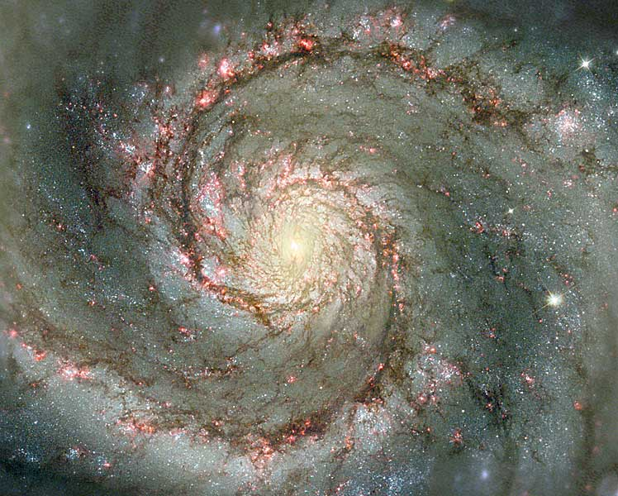
Whirlpool/M51 (HST)
Notes:
12

Slide 13
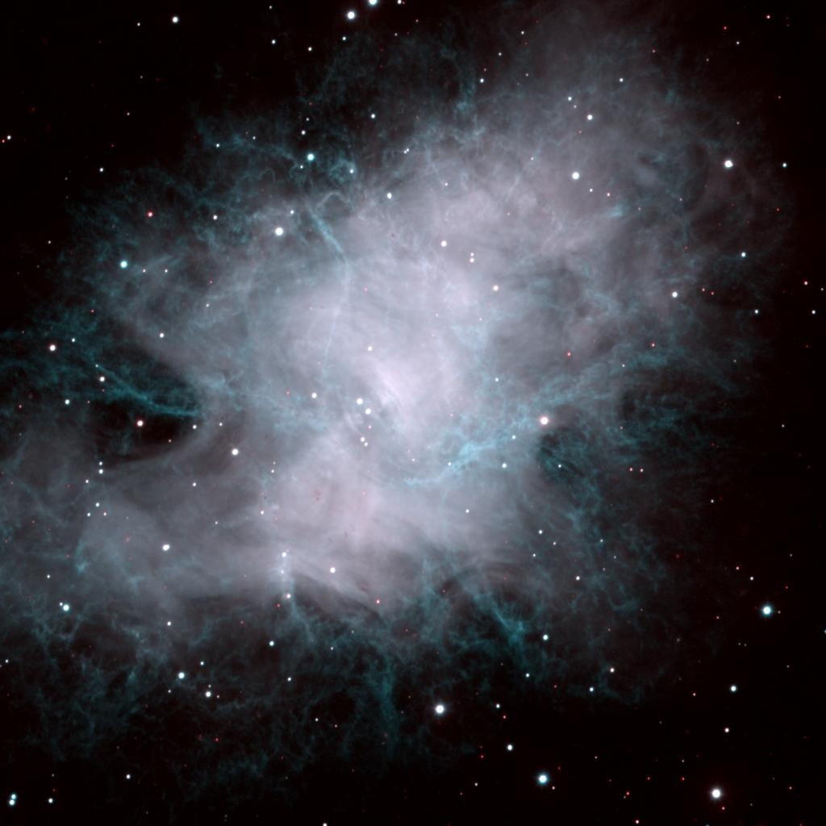
1000 yr old supernova remnant
Crab Nebula (WIYN)
Notes:
13

Slide 14
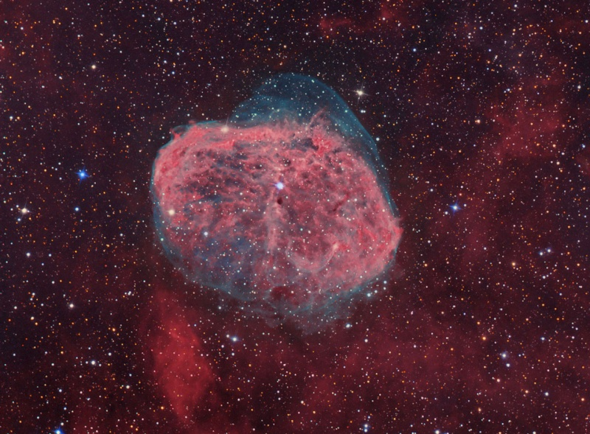
wind-blown bubble: stellar wind impact on its environment
NGC 6888 Crescent Nebula (Tony Hallas)

Slide 15
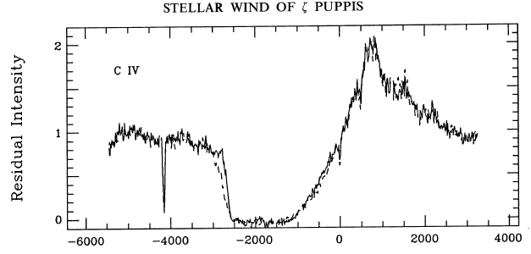
Radiation-driven massive star winds
M ~ 10⁻⁶ M_{sun}/yr
UV spectrum: C IV 1548, 1551 Å
v∞=2350 km/s
Prinja et al. 1992, ApJ, 390, 266
Velocity (km/s)
Notes:
15

Slide 16
Power in these winds:
erg s⁻¹
L_{sun} = 4 x10³³ erg s⁻¹
L_{massive} ≈ 4 x10³⁹
while the x-ray luminosity
To account for the x-rays, only one part in 10⁻⁴ of the wind’s mechanical power is needed to heat the wind
Notes:
16

Slide 17
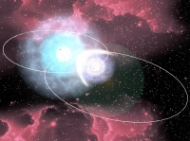
Three models for massive star x-ray emission
1. Instability driven shocks
2. Magnetically channeled wind shocks
3. Wind-wind interaction in close binaries
Notes:
17

Slide 18
Three models for massive star x-ray emission
1. Instability driven shocks
2. Magnetically channeled wind shocks
3. Wind-wind interaction in close binaries
Notes:
18

Slide 19
Winds of massive stars are driven by radiation pressure
opacity
luminosity
mass
For the Sun, Γ_{edd} ~ 10⁻⁵
For massive stars, Γ_{edd} approaches unity
Notes:
19

Slide 20
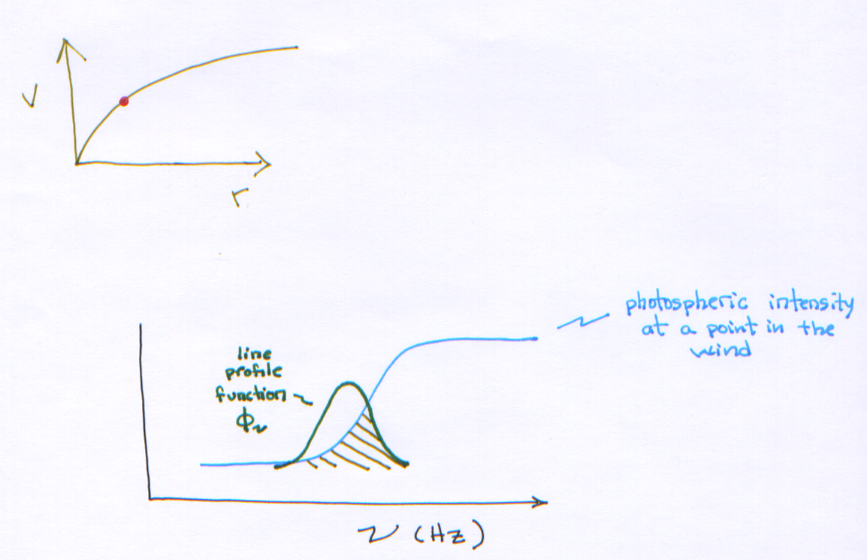
The Line-Driven Instability (LDI; Milne 1926)
Notes:
20

Slide 21
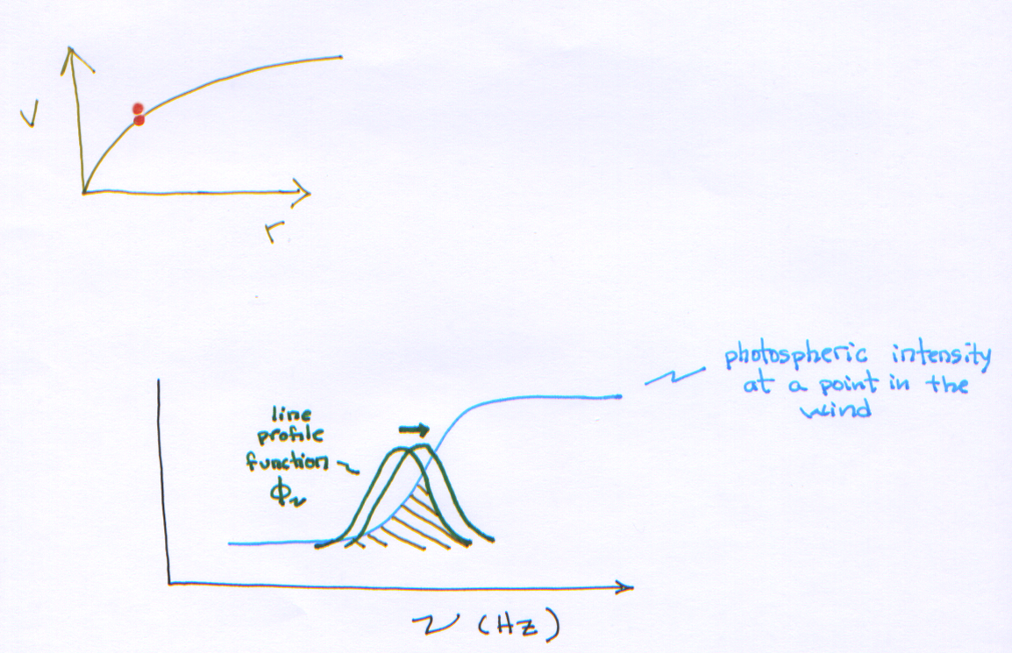
Consider a positive velocity perturbation
Notes:
21

Slide 22
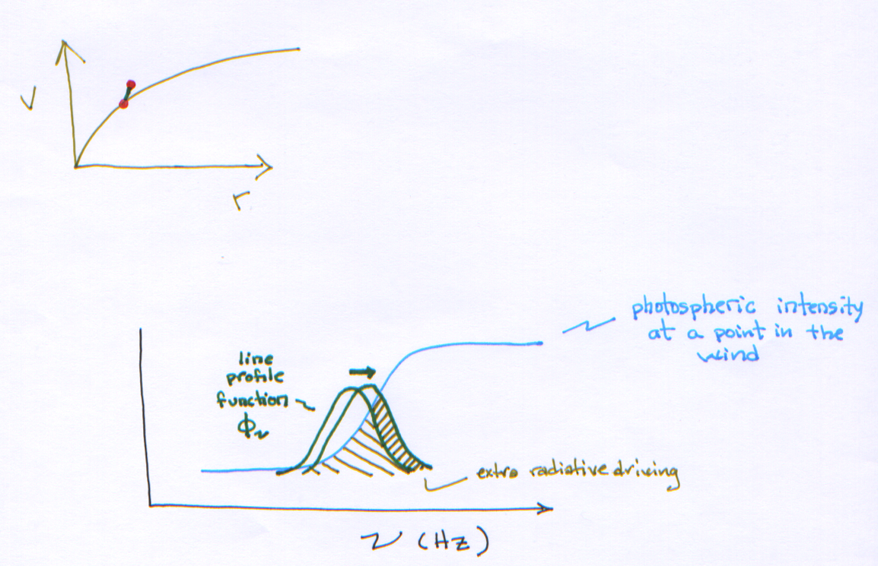
Positive feedback: ion moves out of the Doppler shadow, sees more radiation, gets accelerated…
Notes:
22

Slide 23
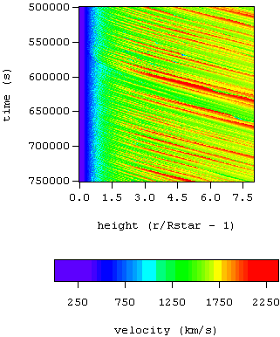
1-D rad-hydro simulation of a massive star wind
Radiation line driving is inherently unstable: shock-heating and X-ray emission Owocki, Castor, & Rybicki 1988

Slide 24
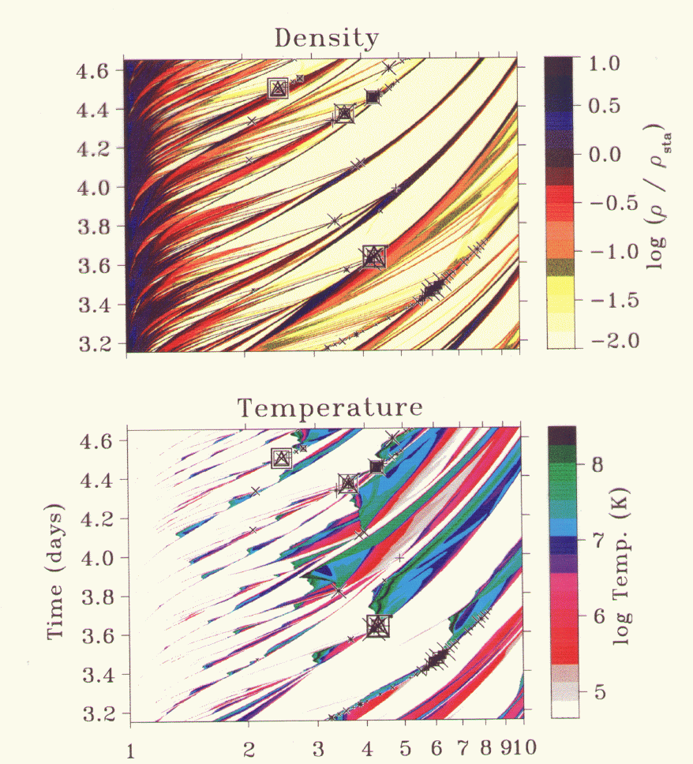
Shell-shell collisions induced by turbulence at the base of the wind flow
Feldmeier, et al. 1997

Slide 25
Predictions of the rad-hydro wind simulations:
Significant Doppler broadening of x-ray emission lines due to bulk motion of the wind flow (1a. Shock onset several tenths R* above the surface)
Bulk of the wind is cold and unshocked – source of attenuation of the X-rays.
Notes:
25

Slide 26
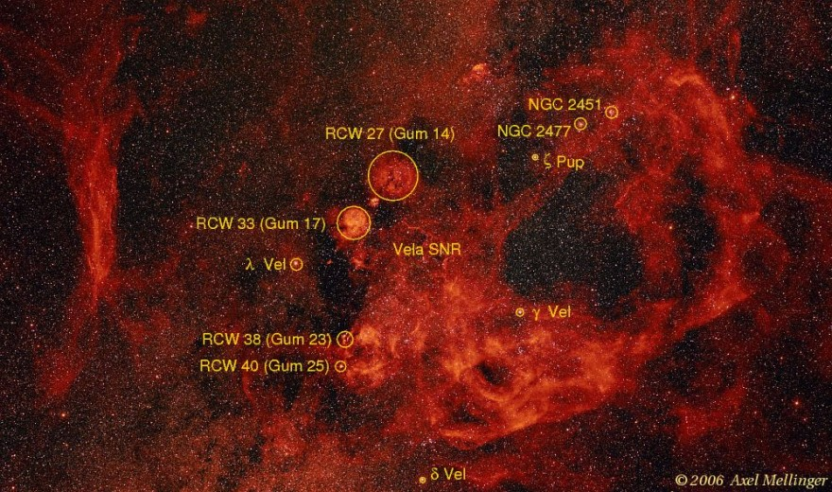
ζ Puppis in the Gum Nebula
Notes:
26

Slide 27
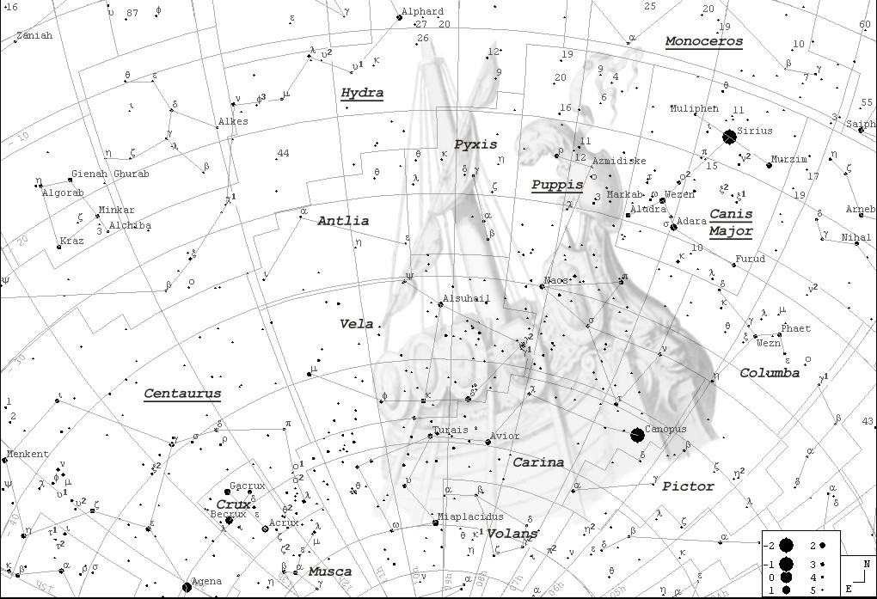
ζ Puppis: 50 M_{sun}, 10⁶ L_{sun}
Notes:
27

Slide 28
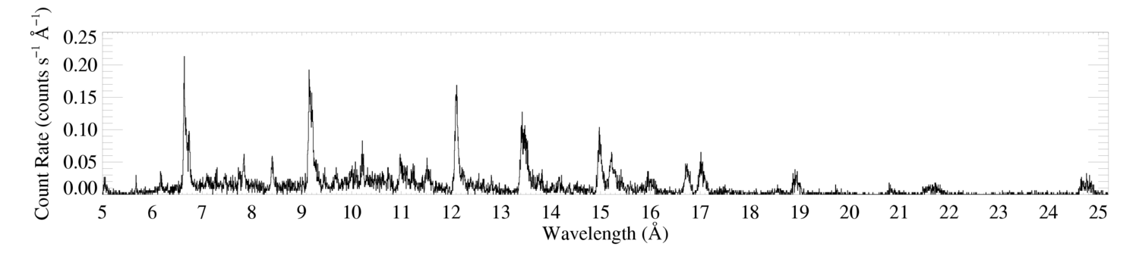
Chandra HETGS/MEG spectrum (R ~ 1000 ~ 300 km s⁻¹)
ζ Pup
Si
Mg
Ne
Fe
O
H-like
He-like
Notes:
28

Slide 29
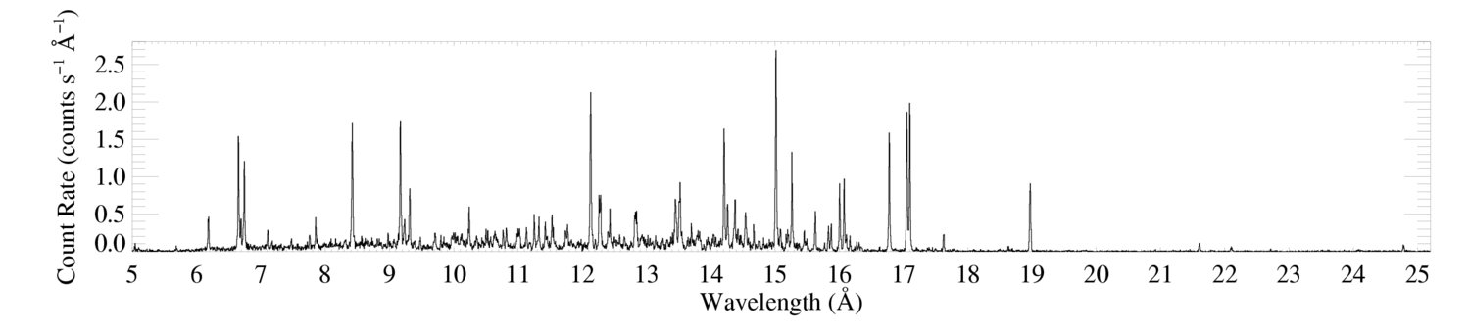
ζ Pup
Low-mass star (Capella) for comparison
Notes:
29

Slide 30
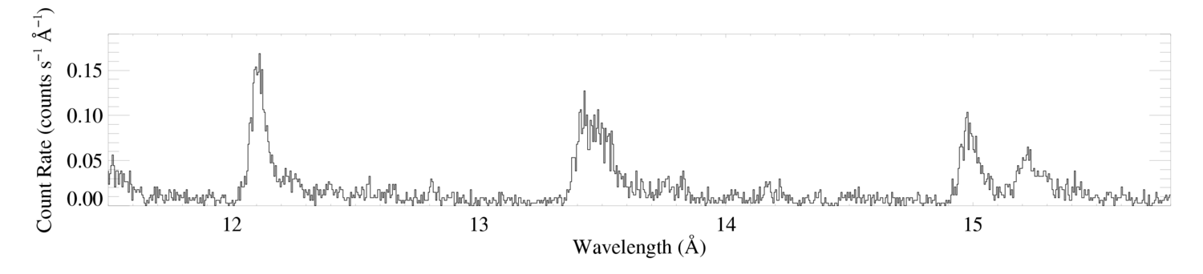
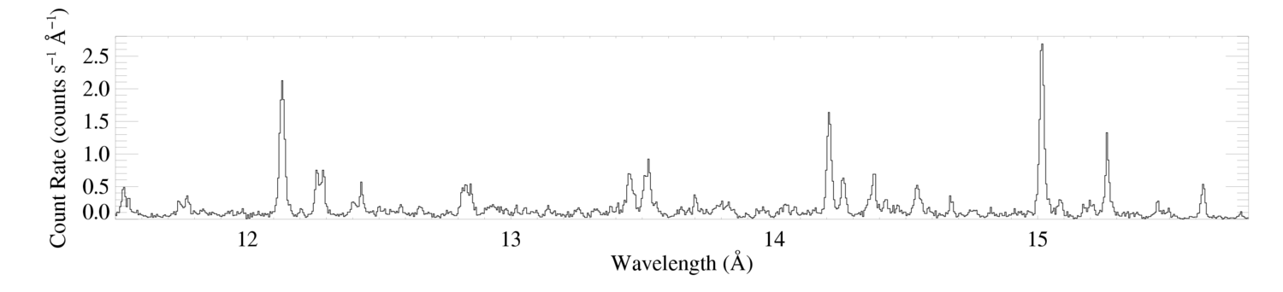
ζ Pup
Ne X
Ne IX
Fe XVII
Capella
Notes:
30

Slide 31
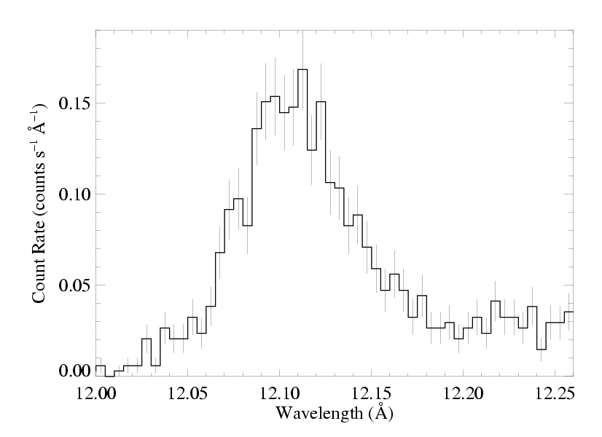
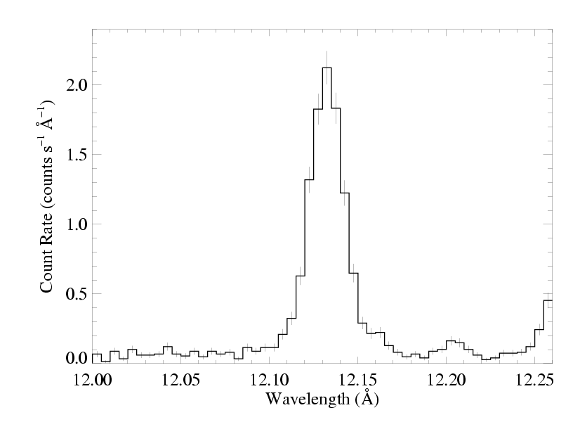
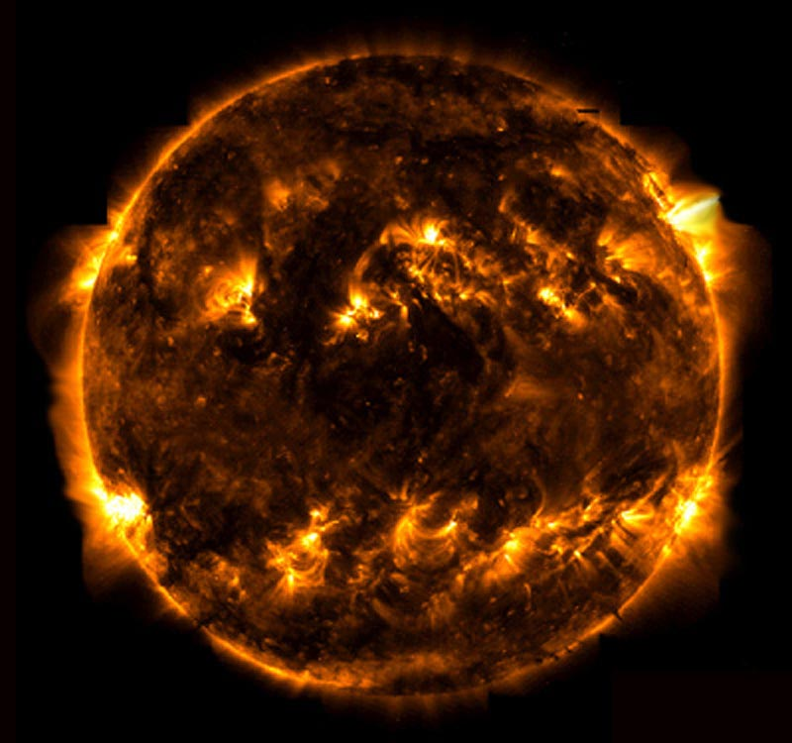
ζ Pup massive
Capella low mass
Notes:
31

Slide 32
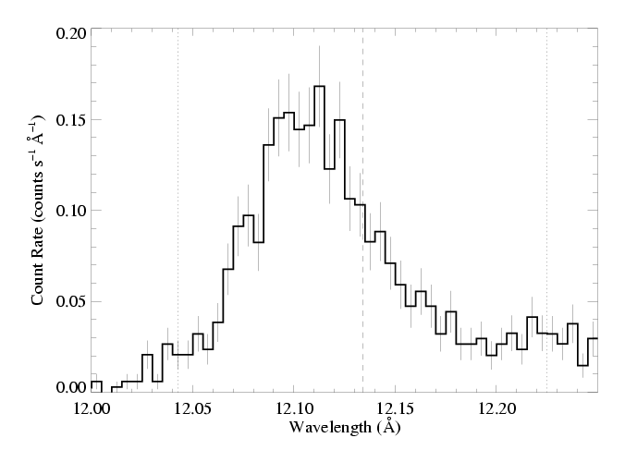
The x-ray emission lines are broad: agreement with rad hydro simulations
ζ Pup
But… they’re also blue shifted and asymmetric
Is this predicted by the wind shock scenario?
Notes:
32

Slide 33
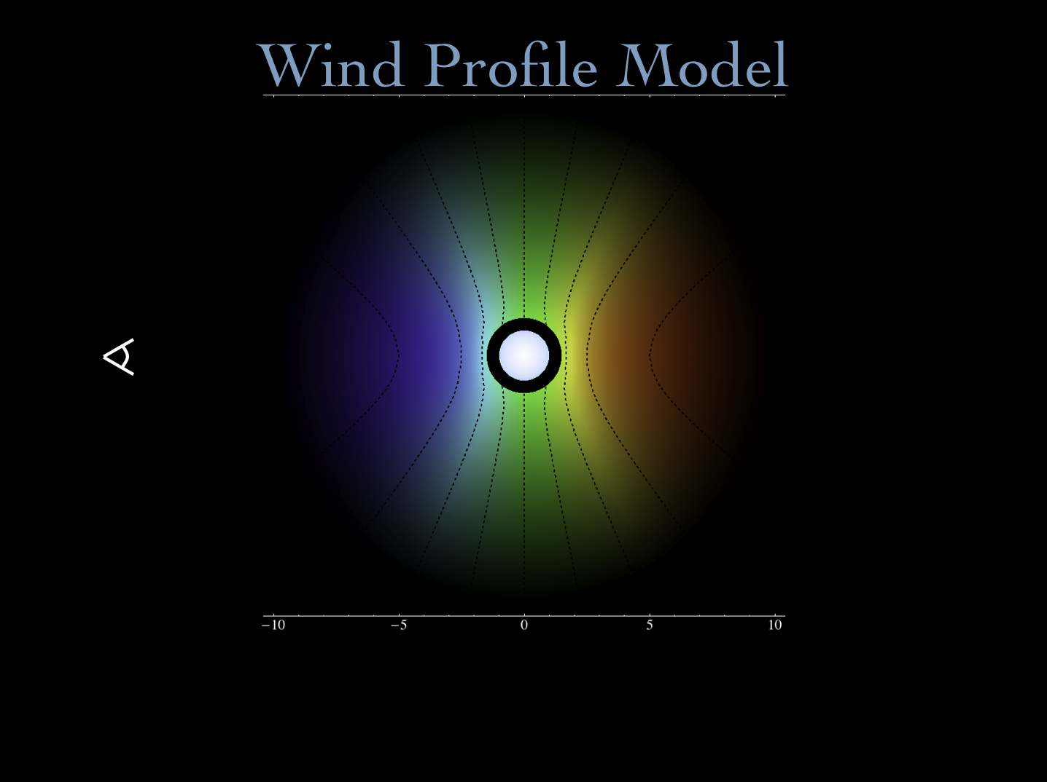
Notes:
33

Slide 34
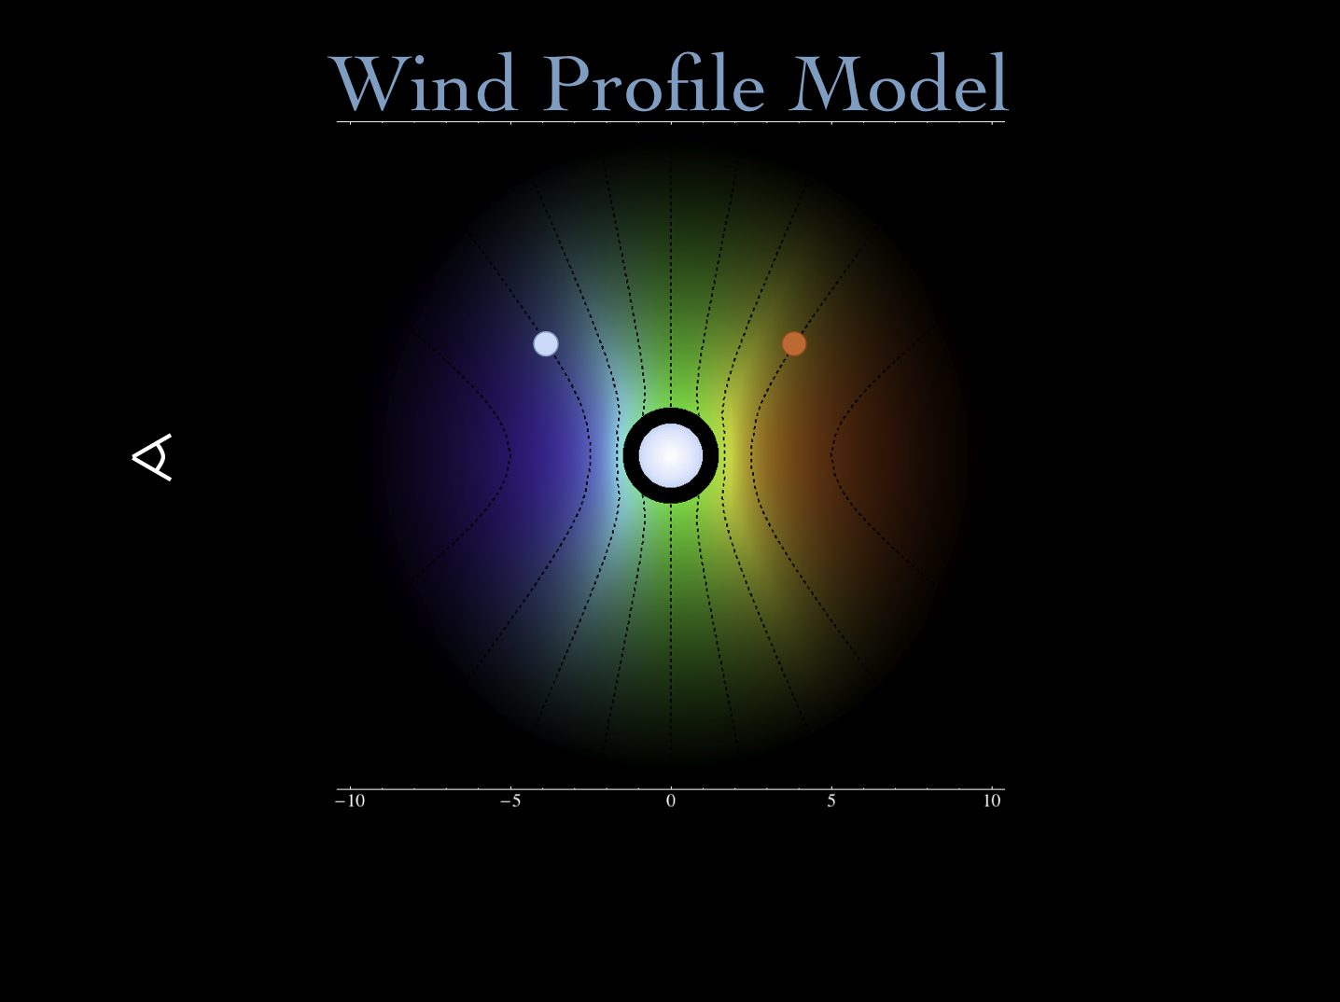
Notes:
34

Slide 35
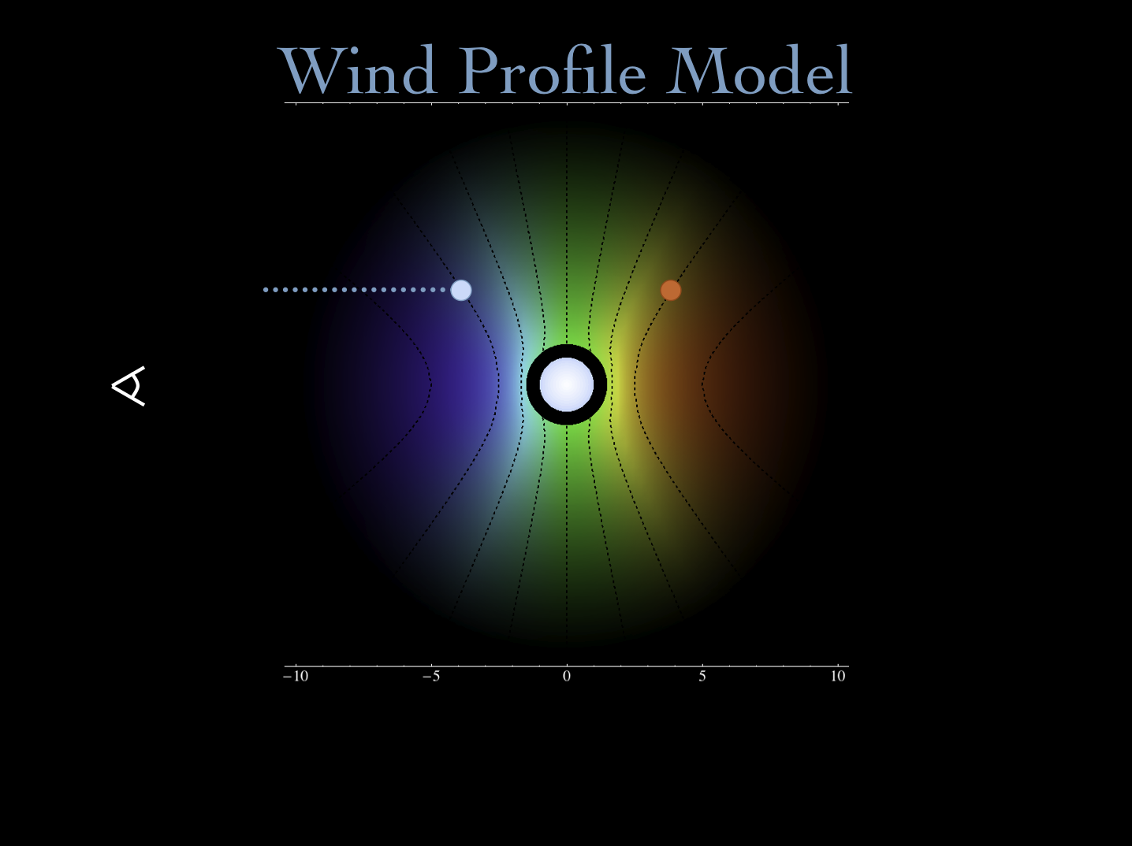
Notes:
35

Slide 36

Notes:
36

Slide 37
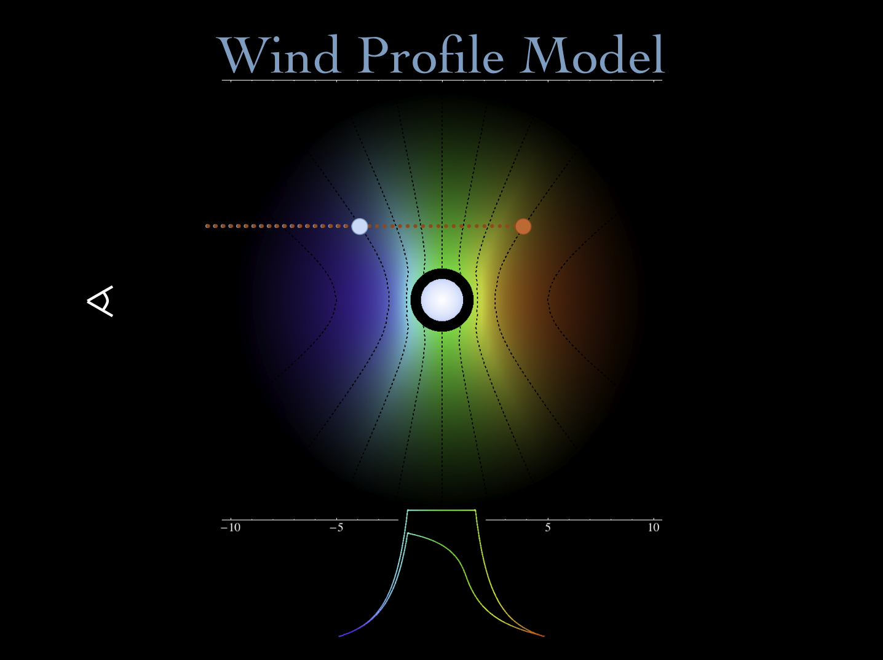
Notes:
37

Slide 38
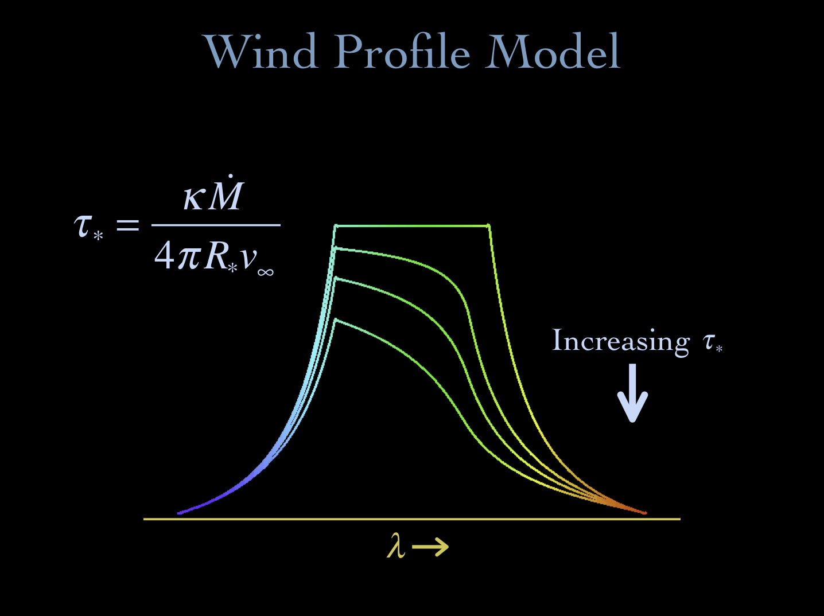
Notes:
38

Slide 39
opacity of the cold wind component
wind mass-loss rate
wind terminal velocity
radius of the star
Notes:
39

Slide 40
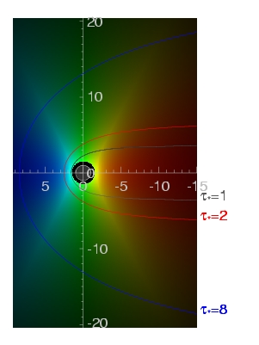
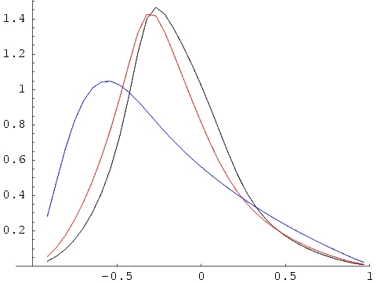
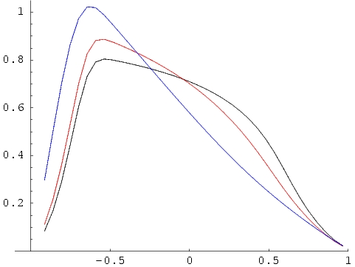
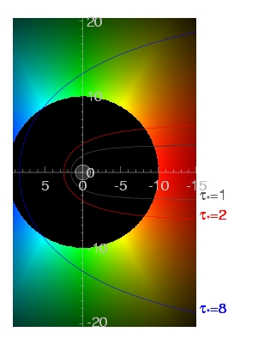
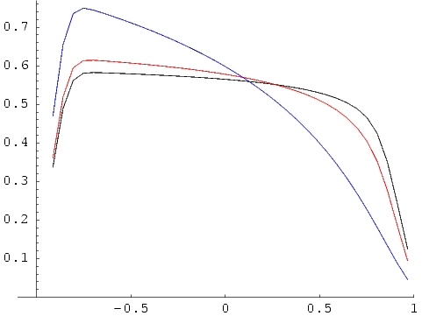
τ=1 contours
τ∗=1,2,8
The basic wind-profile model
R_{o}=1.5
key parameters: R_{o} & τ*
j ~ ρ² for r/R* > R_{o},
= 0 otherwise
R_{o}=3
R_{o}=10
Notes:
40

Slide 41
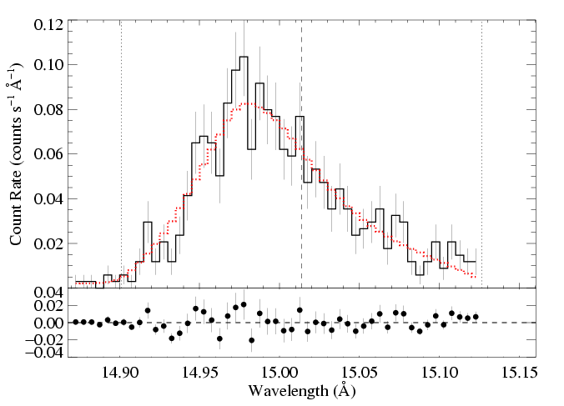
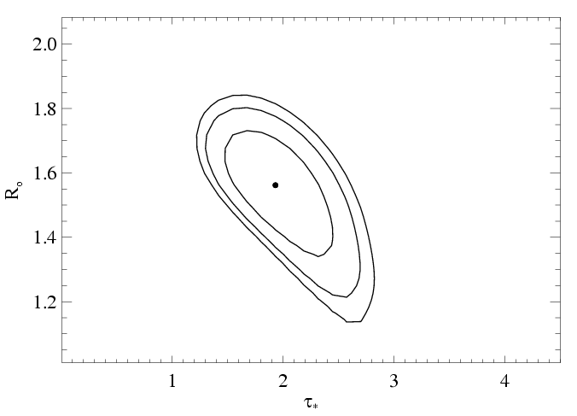
We fit these x-ray line profile models to each line in the Chandra data
And find a best-fit τ* and R_{o} & place confidence limits on these fitted parameter values
Fe XVII
68, 90, 95% confidence limits
Notes:
41

Slide 42
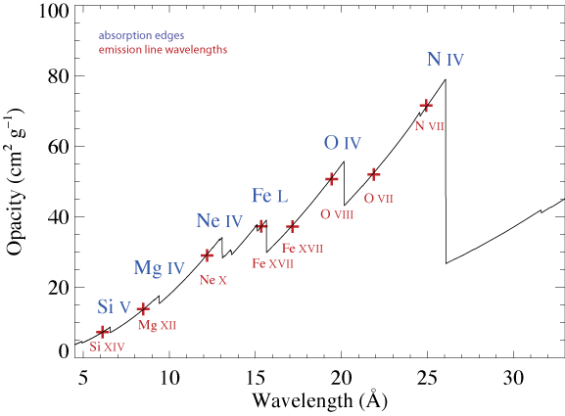
Wind opacity: photoelectric absorption
Abundances; ionization balance; atomic cross sections
Verner & Yakovlev 1996
Notes:
42

Slide 43
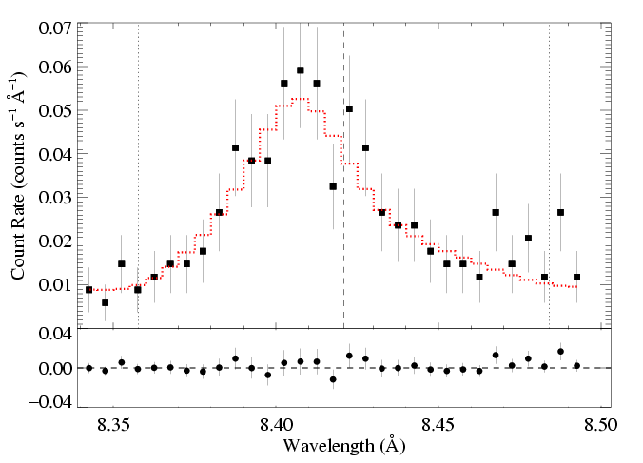
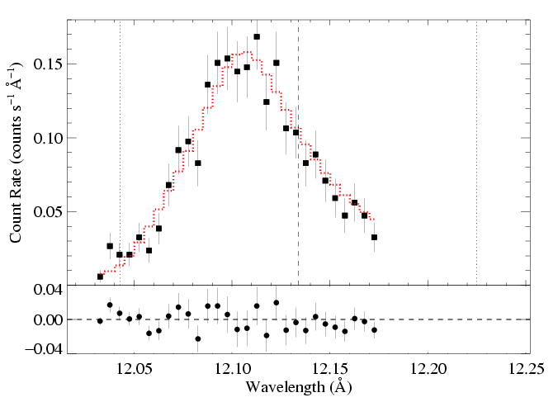
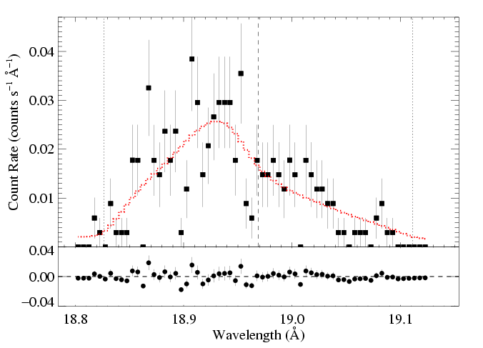
ζ Pup: three emission lines
Mg Lyα: 8.42 Å
Ne Lyα: 12.13 Å
O Lyα: 18.97 Å
τ* = 1
τ* = 2
τ* = 3
Recall:
Notes:
43

Slide 44
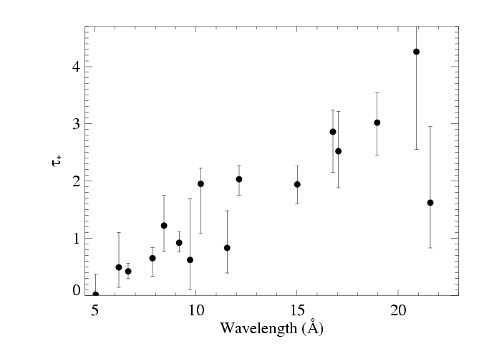
Fits to 16 lines in the Chandra spectrum of ζ Pup
Notes:
44

Slide 45

Traditional mass-loss rate: 8.3 X 10⁻⁶ Msun/yr
Our best fit: 3.5 X 10⁻⁶ Msun/yr
Notes:
45

Slide 46

Notes:
46

Slide 47
What about other massive stars?
Notes:
47

Slide 48

ζ Ori: O9.5

Slide 49

ζ Ori: O9.5 - less massive
Mg XII Lyman-α: τ* = 0.1

Slide 50


Slide 51
Wind shock scenario: consistent with X-ray line profiles…
…but mass-loss rates must be revised downward!

Slide 52


Notes:
52

Slide 53
Are there massive stars that do not fit this paradigm?
Notes:
53

Slide 54

Yuri Beletsky (ESO)
Notes:
54

Slide 55
Notes:
55

Slide 56
Notes:
56

Slide 57

Crucis
aliases:
Mimosa
HD 111123
a massive (16 M_{sun}), luminous (34,000 L_{sun}), hot (30,000 K) star
…but not quite as hot, massive, and luminous as an O star: a B0.5 III star
Notes:
57

Slide 58

Notes:
58

Slide 59
Notes:
59

Slide 60





Notes:
60

Slide 61

β Crucis (B0.5 V): lines are narrow!
unresolved
wind-broadened
best-fit
Fe XVII line
Notes:
61

Slide 62

β Cru: O VIII Ly-α line
Notes:
62

Slide 63

Notes:
63

Slide 64
Conclusions
Normal massive stars have x-ray line profiles consistent with the predictions of the wind instability model.
Photoelectric absorption’s effect on the profile shapes can be used as a mass-loss rate diagnostic: mass-loss rates are lower than previously thought.
Later-type massive stars have X-rays that are harder to understand, though…their emission lines are quite narrow.

Slide 65
Notes:
65

